Slide 1
SOCIAL STUDIES
SHOP.COM
Steve Ashley & Loren Ridinger

Slide 2
Social Commerce Stats
1
46% of online users rely on social media when making a purchase
Social Media lead conversion rates are 13% higher than the average lead conversation rate
2
Social media produces almost double the marketing leads of trade shows, telemarketing, direct mail, or PPC
3

Slide 3
Social Commerce Stats
4
69% of online visitors of Pinterest found an item they decided to buy online
5
93% of network marketers use social media to grow their business
6
74% of marketers say Facebook is their most cost efficient method for lead generation

Slide 4
Twitter 500 Million Users – 170 Billion Tweets sent – 208 followers per avg/user
78% of brand engagement is a RT
22% of brand engagement are Replies
92% brands tweets are links
Fastest growing social media platform
170 minutes per day/user
30% higher interaction rates between 8am-7pm
Sending links or pics creates twice as much as engagement
Twitter engagement rates 17% higher on weekends
Links receive 86% higher RT
Tweets with # receive twice as much engagement than those without
Tweets that ask for RT 12% higher RT than those who do not

Slide 5
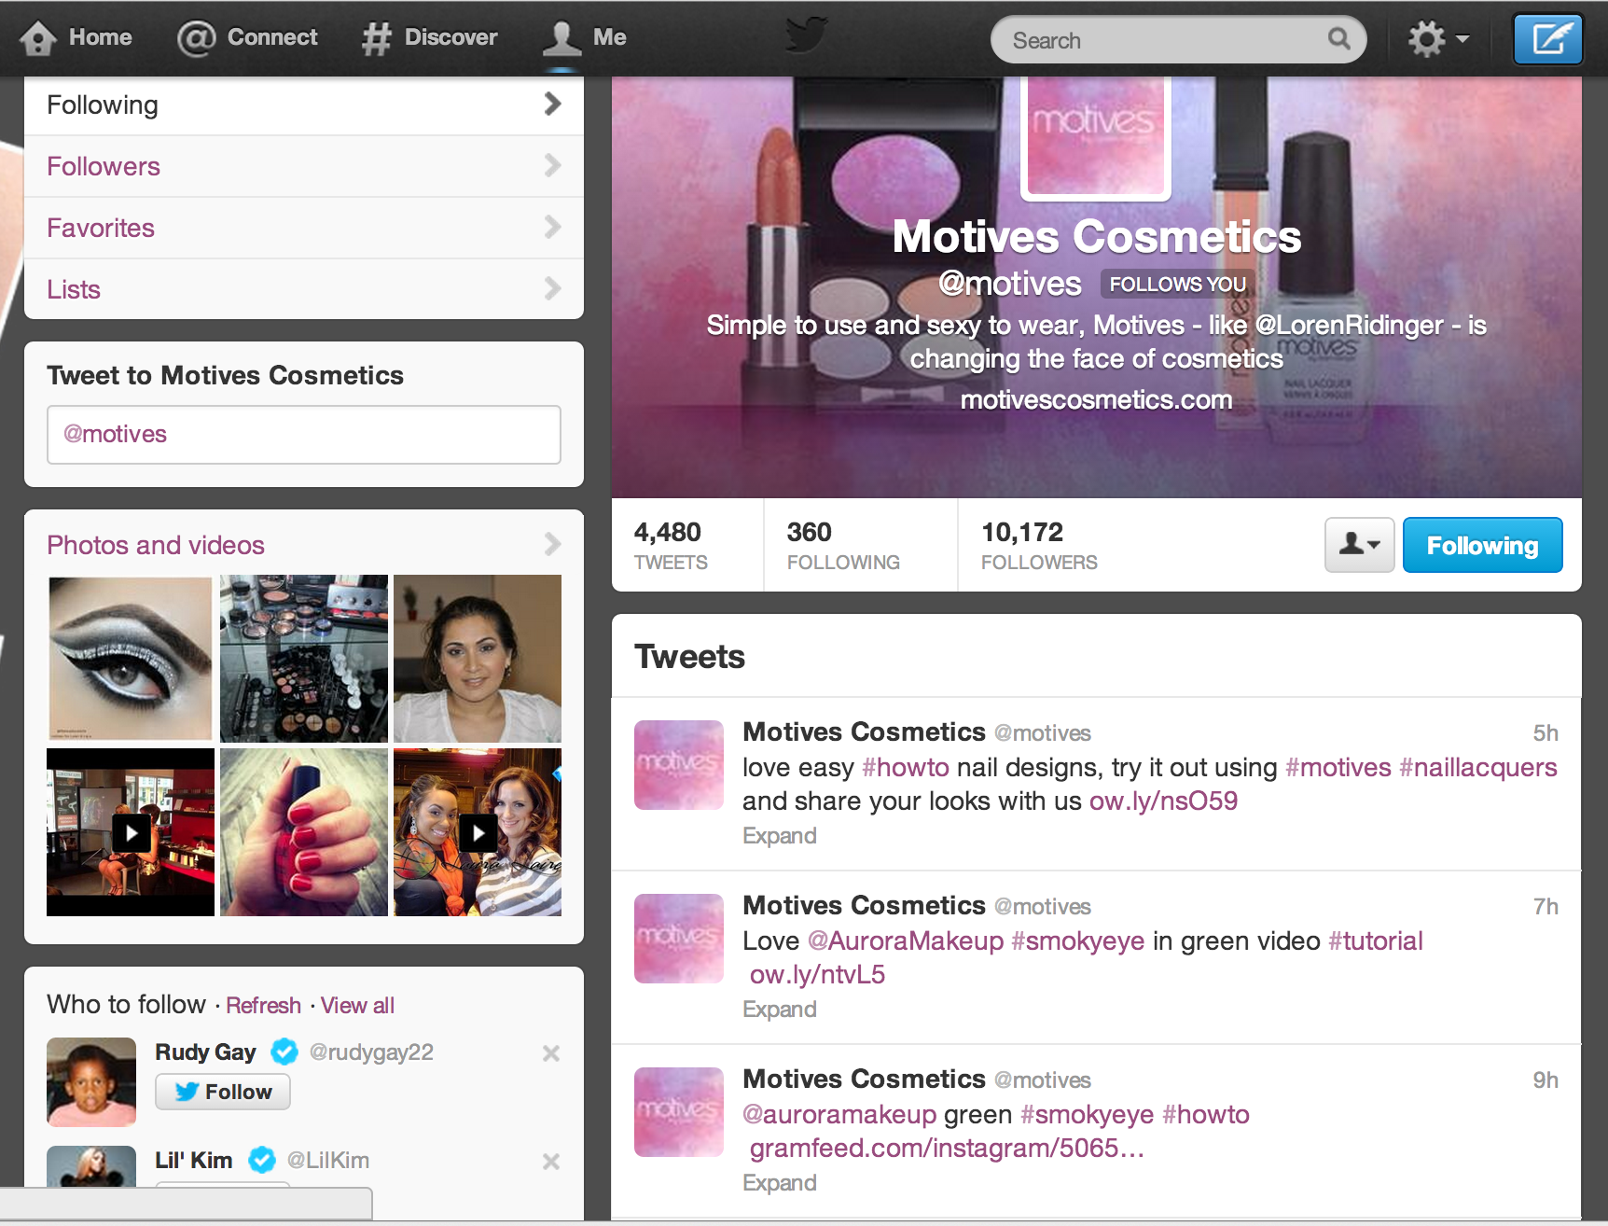

Slide 6
LinkedIn – 225 Million Users
28.3% identify business opportunities
38.5% build new relationships with potential customers
75.8% connect with past business associates
35.8% increase branding and presence in market place
27 million businesses have a Linkedin page
87% of users trust product info they learn about
49% trust word of mouth brand suggestions by users on Linkedin

Slide 7
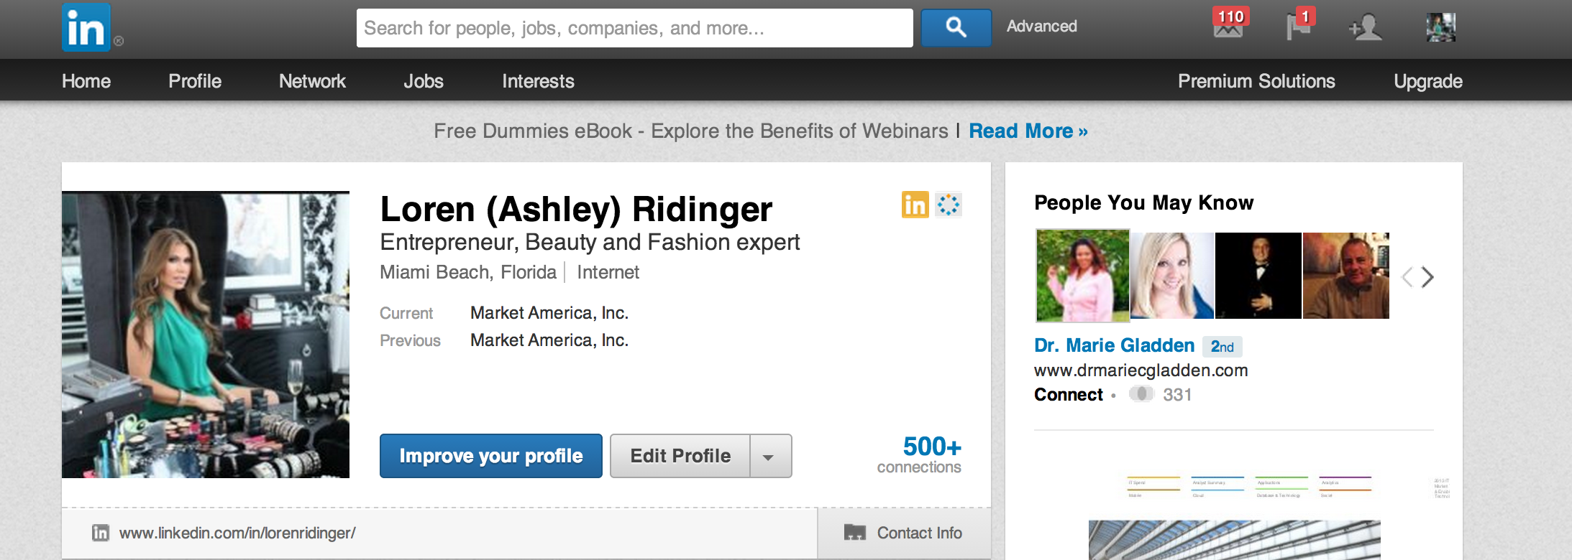
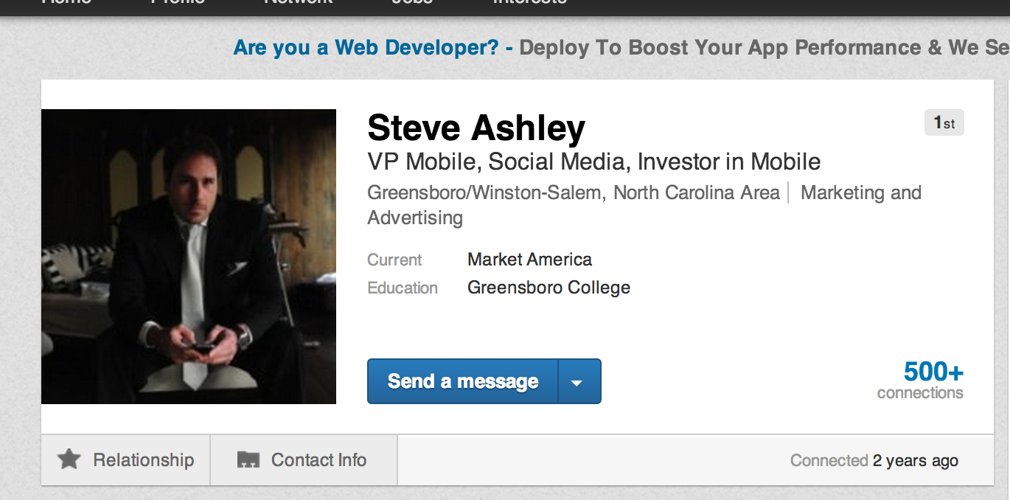

Slide 8
Facebook 1.1 Billion users - 4.5 Billion daily Likes
92% industry professionals have acquired customers thru FB
80 characters or less get 23% higher interaction
Asking fans for photo captions increasing comments 5.5 times
20 minutes per day/user
Every follower you engage there are 34 more reachable friends who want the same thing
Wednesday 3:00pm BEST TIME to post
Weekdays from 1-4pm is other best time
Weekends after 4pm
Best words to use: Win, Winner, Giveaway, New
Worst amount of $ OFF or % OFF
Photo contests best
Ask fans to share tips

Slide 9
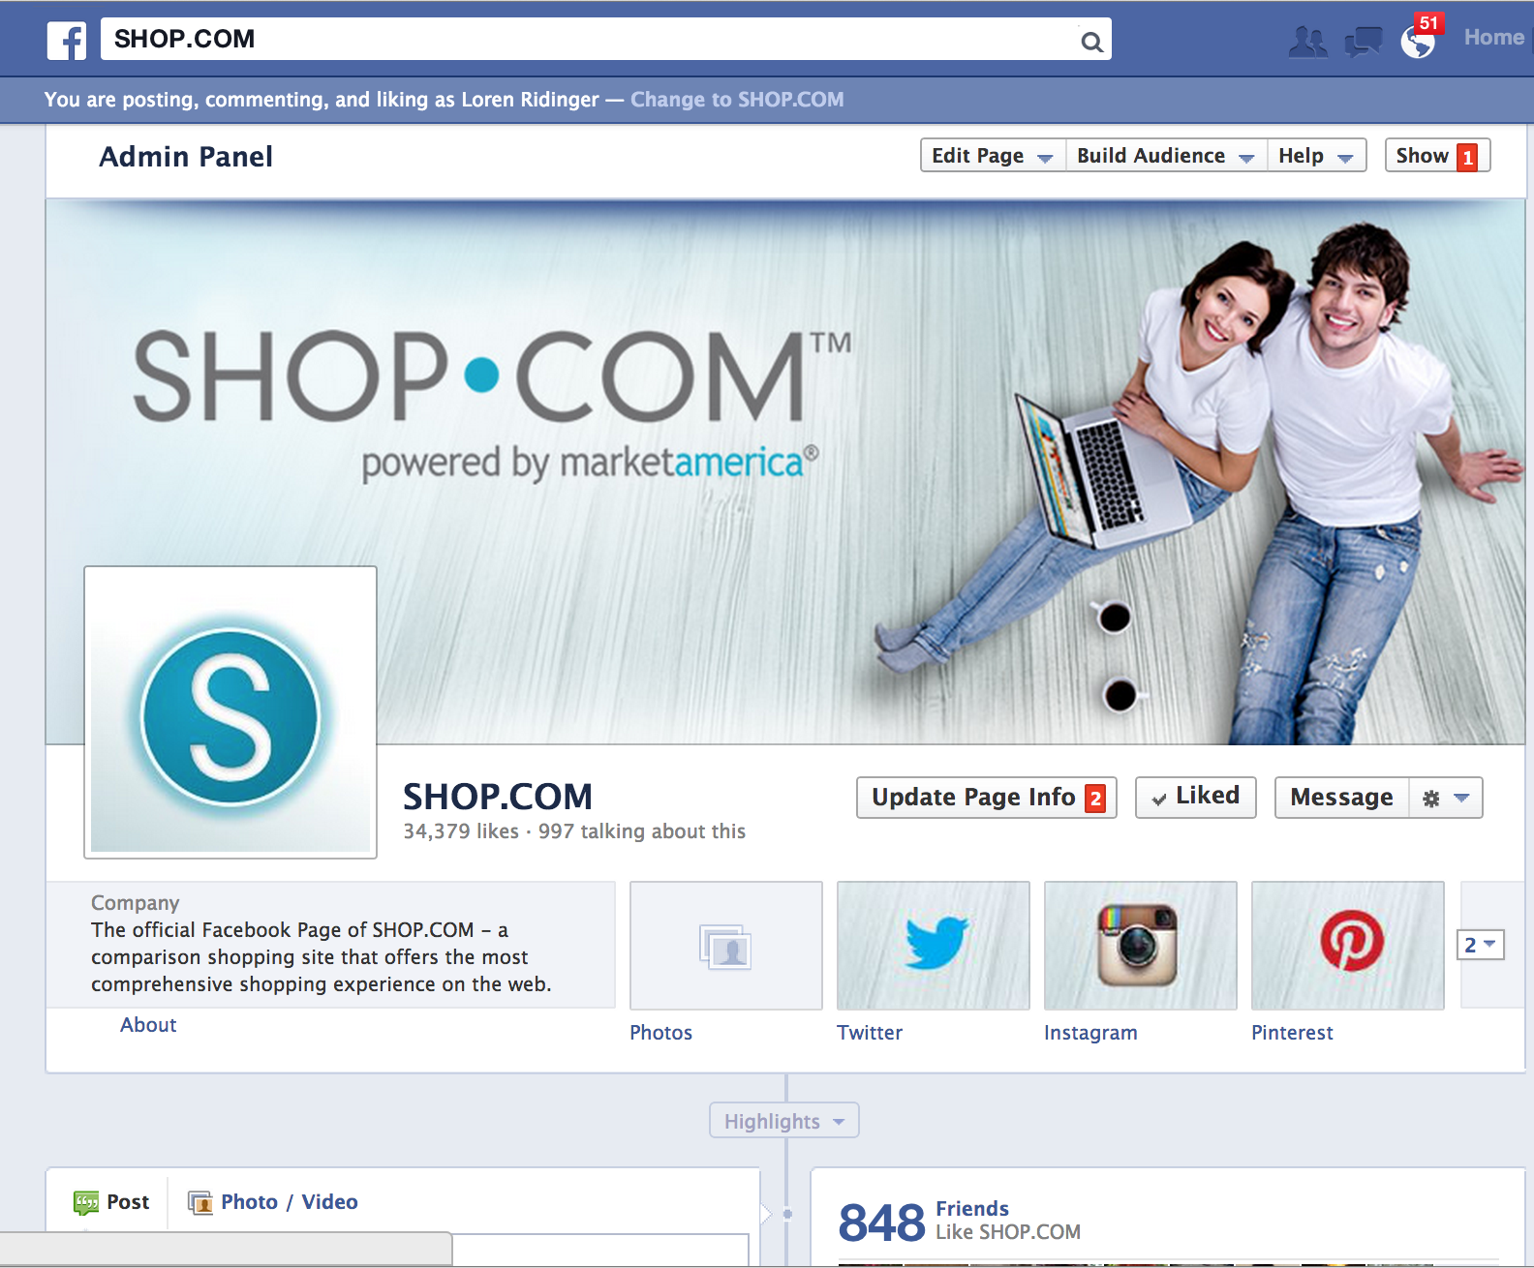

Slide 10
Instagram – 130 Million Users – 16 Billion photos shared – 40 Million photos per/day
Pictures and Videos
40% of people respond better to visual information than that of text alone
Enhance overall brand image with product offerings and fulfilling
promises made
Curate content ranging from loosely branded to product specifics
Engage with users to build all online communities
Hold visually stimulating contests and giveaways
Drive traffic to other social channels and website

Slide 11
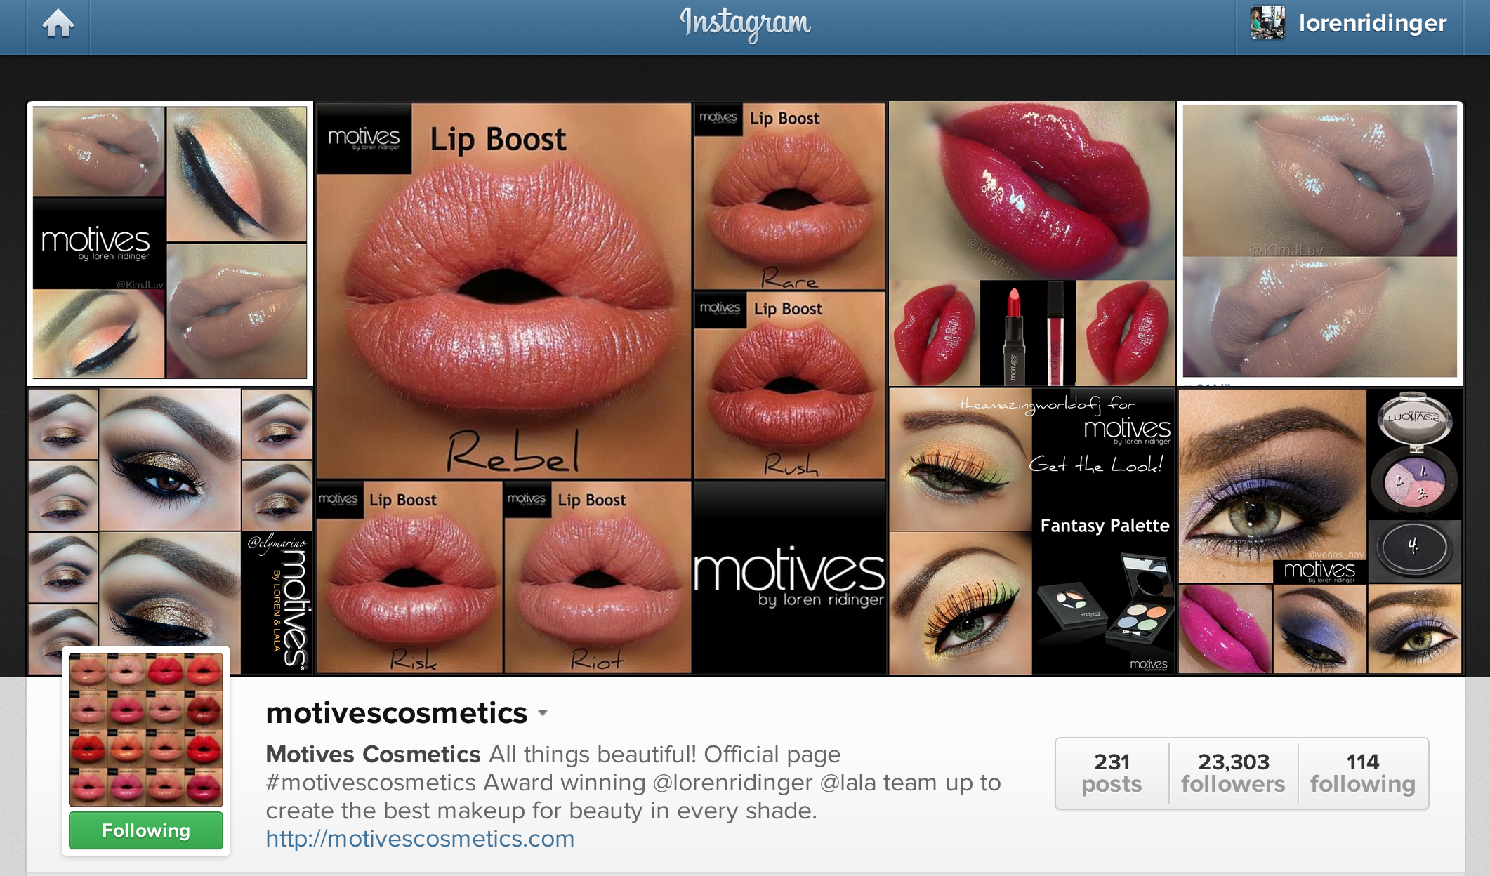

Slide 12
Social Media Comparison (no. users)
Facebook 1 Billion users
Google+ 390 million
LinkedIn 225 million
Twitter 500 million
Instagram 130 million

Slide 13
How to Build a Following
1
Follow some people yourself
Run contests – give a discount on first time orders if they click “follow”
2
Ask questions to learn about people
Offer exclusives “first look”
Hold webinars & tutorials to help
3
Share frequently 2-3 times/day
Join conversations by replying
Build an email subscriber thru FB

Slide 14
How to Build a Following
4
Create a SlideShare to introduce your brand or products and share on social media
5
Utilize tools(hootsuite, Social Sprout)
Visual (use pics and videos on all SM)
6
Take a poll to collect advice and info
Top 5 or 10 info on a specific topic
Post resources to help where u can’t

Slide 15
How to Build a Following
7
Hold FB event
Start using video to market and educate
Connect and stop selling
bit.ly (shortens link and track who sees it)
Post unique content
8
9
Add keywords in profile to increase to your profile so others can find you in search

Slide 16
Perfect Post Twitter
CALL TO ACTION
Give a clear CTA so your readers know what you want them to do
PUNCTUATION
Don’t sacrifice grammar just because you’ve got 140 characters. Avoid abbreviations and all caps
SHORTEN URLs
Bitly links generate the most RT’s, so shorten all of your URLs
MESSAGE
LINK
FORMAT
Use questions, facts and figures to engage viewers and drive tweets
MENTIONS
Use mentions to prompt influencers to engage with you and then respond
RETWEET
RT relevant content for your audience. Don’t forget to leave 20 characters, so people can add comment

Slide 17
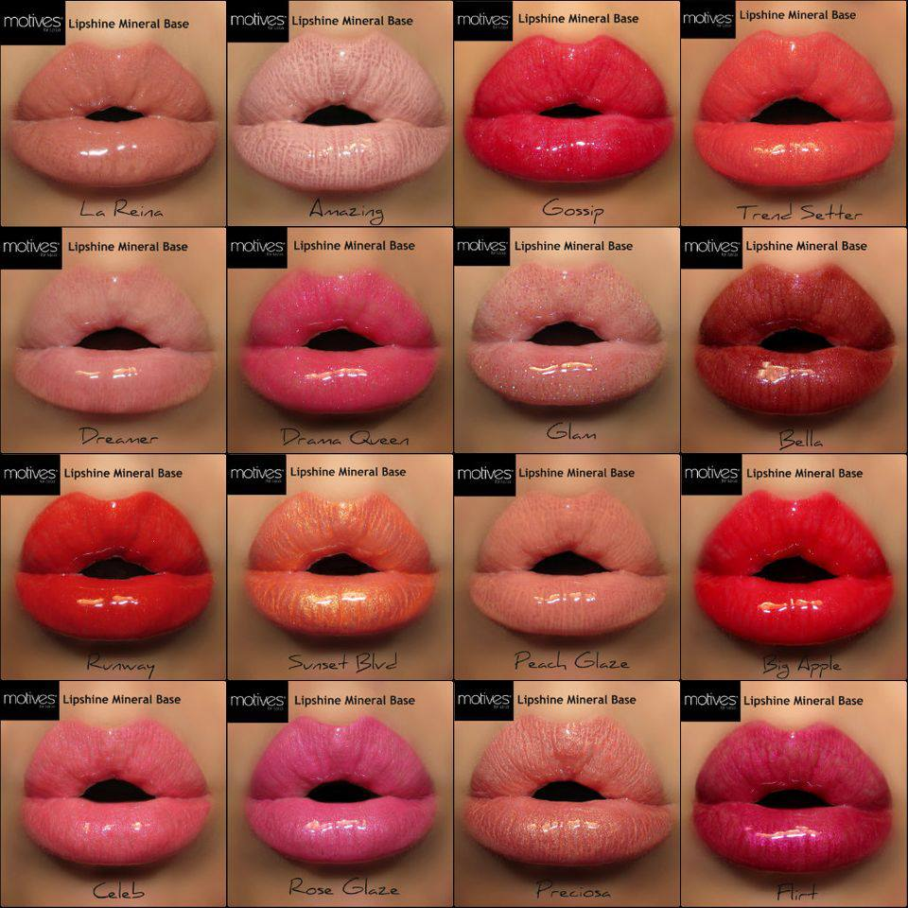
Perfect Post Facebook
KEEP THINGS POSITIVE
Positivity breeds engagement and sharing. Inspires and excites users
PROVIDE INFORMATION
The most appealing updates are the ones that offer something but don’t make disclose everything, make fans want to click…
PROVIDE A LINK
If you are going to provide a link, you can use Bit.ly so you can track how many people are clicking through from Facebook
STATUS UPDATE
http://link.com
INCLUDE IMAGES
Posts with images get the highest amount of engagement on facebook- so include when you can perfect size 800 x 600
MOBILE FRIENDLY
Use simple imagery that will be easily seen on mobile devices as 70% of your fans will see the posts on their phone
ENGAGE WITH USERS
Posts just don’t grab attention- comments and responses do. Engage with people and build relationships thru conversational dialogue
BE AVAILABLE
Post when the audience is listening not just when your business is open. This will ensure more engagement from users
LIKE- COMMENT- SHARE
COMMENTS

Slide 18
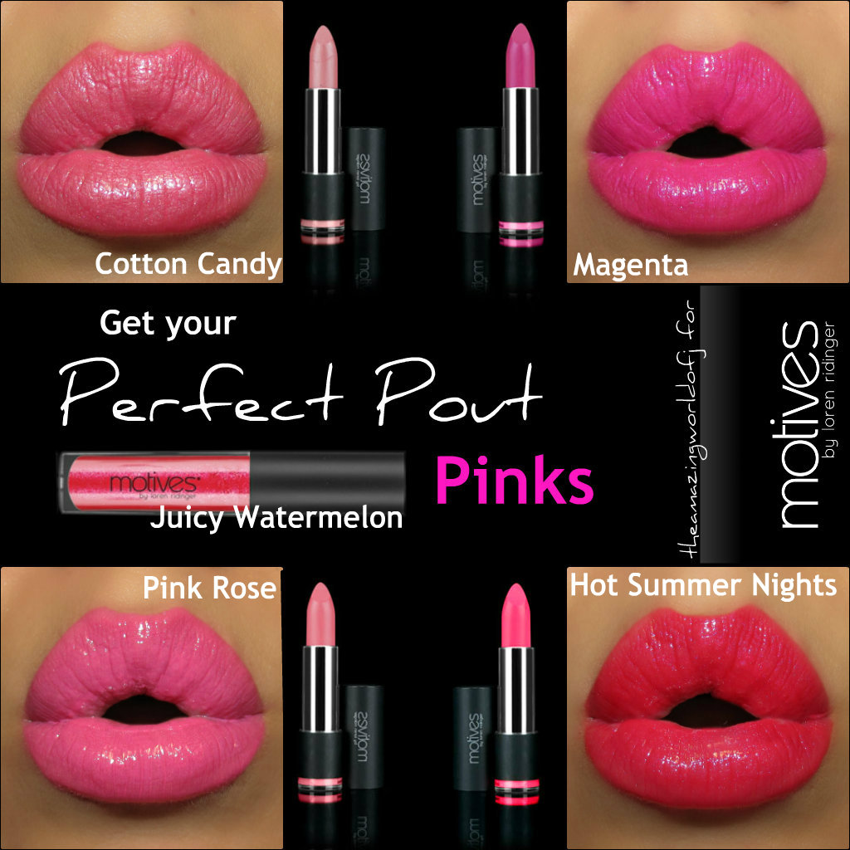
Perfect Post Google+
@TAG BRANDS
& PEOPLE
Tag brands and people when applicable, they’ll get a notification and potentially engage with that post
#UTILIZE HASHTAGS
Increase your page’s reach by adding relevant hashtags to your posts i.e. #infographic. Remember
G+ will automatically add a hashtag for key/trending topics
TRENDING TOPICS
Get involved with “Hot” topics to show your brand is keeping up with real time events. This will also increase your brand’s visibility
HOT
STATUS UPDATE
#HASHTAG
USE IMAGES
Using full sized images 800 x 600 will make your posts stand out on the page compared to tiny images and link thumbnails
?INTERACT WITH AUDIENCE
When you get comments on Google+, you are able to extend those conversations
FIND COMMUNITIES
Find relevant communities, engage and contribute in them, you’ll see an increase in engagement as you all have one thing in common…that community topic
+1 SHARE
COMMENTS
Communities

Slide 19
Finding Appealing Content
Golden nuggets from webinars
Seminar notes from NMTSS events (Photos are even better)
Subscribe to a few emails for your niche and don’t just share interesting article, make sense of them
Pick up a book and share nuggets you learn from it
Bottom line-We are exposed to information all day. Listen and if something peaks your interest or you learned something from it, share it!

Slide 20
Call to Action Words

Slide 21
Social Calls to Action
Work on Twitter
% of Tweets ReTweeted
0% | 10% | 20% | 30% | 40% | 50%
Please ReTweet
Please RT
Neither
% Diff. ReTweets per/follower from avg
0% | 20% | 40% | 60% | 80% | 100% | 120% | 160%
Please Help
Please ReTweet
Please RT
Please
ReTweet
Spread
Visit

Slide 22
Social Calls to Action
Work on Facebook
The Word “LIKE” -Action per fan
0.0% | 0.2% | 0.4%
LIKES
LIKES
The Word “COMMENT”
0.0% | 0.1% | 0.2%
The Word “SHARE”
0.0% | 0.15% | 0.30%
With
Without

Slide 23
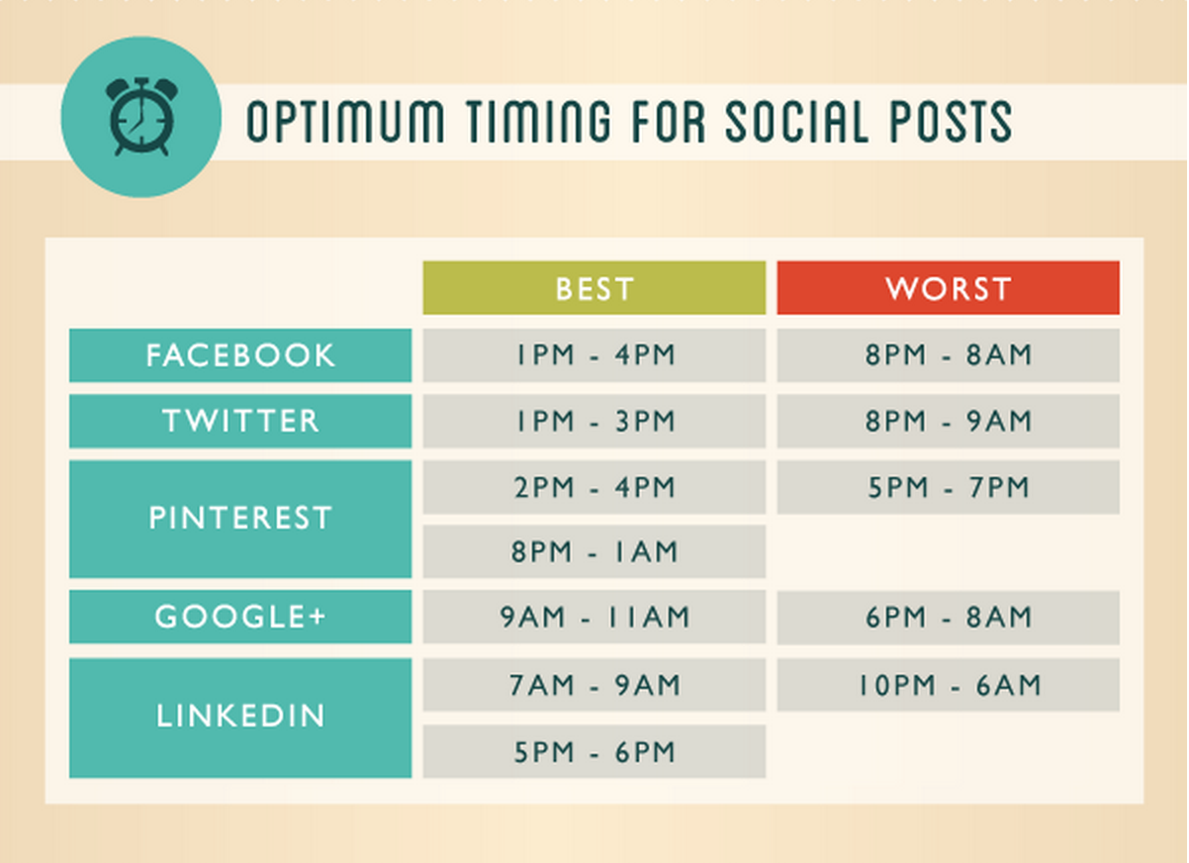

Slide 24
Don’t
Put your portal address on Dist pages
Spam on your wall as people will block you
Allow SM to replace human contact
Waste time clicking items in your profile feed
Over post especially recycled content

Slide 25
Don’t
Complain about your job/life (we all have problems)
Comment or LIKE every post
Measure SM influence by number of friends
Sound desperate
Pretend to be anyone else

Slide 27
Symbol called #Hashtag are used to make keywords/topics in social posts
#
#
Often become trending topics
Help you find interesting topics
#
#
Clicking on a #word in a post shows you all the other messages in that category
Hashtags are great to use when searching for customers and prospect

Slide 28
Symbol called #Hashtag are used to make keywords/topics in social posts
#
#
Used before relevant keywords in their posts to categorize them more easily when searched
Can occur anywhere in posts
#
#
3 words or less
#motivescosmetics
#makeuprtist
#lipstick
Cause chats and connecting with people of similar interests

Slide 29
Symbol called #Hashtag are used to make keywords/topics in social posts
#
#
Hashtag your expertise, topics, or an industry
Use to promote an event #MAIC2013
#
#
Use it as a tool for content discovery
Redirecting audiences to external web content (links,videos,articles)

Slide 30
# Hashtags
This is NOT how to use hashtags
#I #sell #motives #cosmetics
#I #am #excited
#I #love #opc3
This is #hashtag appropriate
I love my red coral lipstick by #Motivescosmetics #lipstick

Slide 31
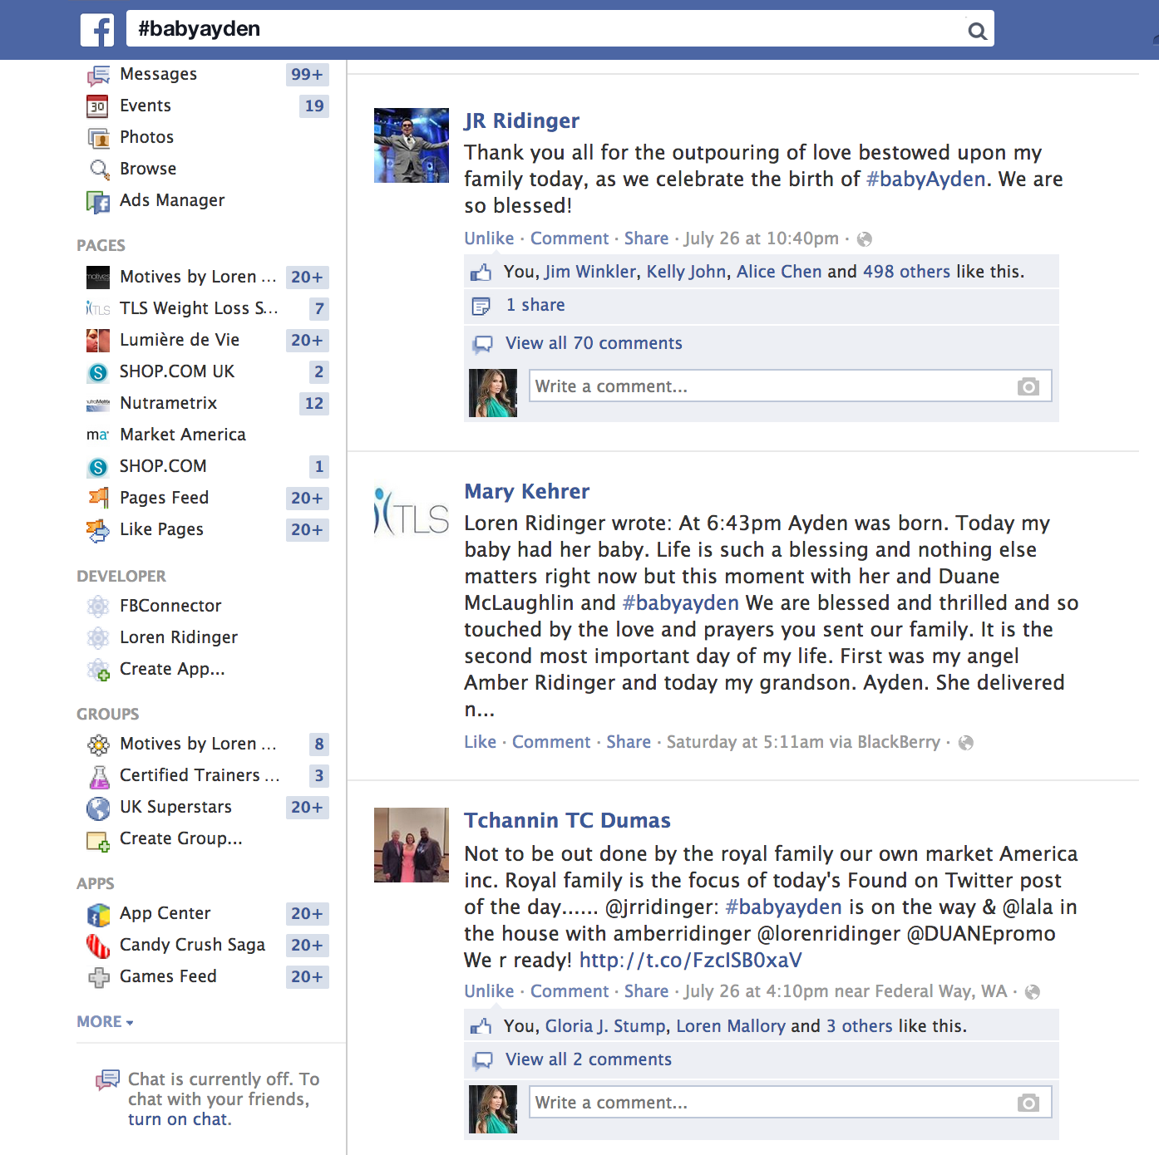

Slide 32
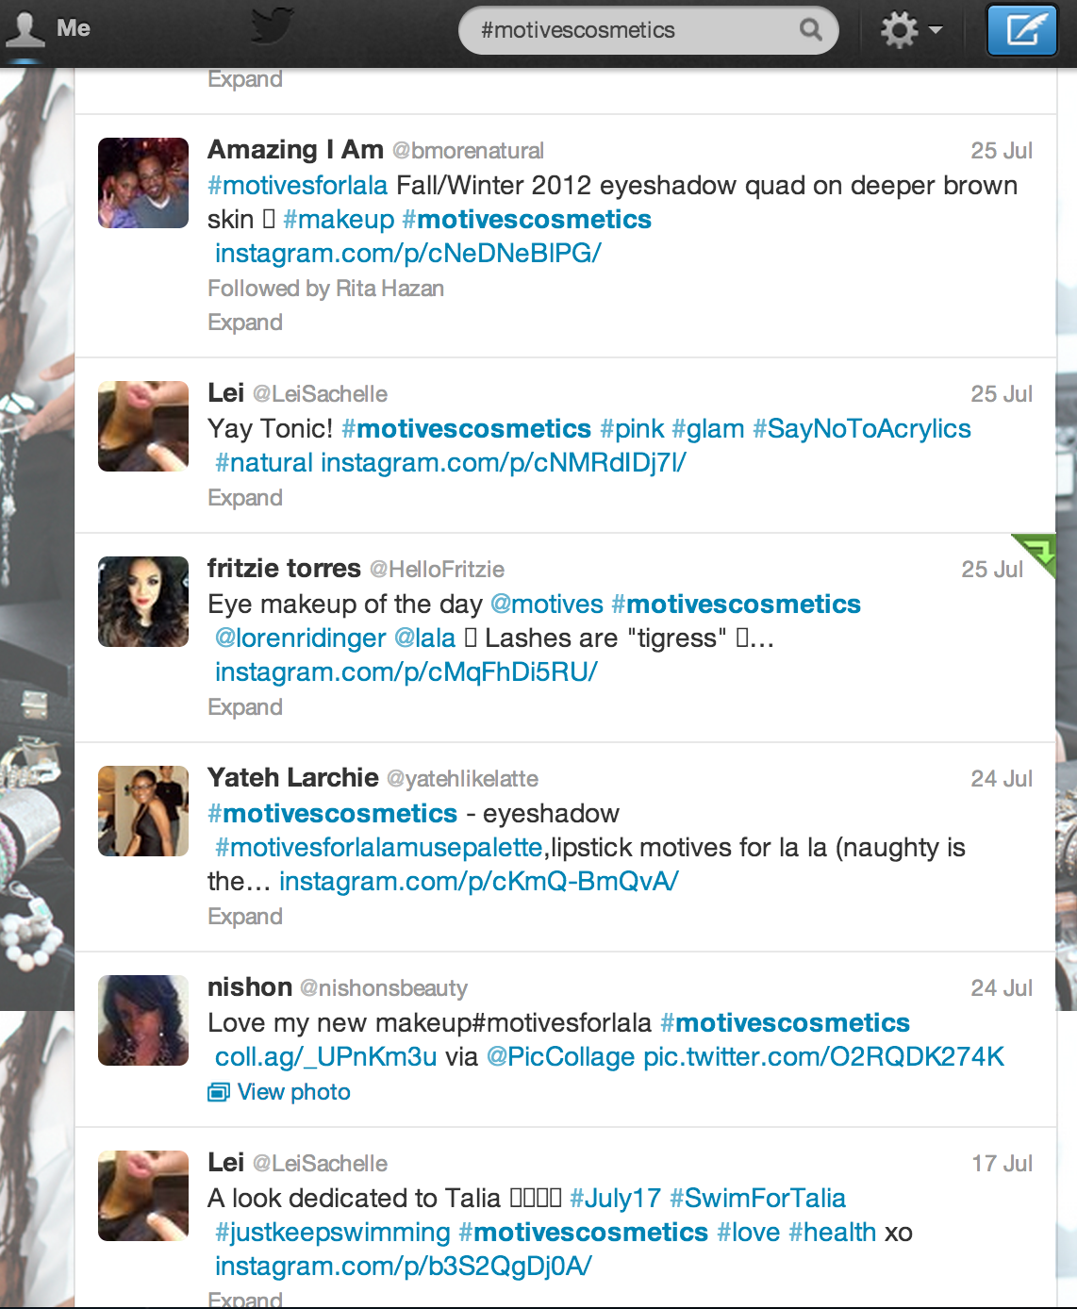

Slide 33
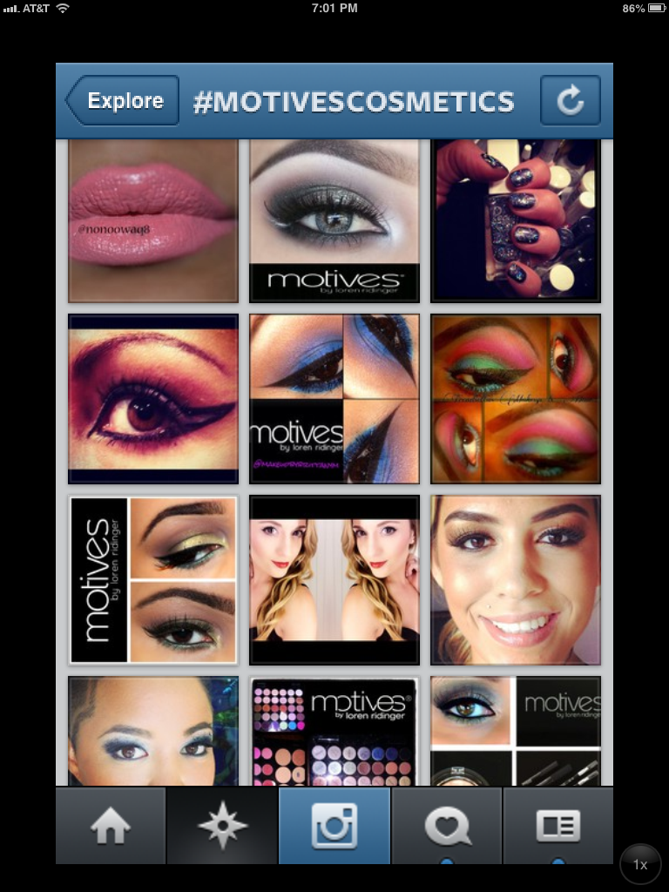

Slide 34
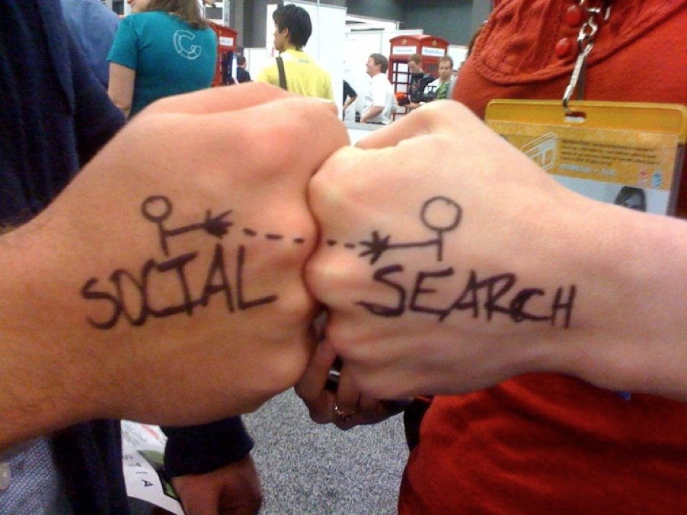
Social Searching to Recruit

Slide 35
Social Searching
Basics
What you tweet is what you attract

Slide 36
Social Searching
Basics
What you tweet is what you attract
Use relevant keywords

Slide 37
Social Searching
Basics
What you tweet is what you attract
Use relevant keywords
Be a listener & solution for pp wants

Slide 38
Social Searching
Basics
What you tweet is what you attract
Use relevant keywords
Be a listener & solution for pp wants
Make the time and reap benefits

Slide 39
Loves Makeup!
Share My Story!

Slide 40
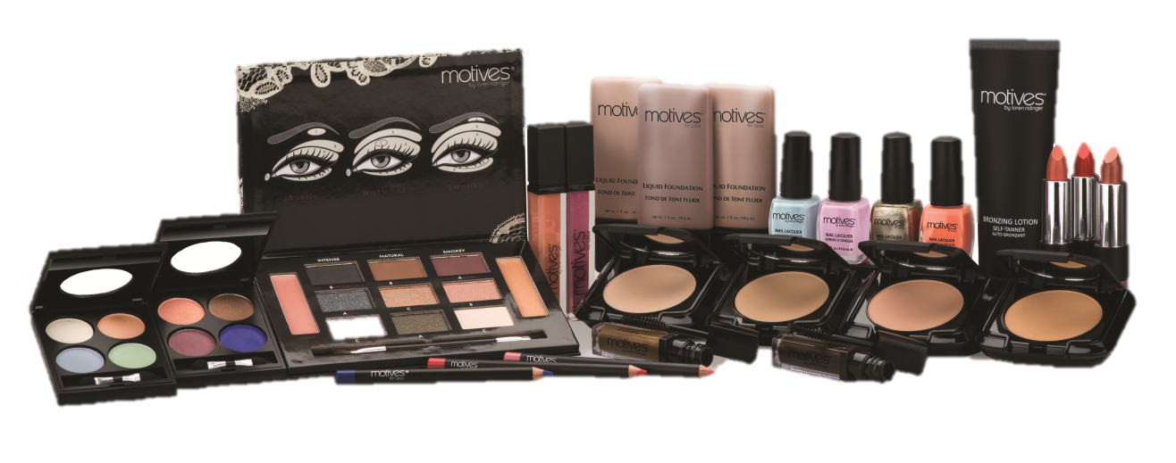
WHERE DO I FIND THEM?
GIVE THEM WHAT THEY ARE LOOKING FOR

Slide 41
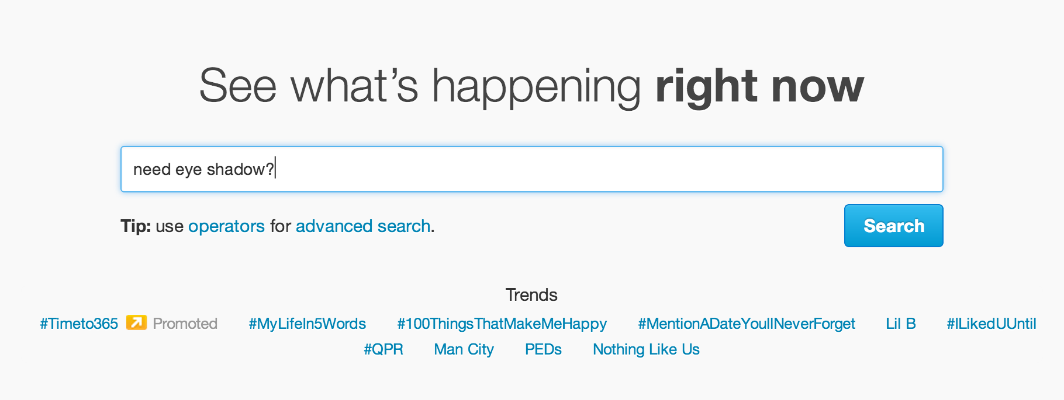

Slide 42
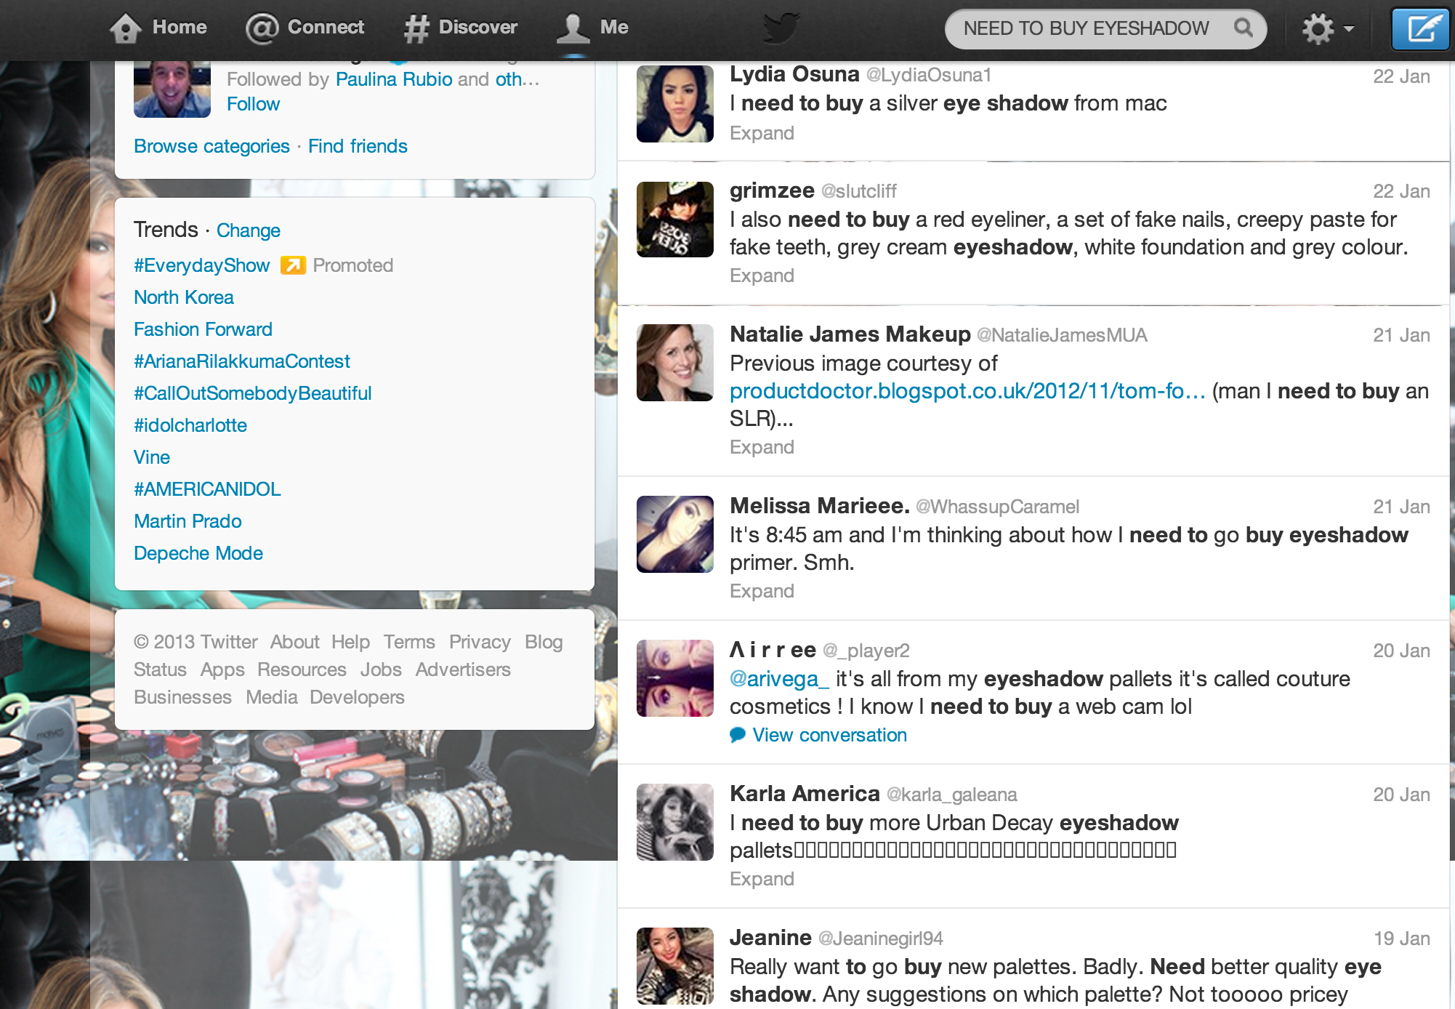
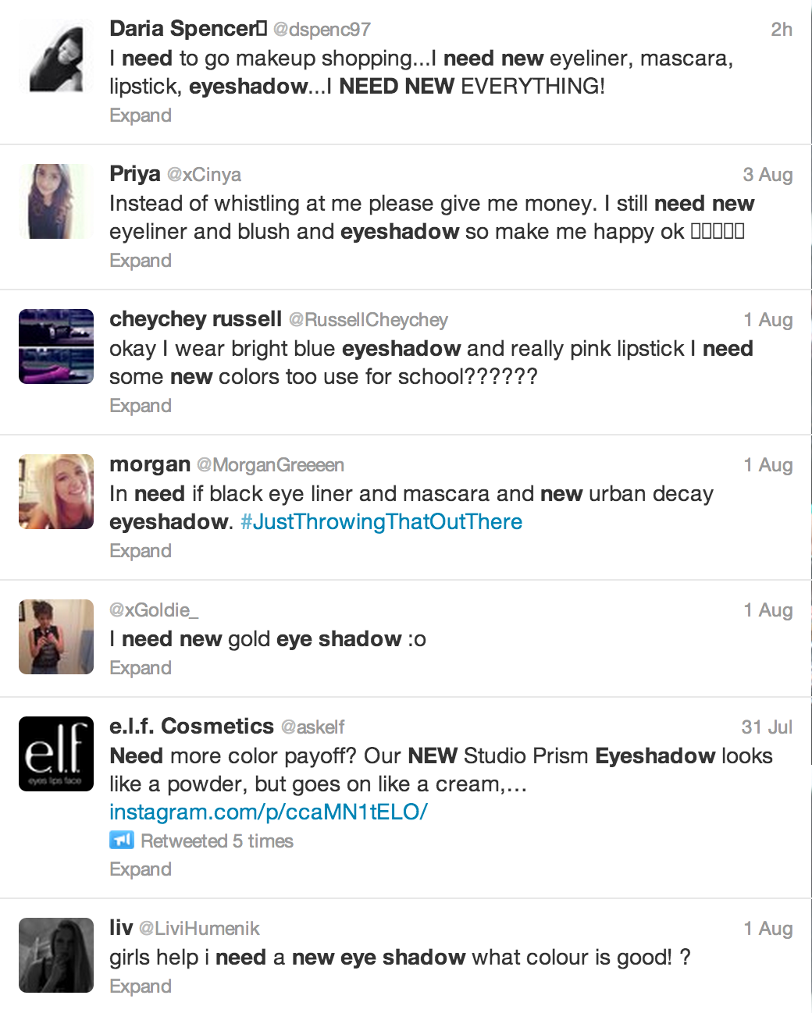
THIS IS HOW
When I search for “need new eyeshadow”…

Slide 43
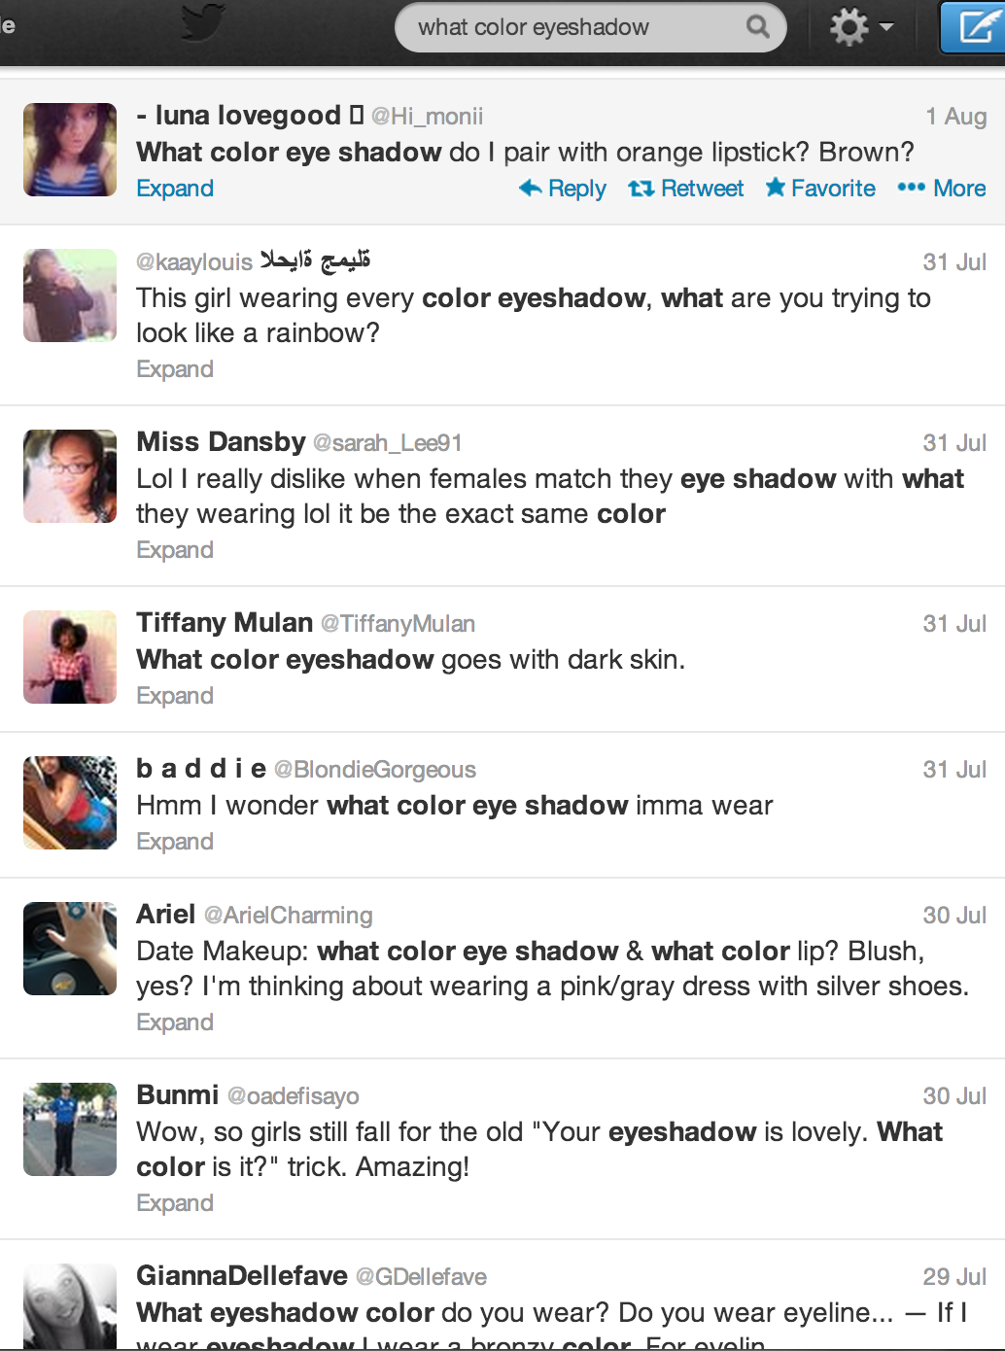
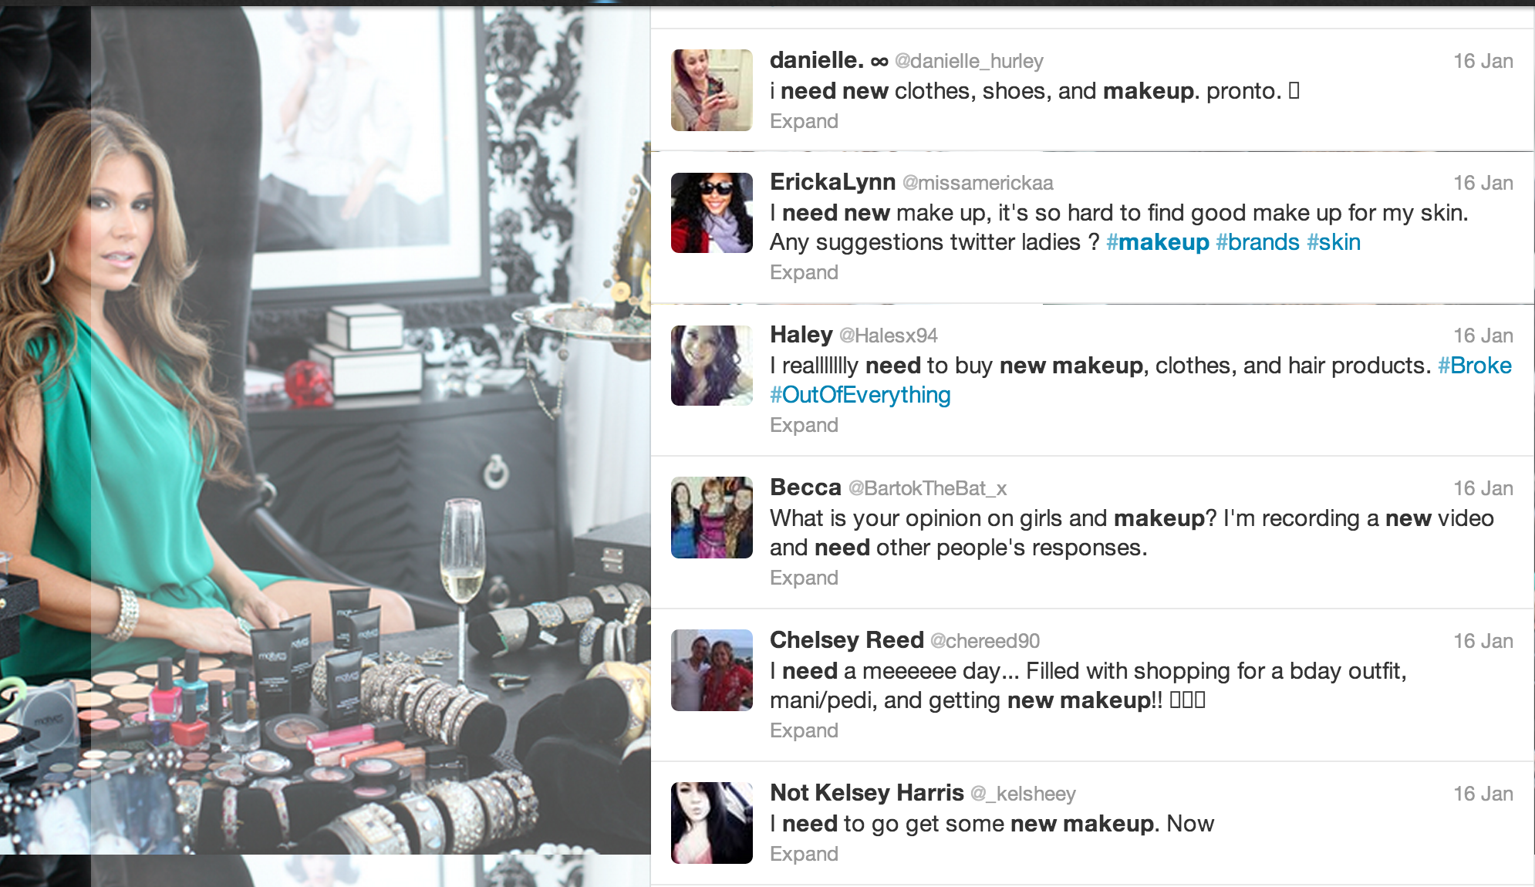
They are asking for suggestions

Slide 44
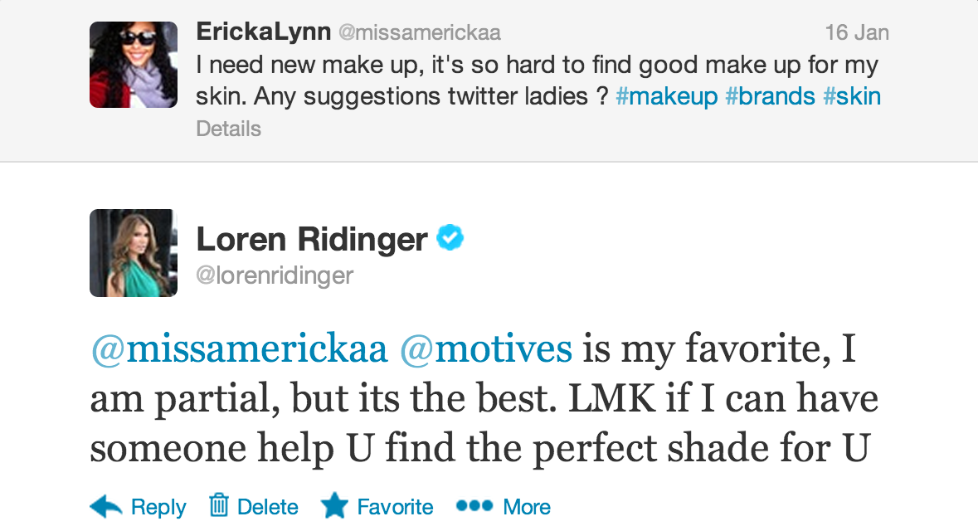
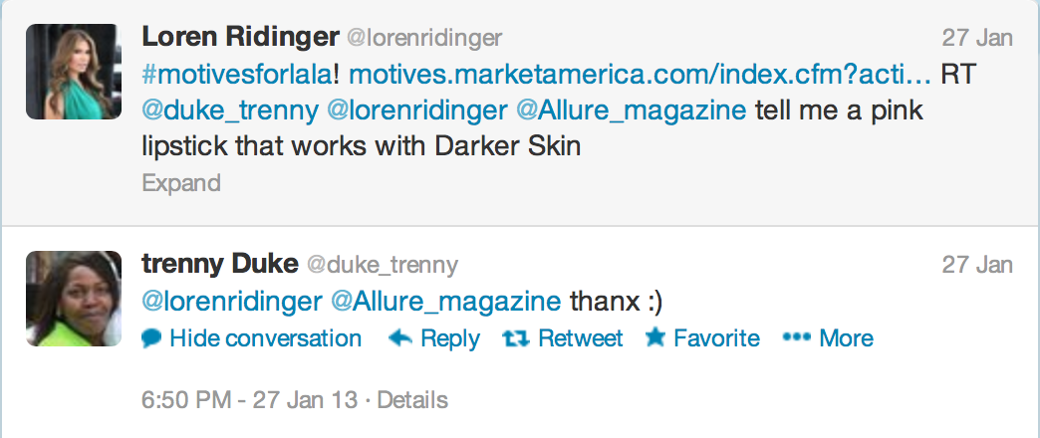
THIS IS HOW
Offer to Help!

Slide 45
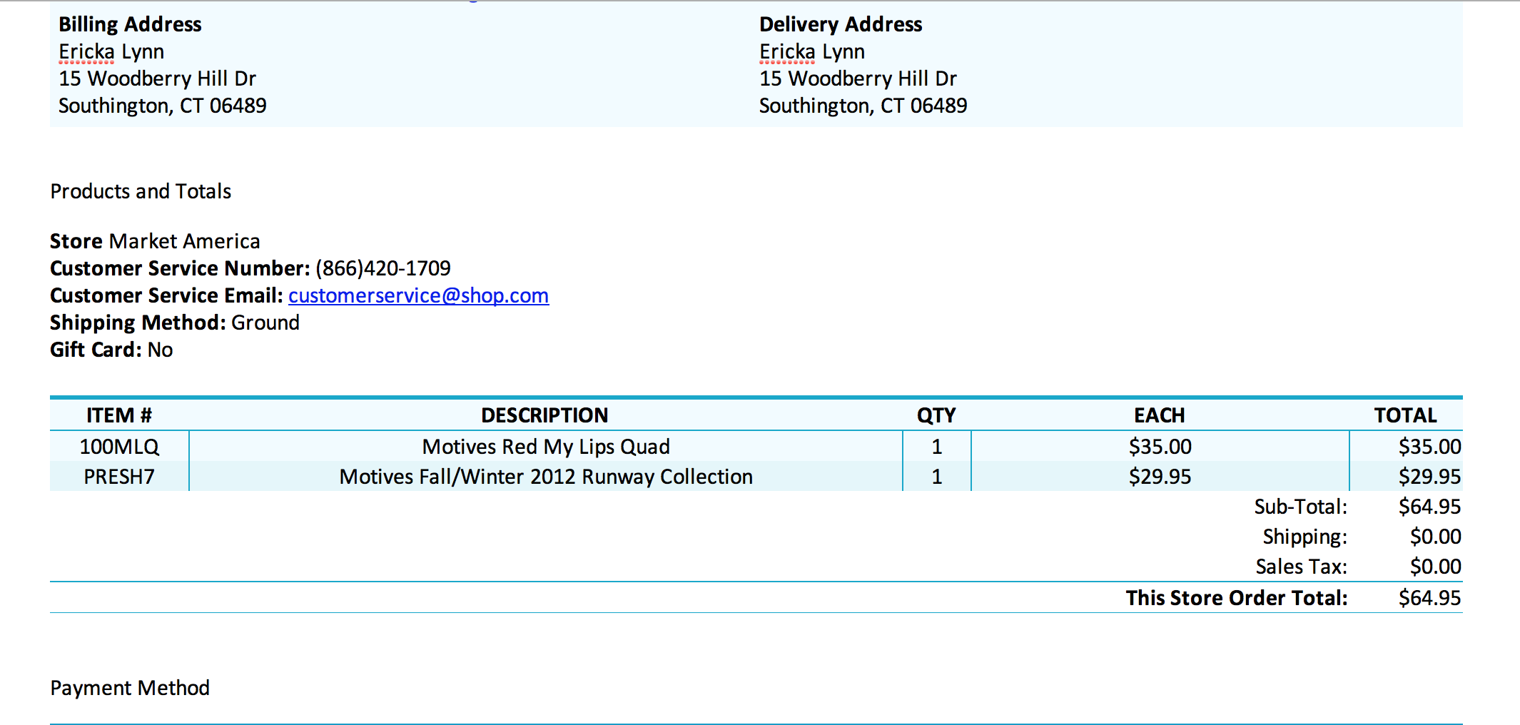

Slide 46
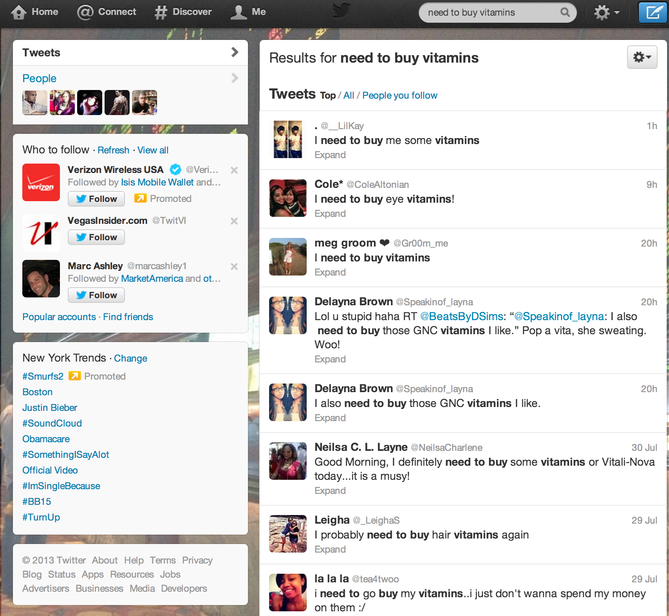
ISOTONIX
Search for “need to buy vitamins”
S

Slide 47
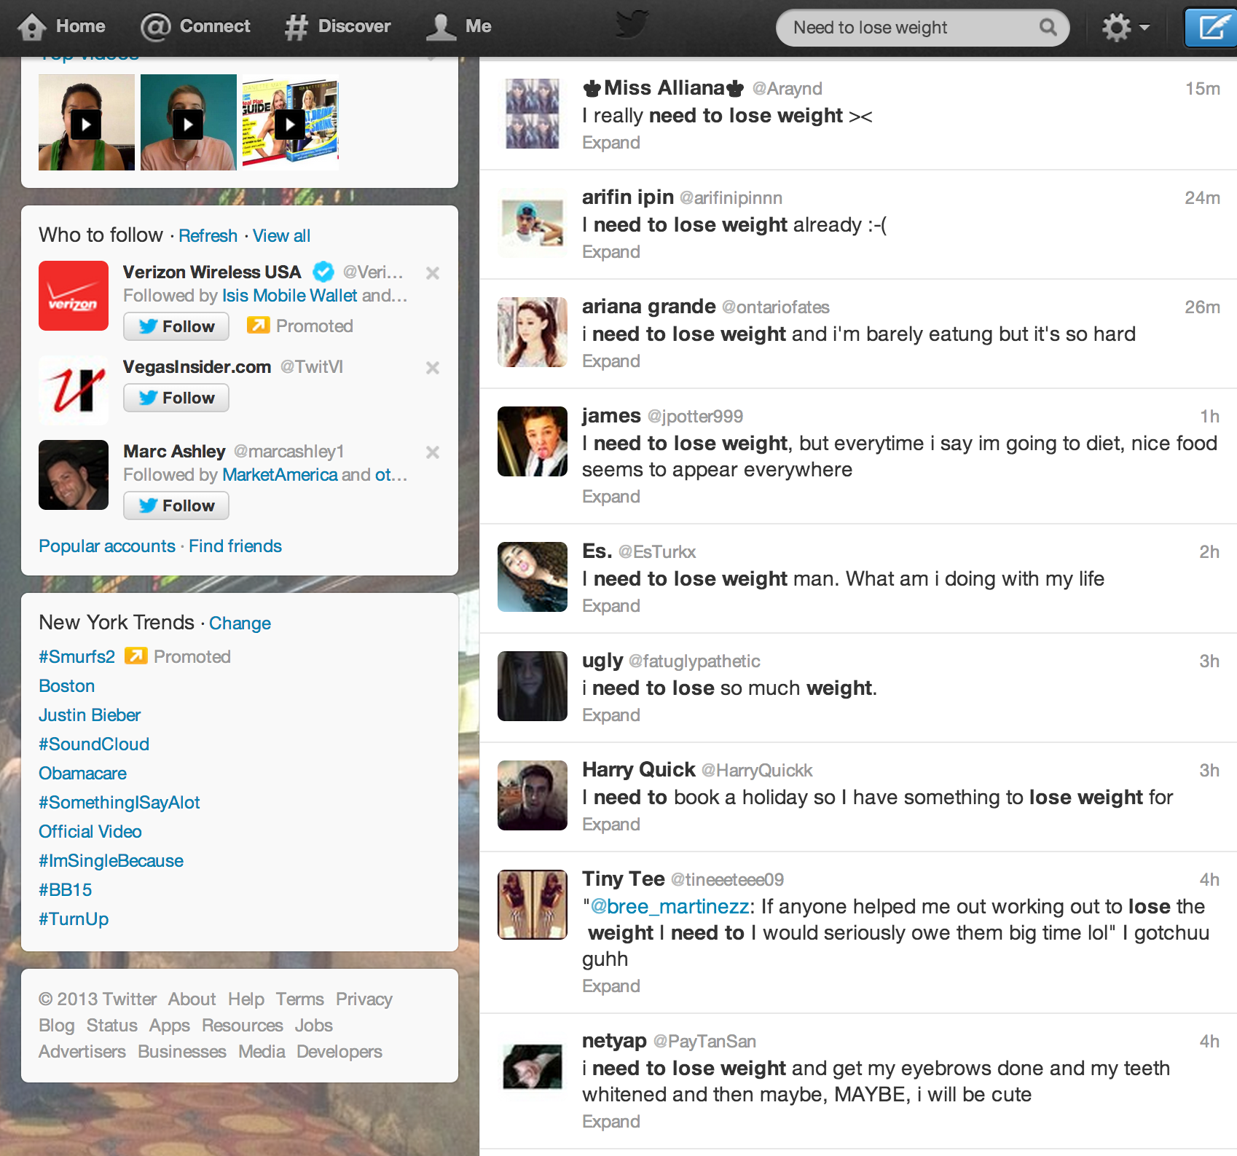
TLS
Search for “need to lose weight”
S

Slide 48
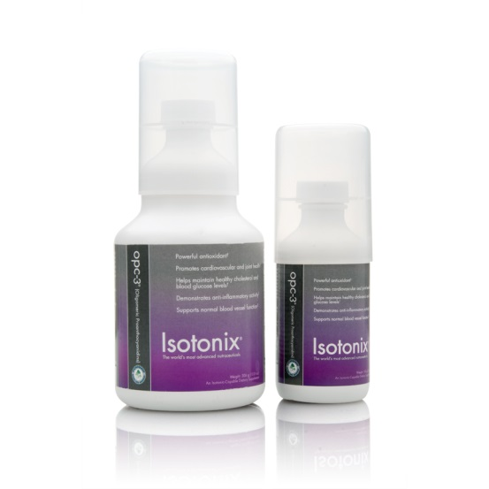
THIS IS HOW
Engage and guide without being pushy

Slide 49
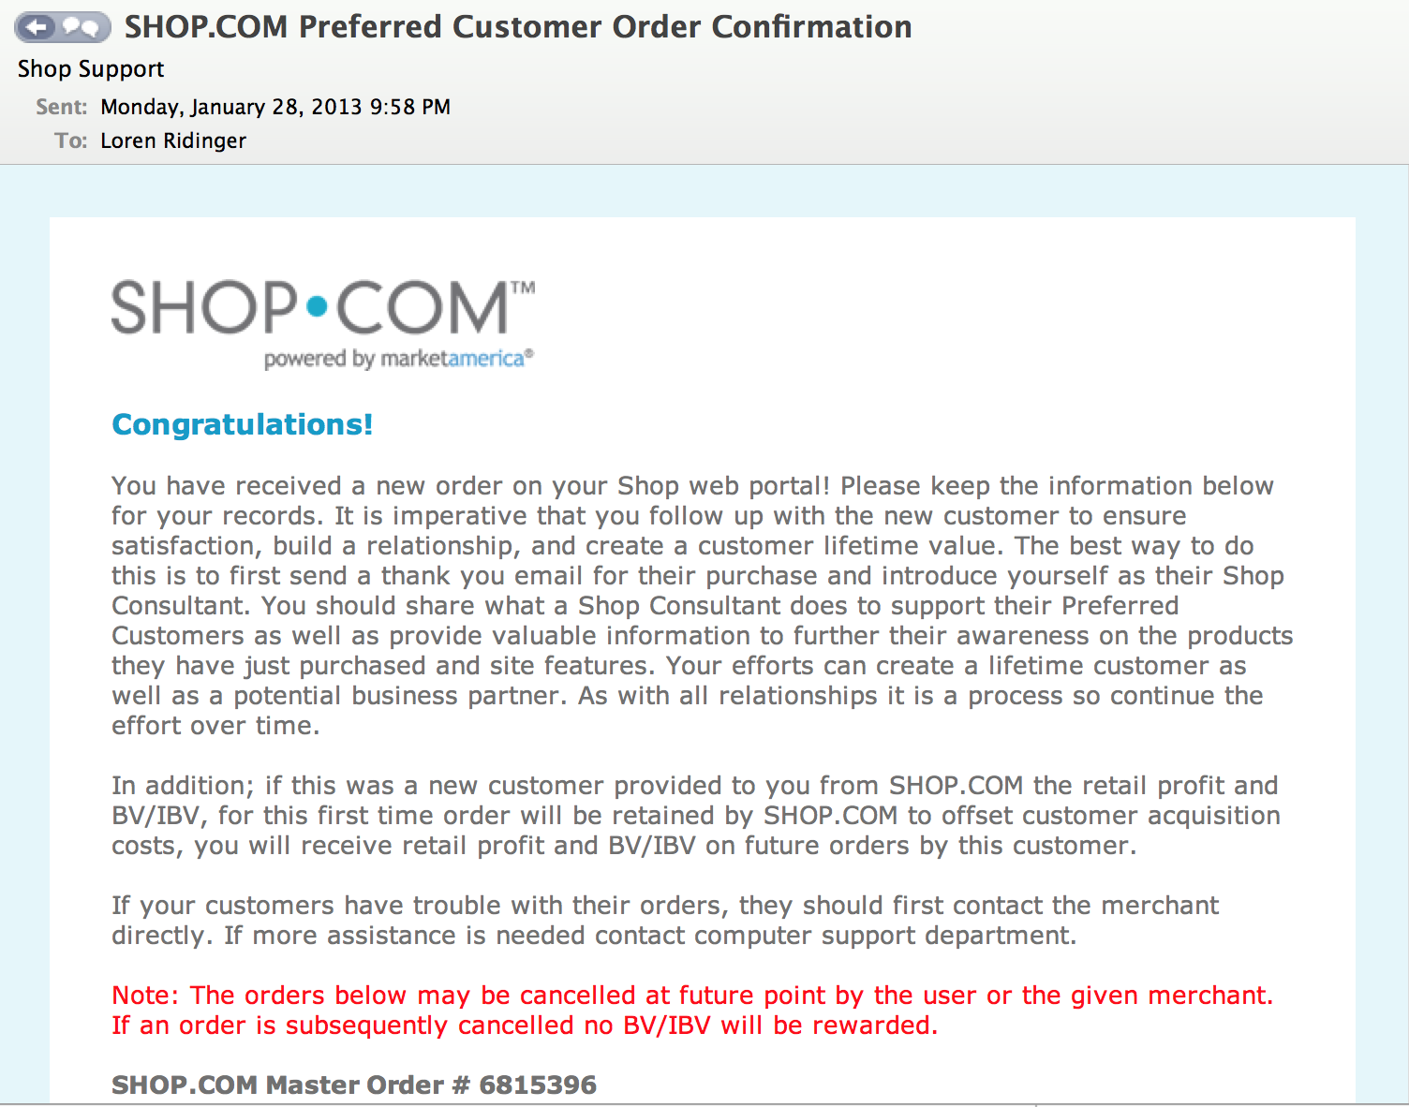

Slide 50
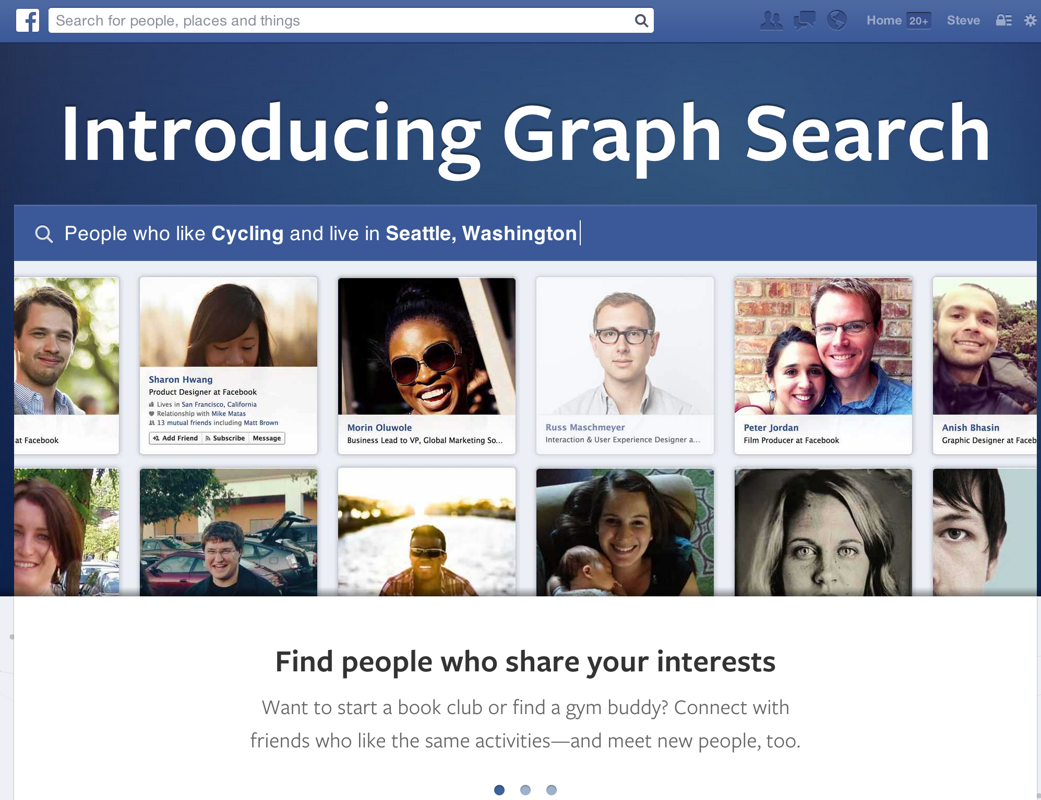

Slide 51
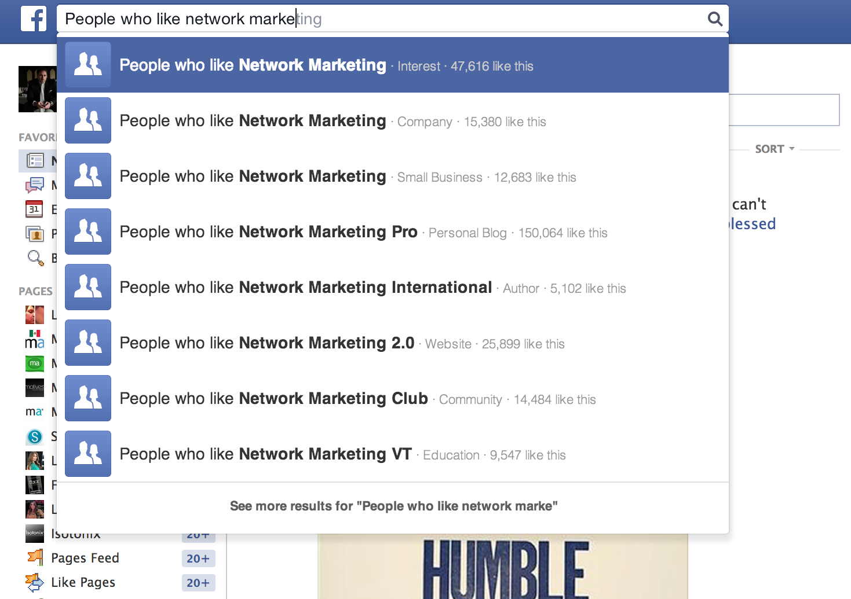

Slide 52
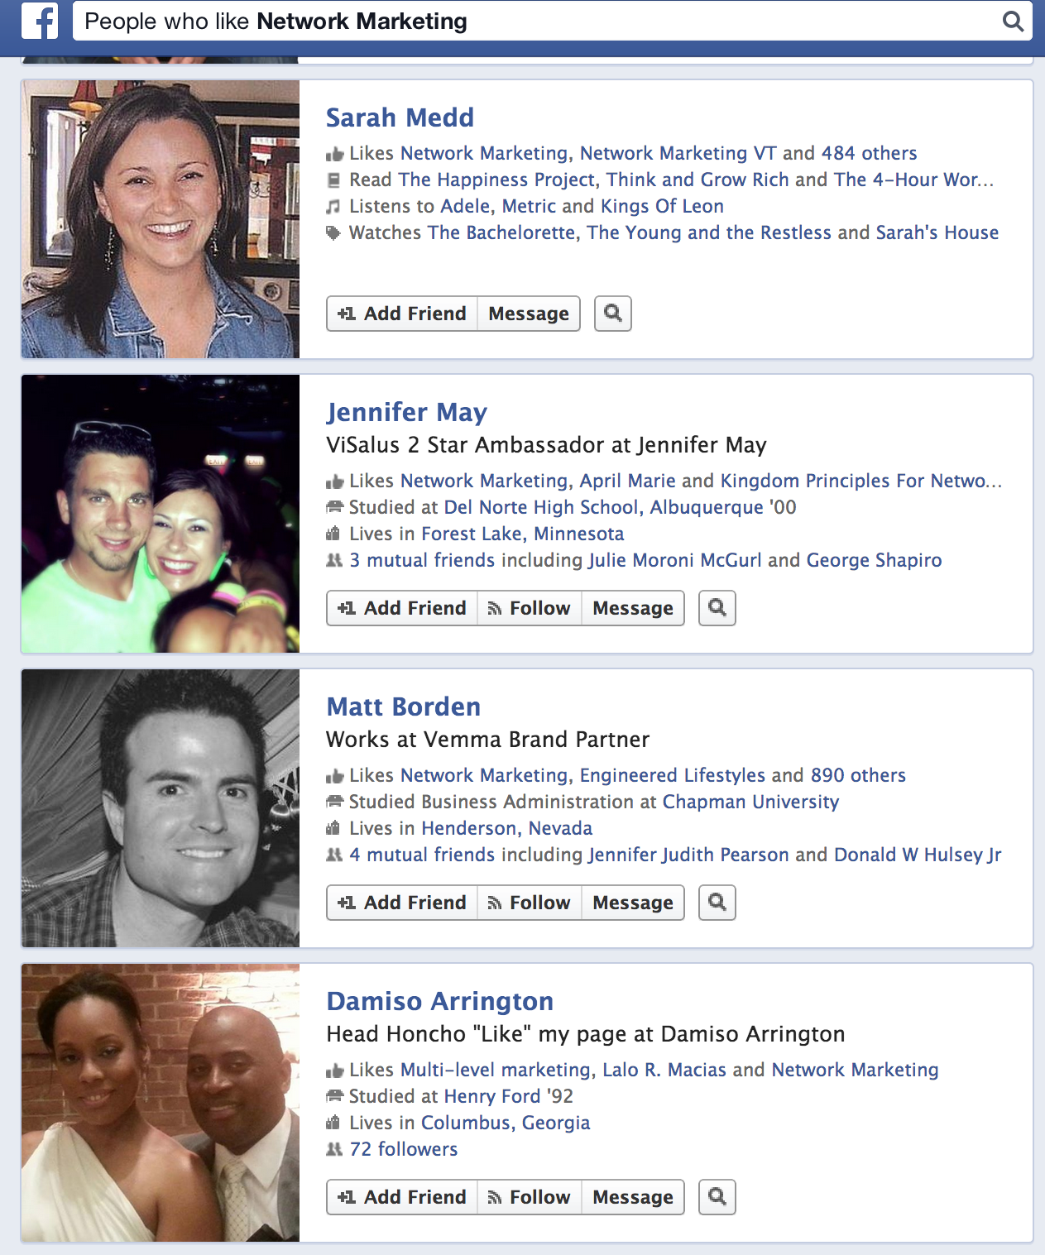

Slide 53
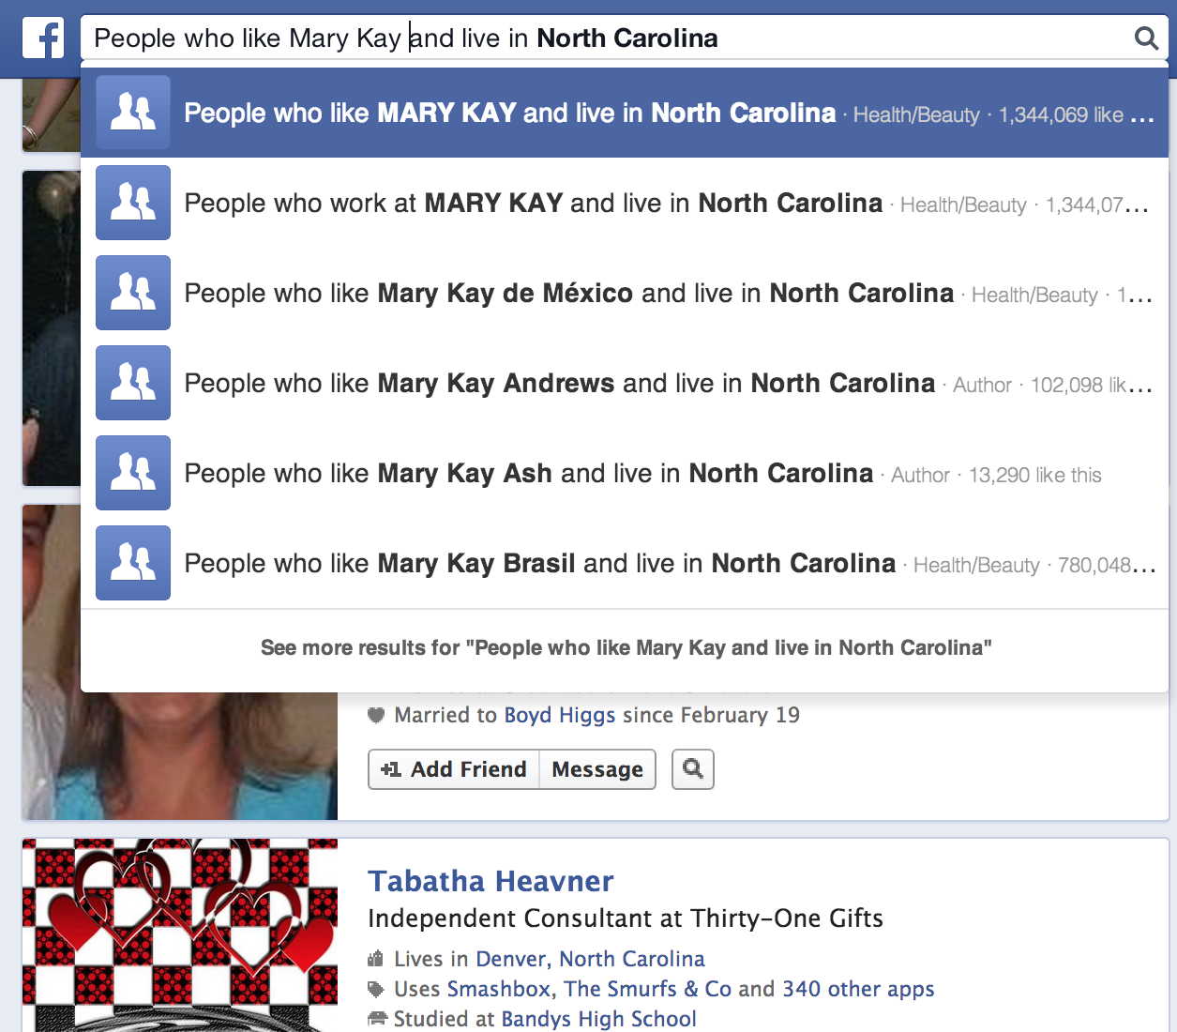

Slide 54
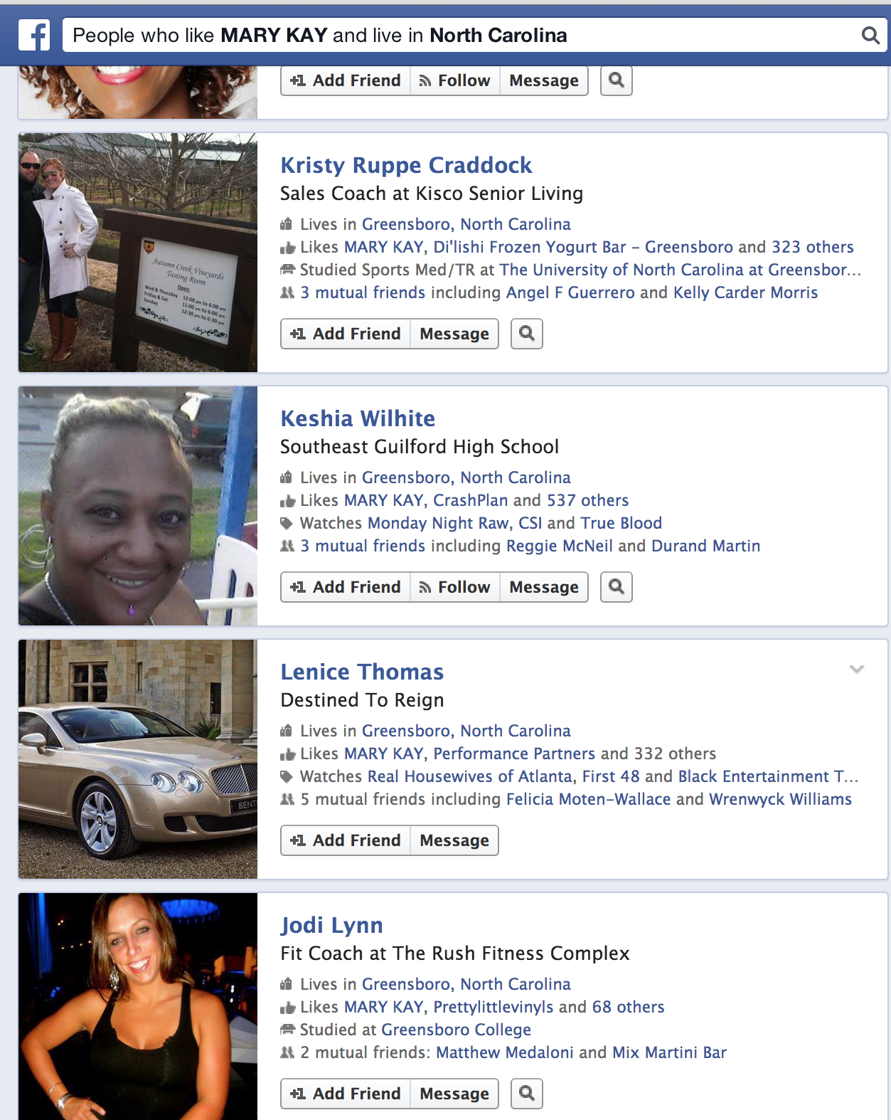

Slide 55
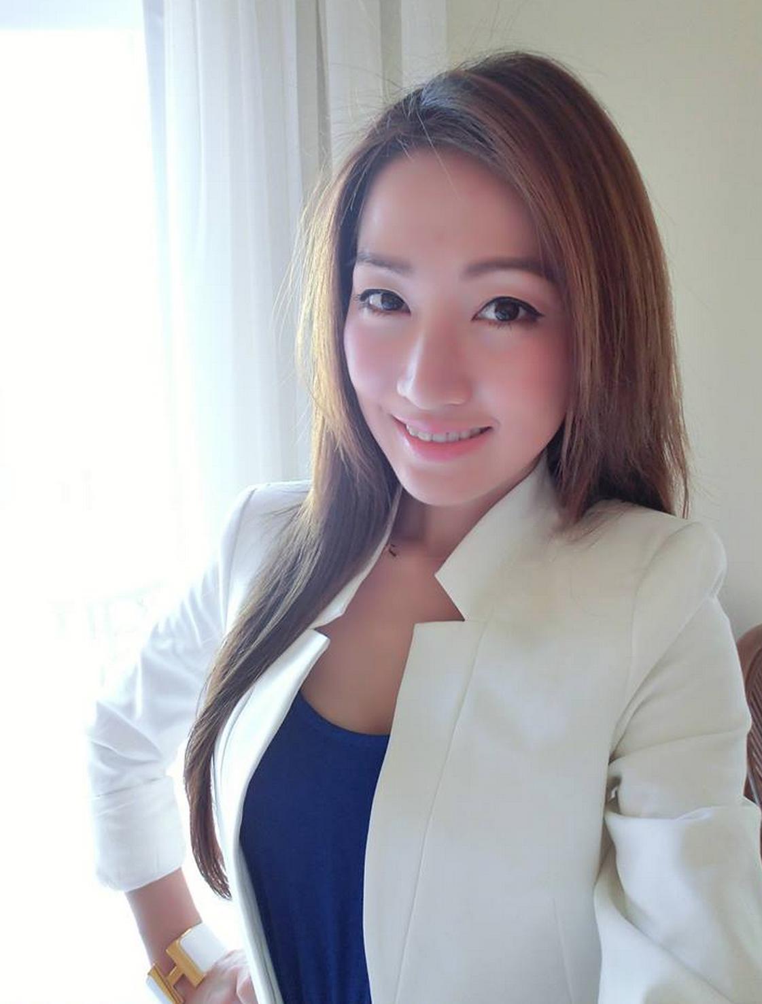
Average User: 25 year old woman, living in a big city w/ a college degree and household income of $75K

Slide 56
Cross Pollinate Socially
Build and work with all your groups
without leaving your home during the times
you can’t travel or be there in person
Notes:
56

Slide 57
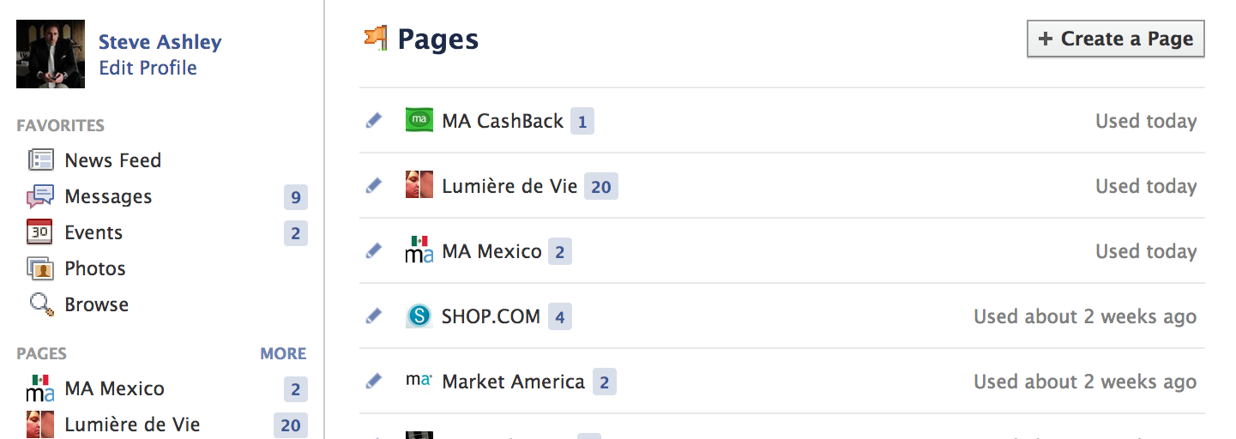
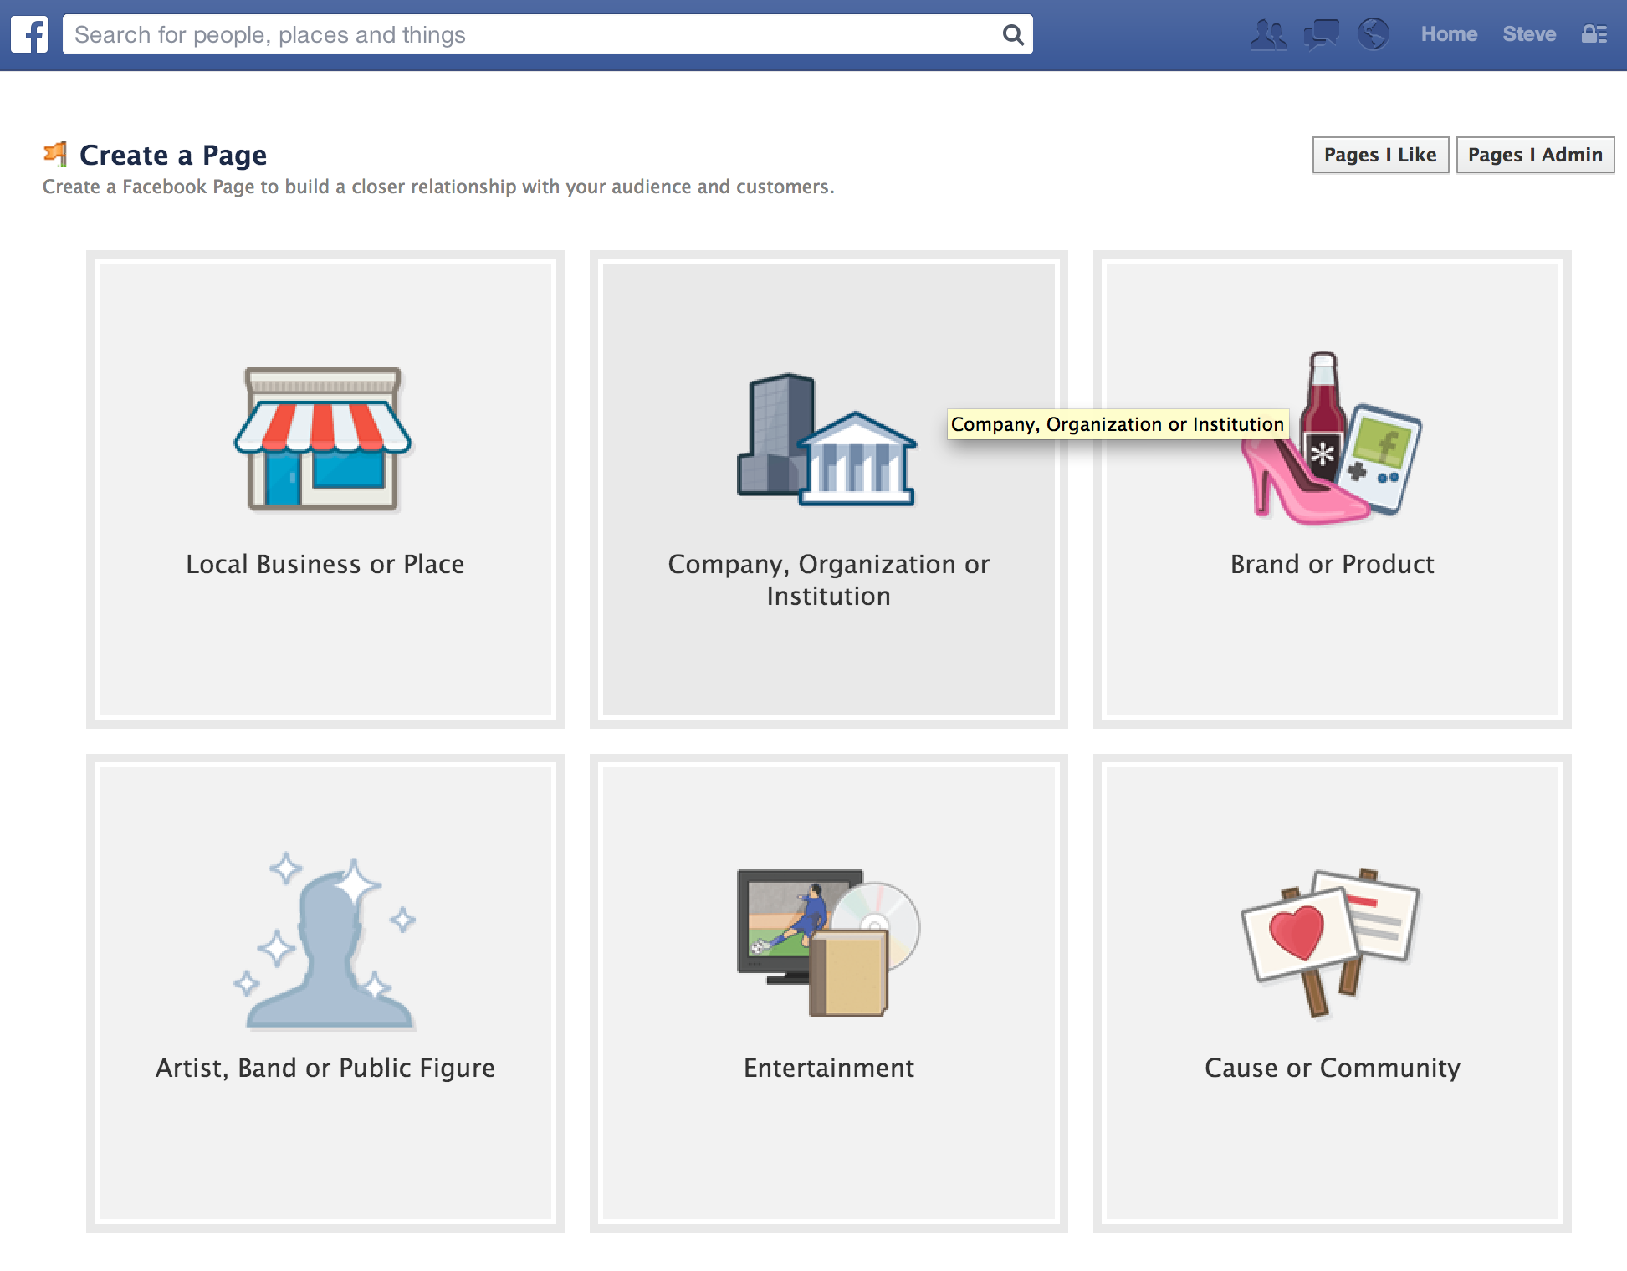
Create a Facebook Page

Slide 58
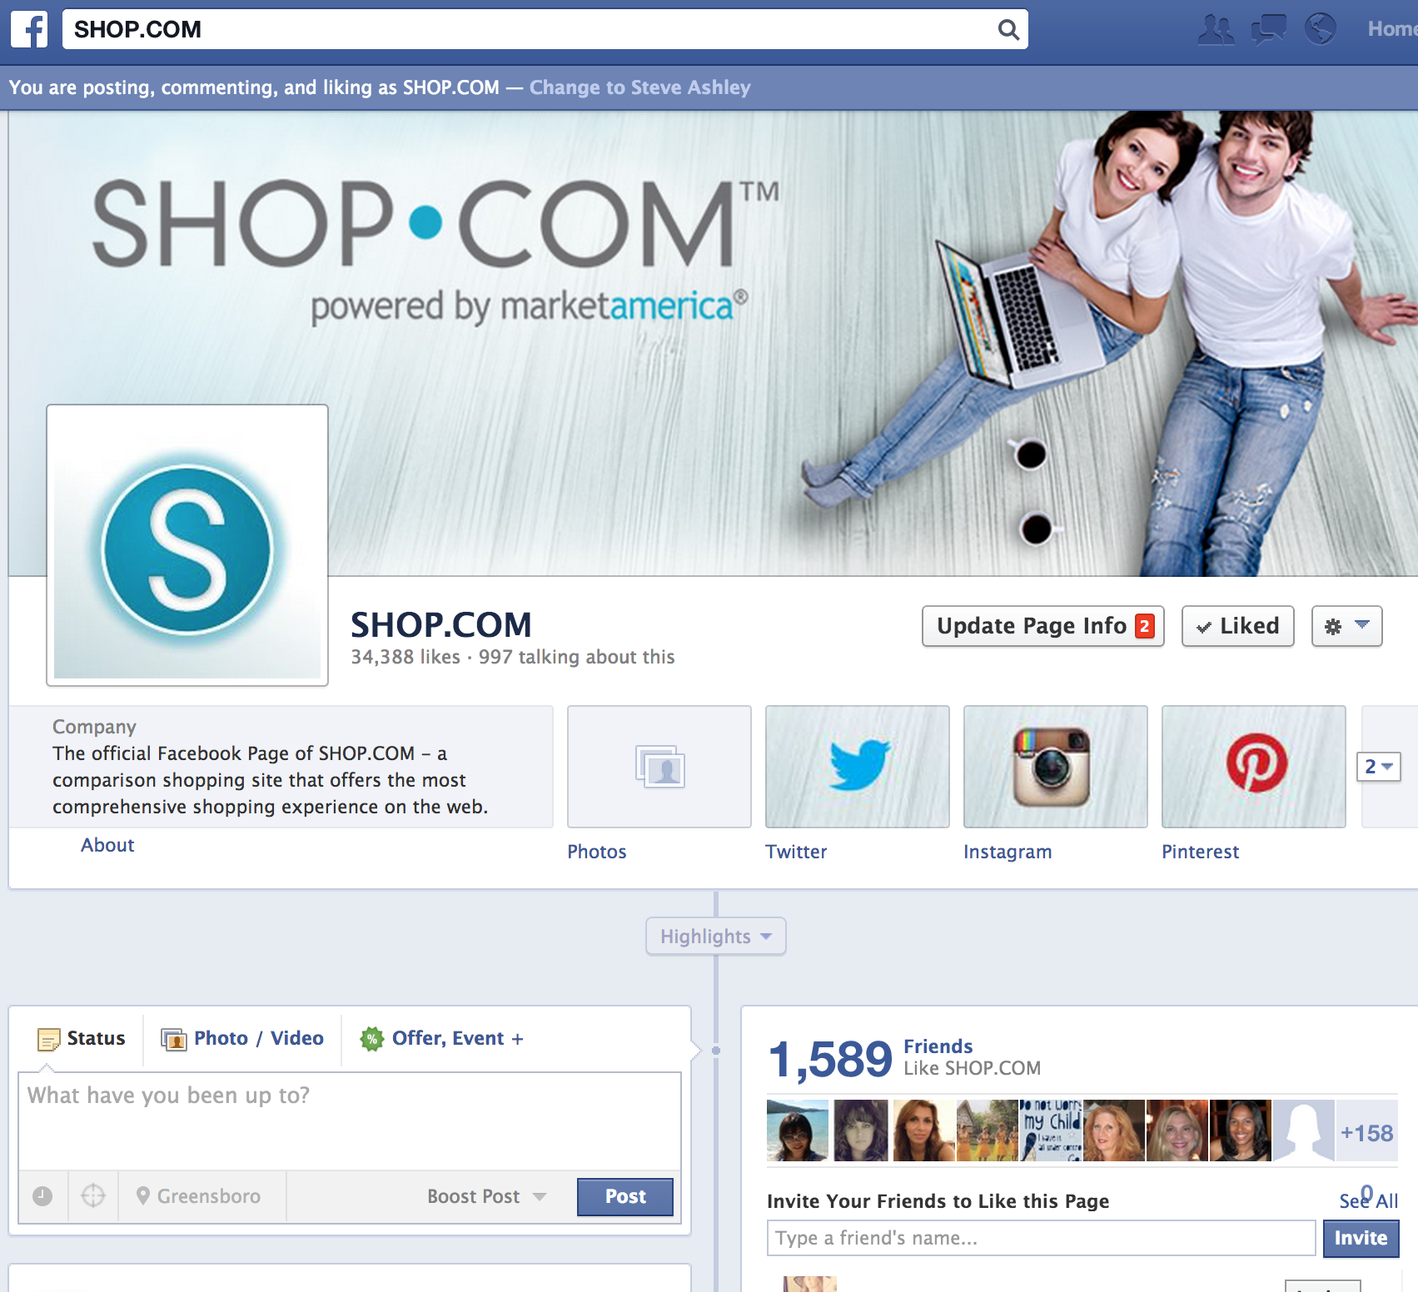
Comment as your brand
+ Unlimited Friend Count
+Separate Personal/Business Life
+Content is indexed for SEO
+Facebook Insights reporting
+Business relevant information since Pages are approved for Commercial use
Create Tabs
Schedule content, create offers, milestones, or events

Slide 59
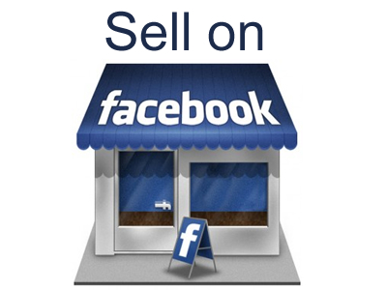
Social Shopping
Sell more products with a store tab on your Facebook page
Set up a store in minutes and start making money.

Slide 60
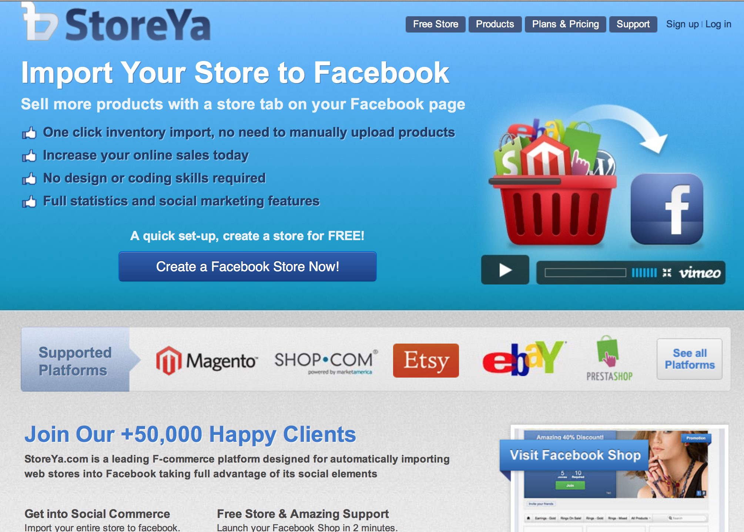

Slide 61
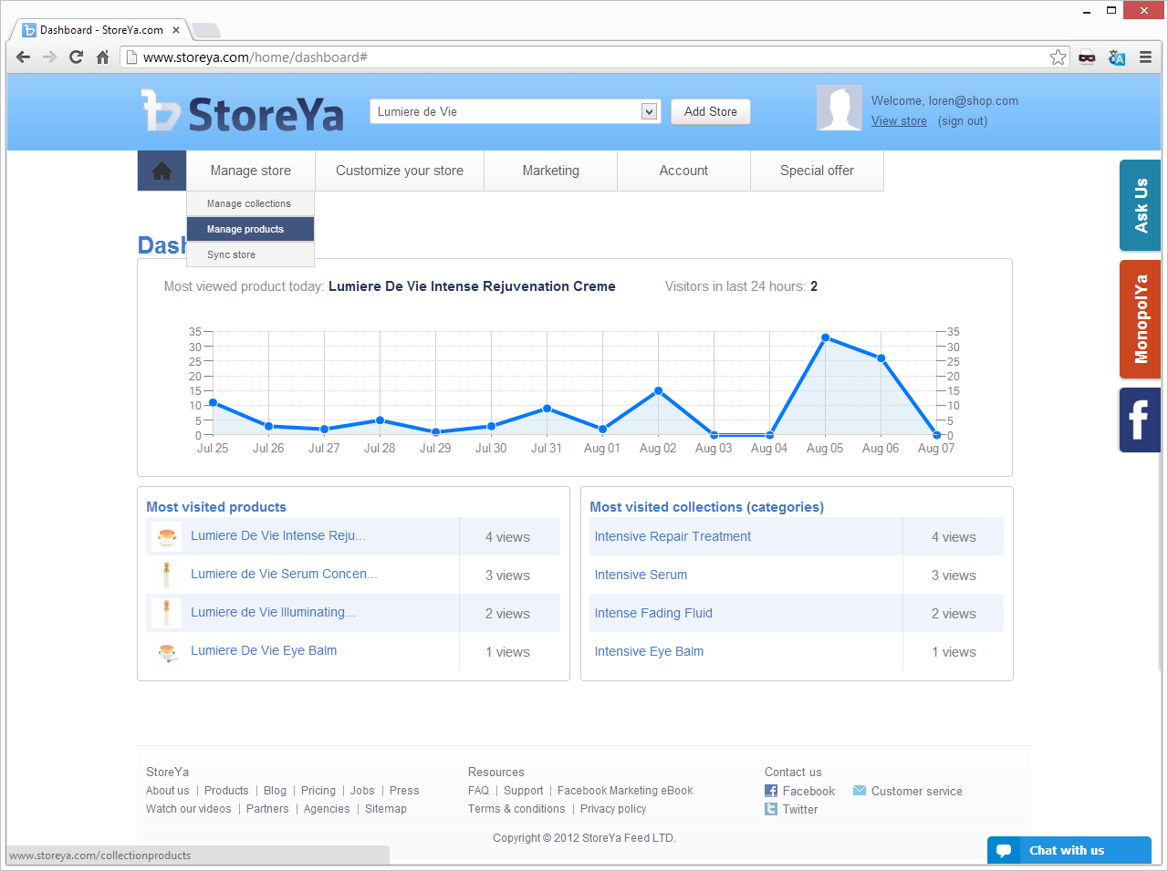
Go to “Manage products”

Slide 62
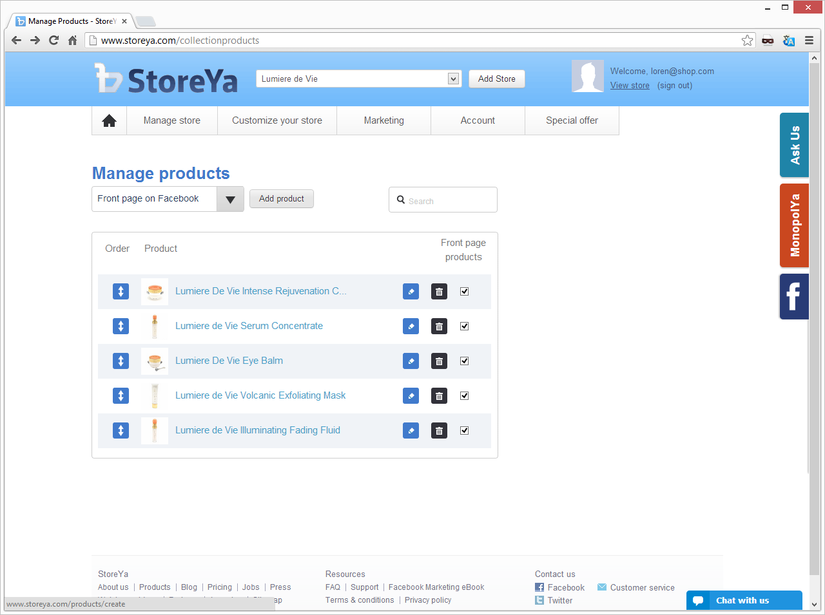

Slide 63
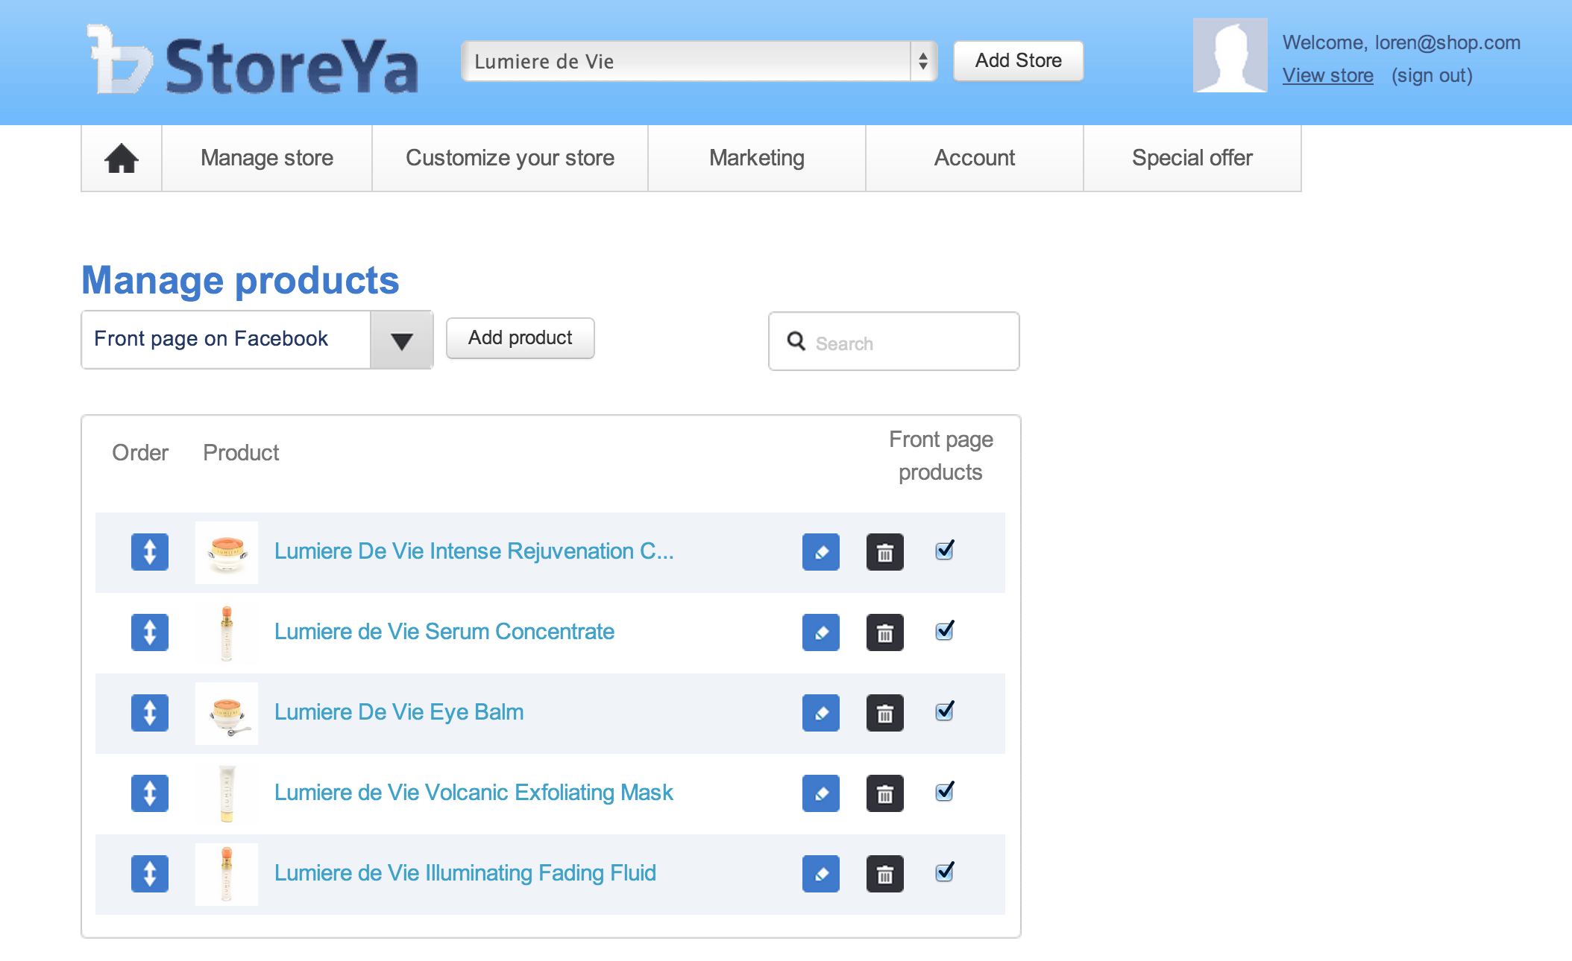

Slide 64
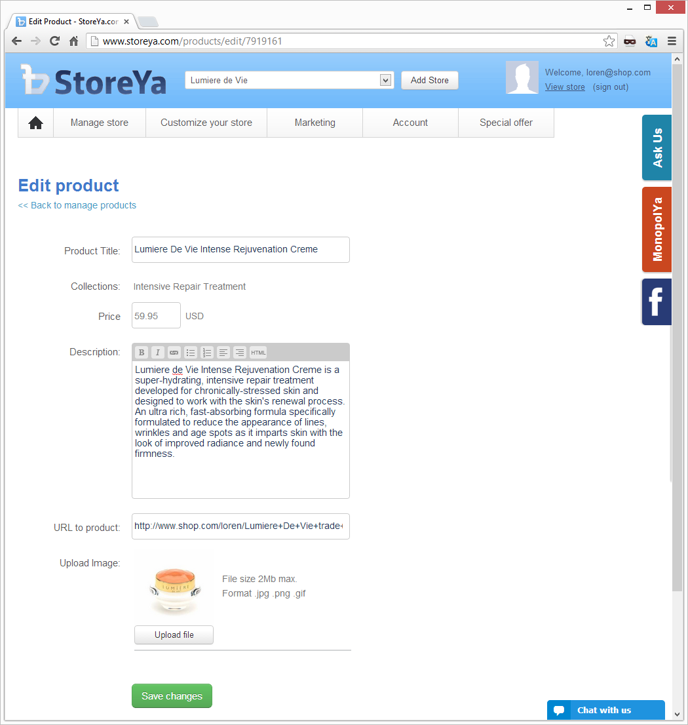
Note: You need to be sure the URL includes your “Portal Name”.
Go to your SHOP.COM site, and select the URL from the SHARE feature.

Slide 65
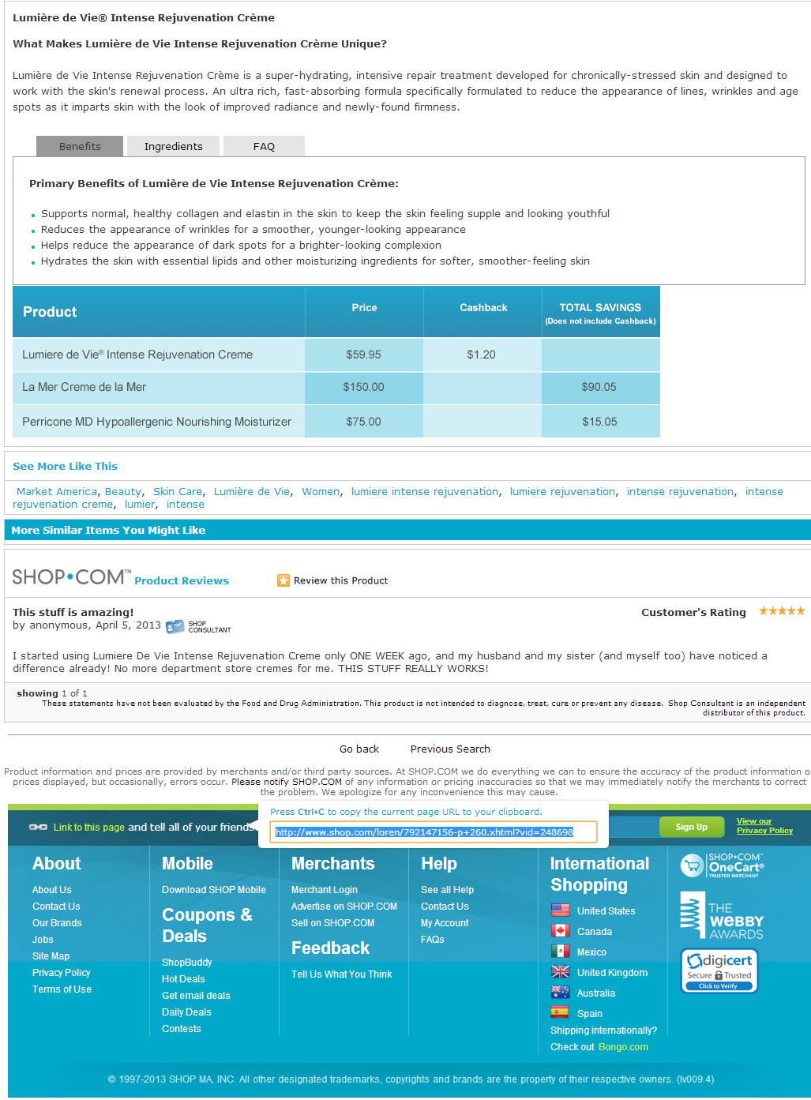
Note: You need to be sure the URL includes your “Portal Name”.
Go to your SHOP.COM site, and select the URL from the SHARE feature.

Slide 66
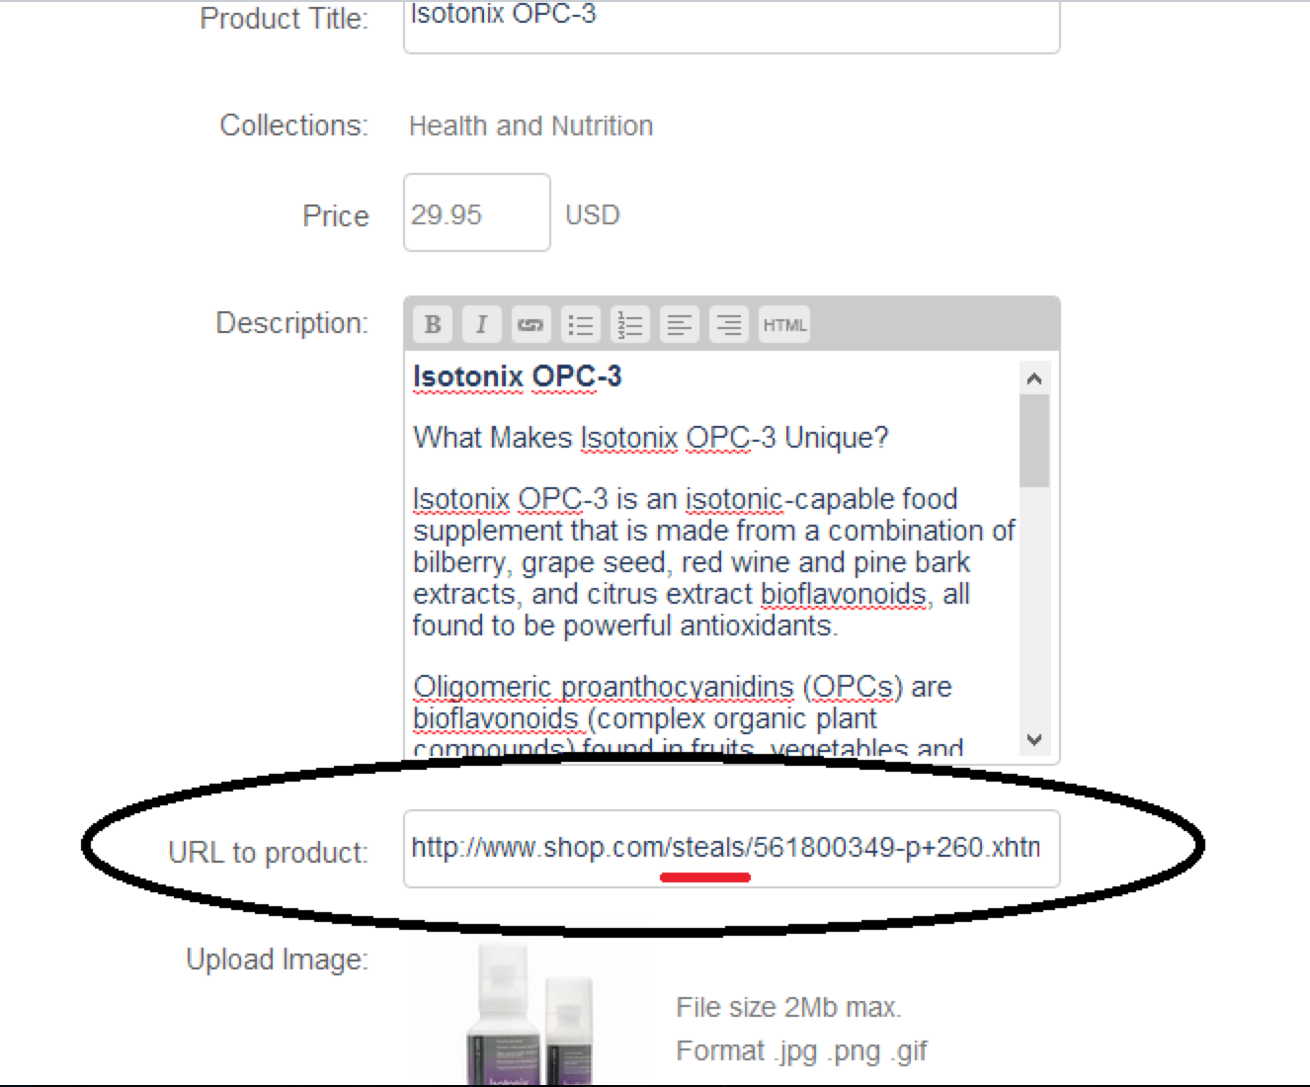

Slide 67
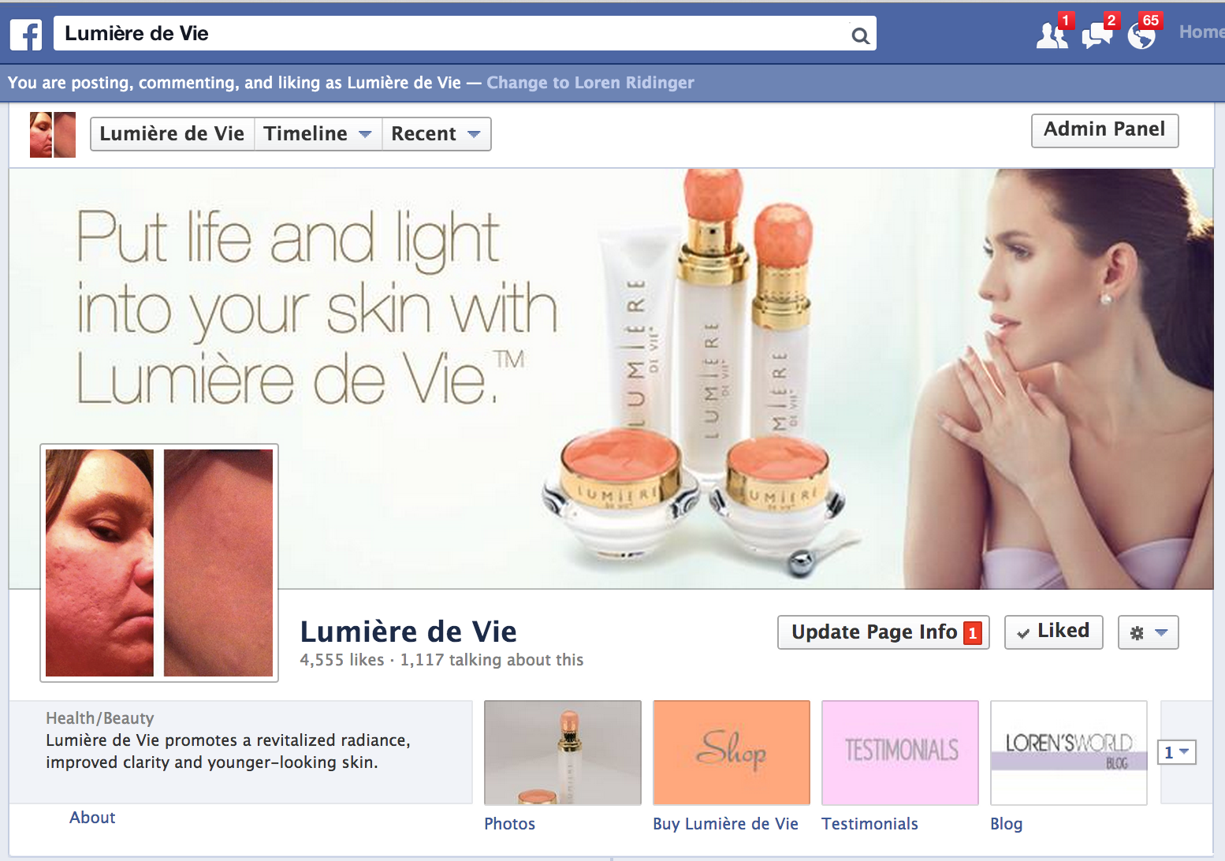

Slide 68
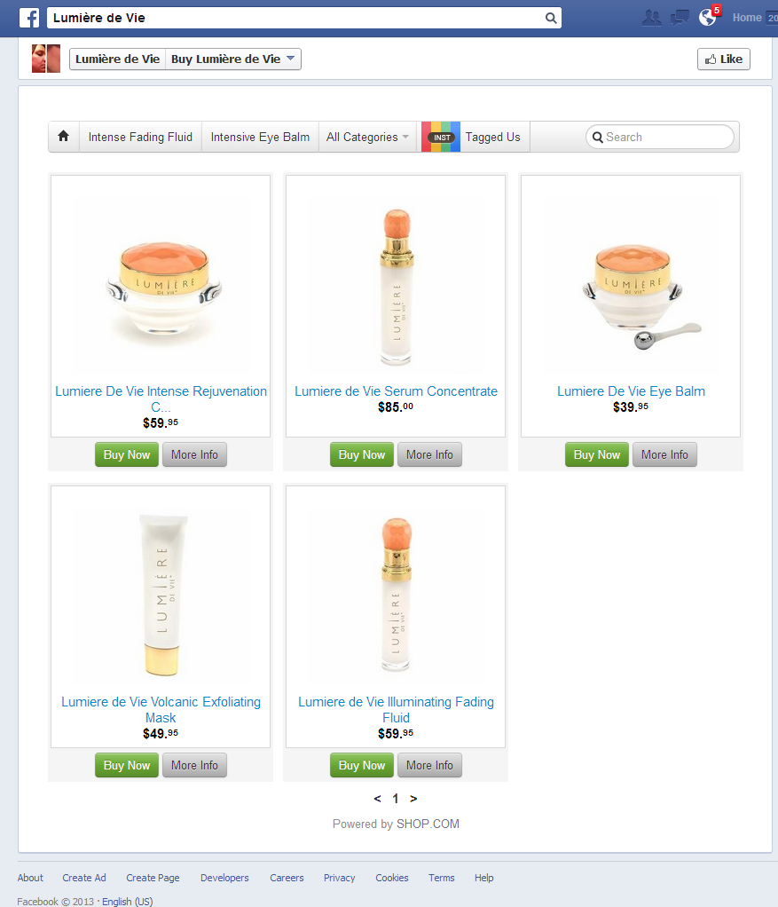
How the products
appear on facebook.com

Slide 69
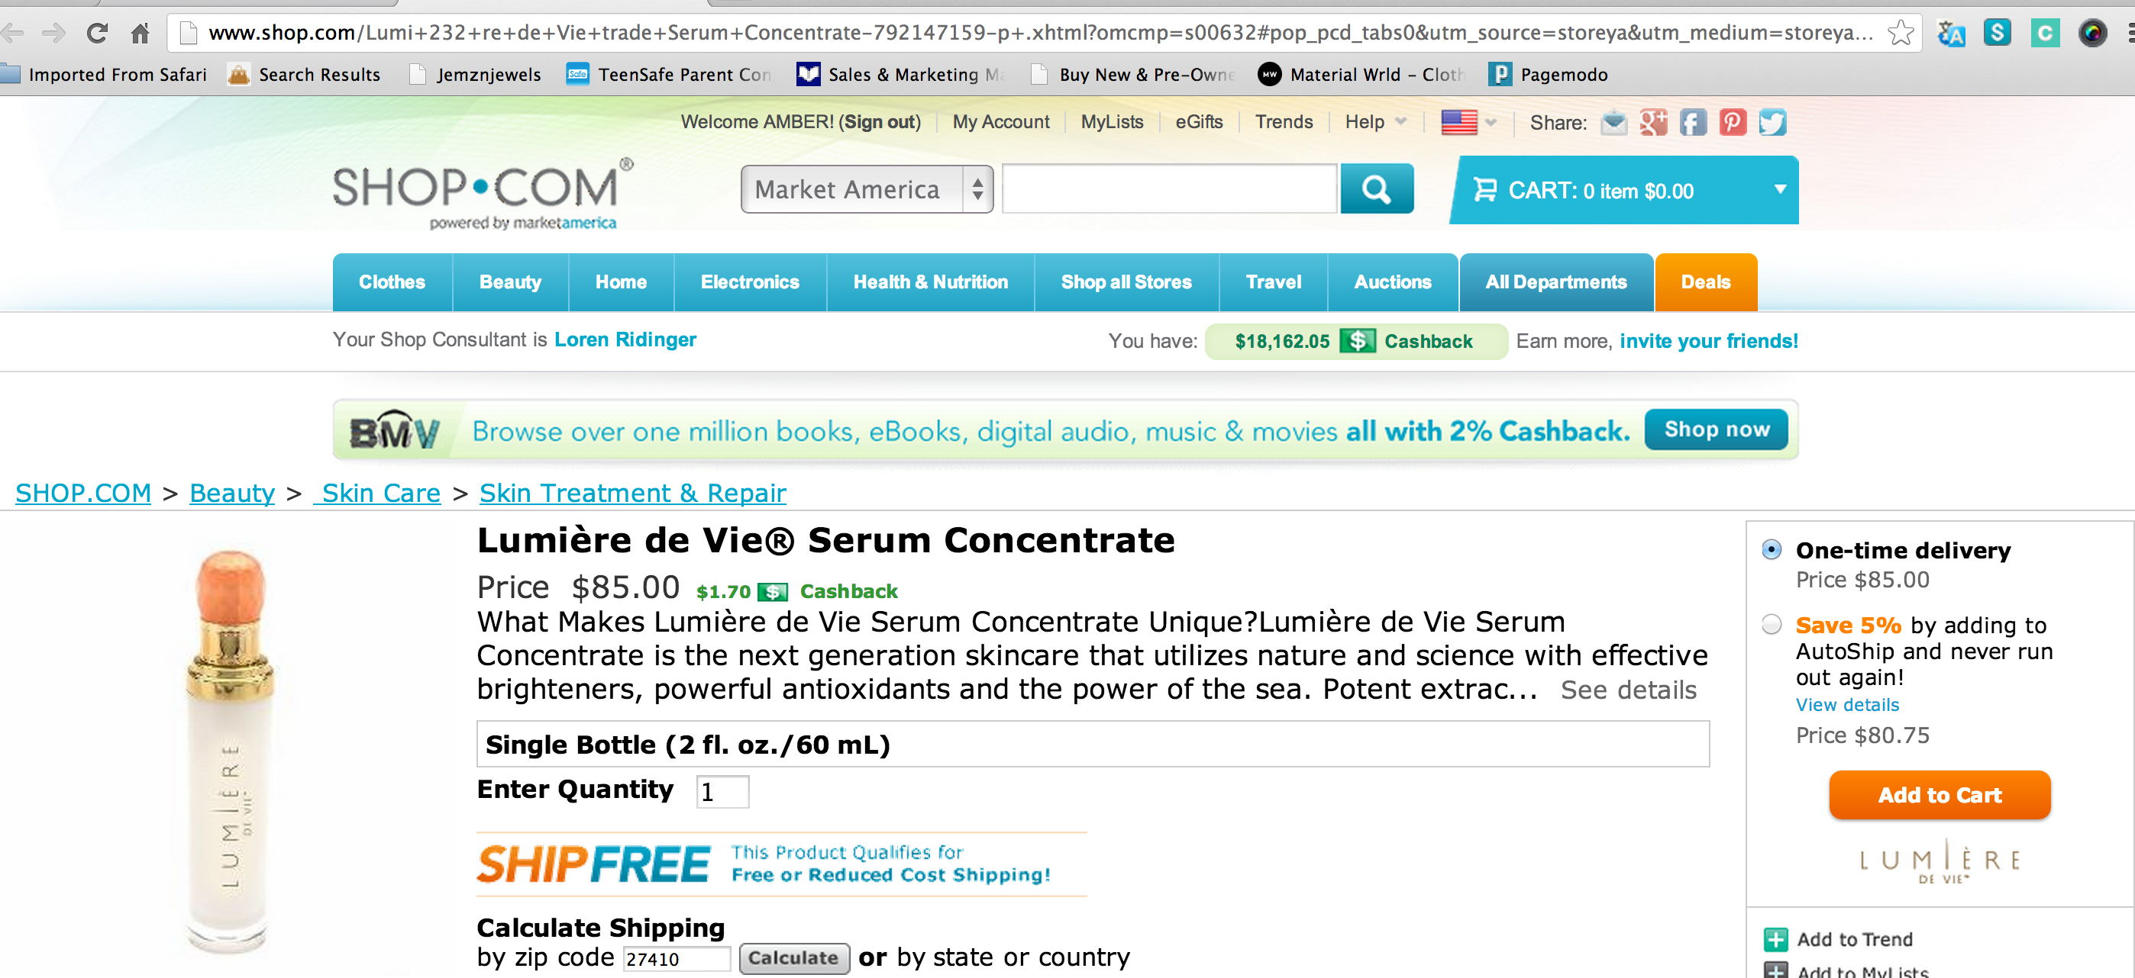
Takes them right to your portal

Slide 70
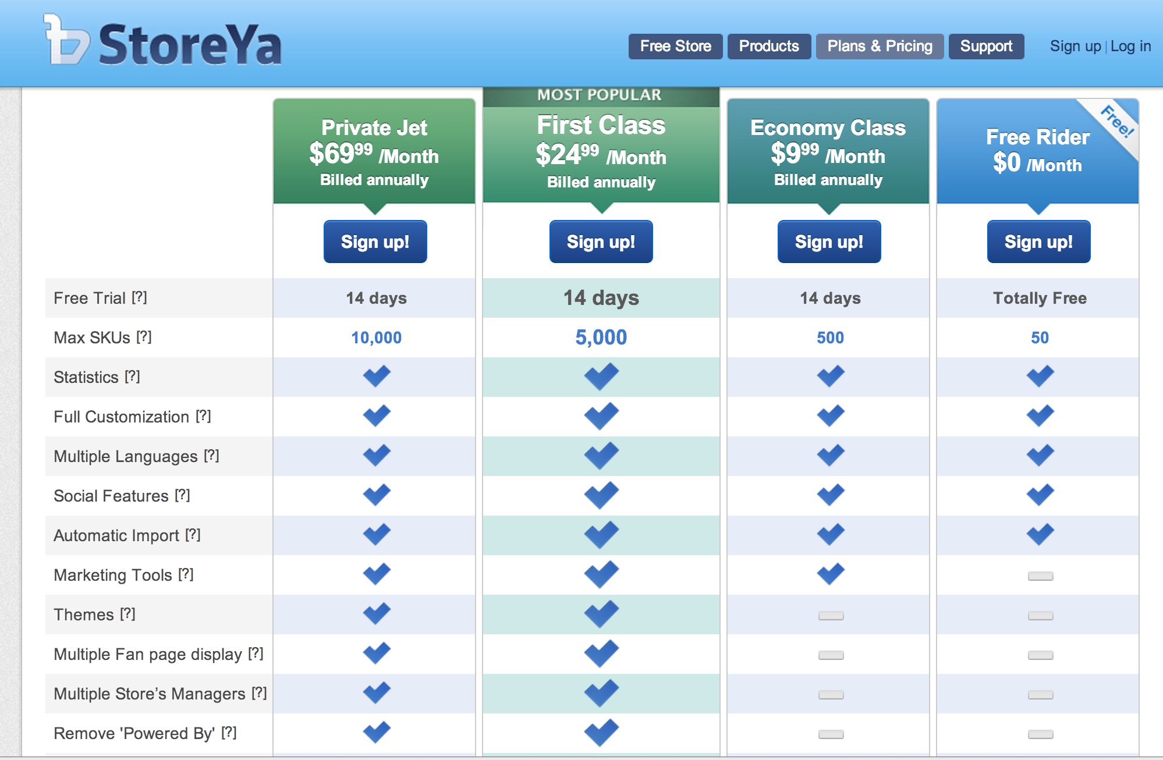
25% off your
first payment
monthly or annually
Coupon: SHOP.com

Slide 71
.
Notes:
71

