Slide 1
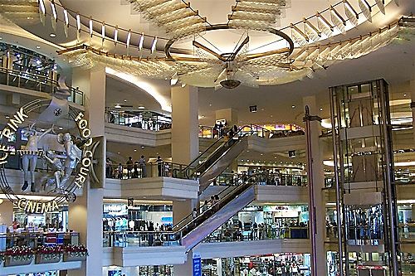
Online shopping centre

Slide 2
Do you know what you have?
Hundreds of exclusive Market Australia branded products
Over 600 partner stores
You have to shop at your own shopping centre so you know how to show others

Slide 3
Do a Web Portal Tour
Show your preferred customers how to shop online
For Market Australia product
For partner store products

Slide 4
Don’t shop for your customers
Don’t buy the products in
Delivery to them
And collect money

Slide 6
Teach your customers to be independent
Customers do their own shopping
They shop online
They pay online
Market Australia ship the products out
Increase share of customers
Sale don’t stop when you are away!

Slide 7
Shopping MA branded products
You earn retail profit & BV
& referral cashback!

Slide 8
Referral cashback $29.26

Slide 9
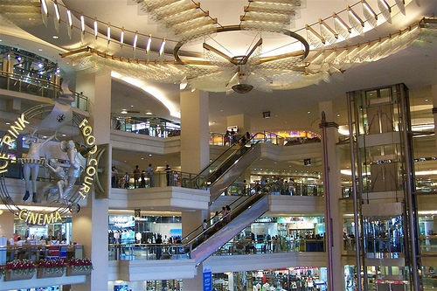
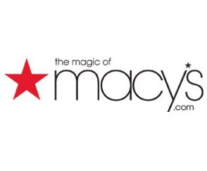
Online shopping centre
au.shop.com
2%
2%
3%
3%
0%
4%
2%
0%
5%
2%
4%
0%
4%
2%
5%

Slide 10
Earning cashback & IBV for your own shopping
Accor Hotel 2% cashback 4% IBV
Always On Sale 5% cashback 4% IBV
Apple Store 2% IBV
ASOS 4% cashback 4% IBV
Dan Murphy 3% cashback 4% IBV
Big W 2% cashback 4% IBV
Cartridge Sale 3% IBV
Webjet 4% cashback 4% IBV
Rebel Sports 4% cashback 4% IBV
Styletread 5% cashback 5% IBV

Slide 11
December best time to earn cashback & IBV

Slide 13
IBV Bonus Pool
Congratulations ! You have 67.50 IBV available for you to place within your organization* from the Advertising Bonus Pool.
ie. 67.50 x 4 = 270 IBV

Slide 14
The power of leverage
Example
5 people on each side qualify for IBV bonus pool
5 x 270 = 1350 IBV
That is $300 IBV commission!
20 people on each side qualify for IBV bonus pool
20 x 270 = 5400 IBV
That is $1500 IBV commission!

Slide 15
The power of leverage
If 200 people in this room earn $500 cashback in a year
How much cashback do we all get in total?
$100,000

Slide 16
Don’t leave money on the table
Change your buying habit
Change the way people shop
Shop in your online shopping centre!
YOUR OWN WEB PORTAL!

Slide 17
ONLINE SHOPPING
auWebCentres

Slide 18
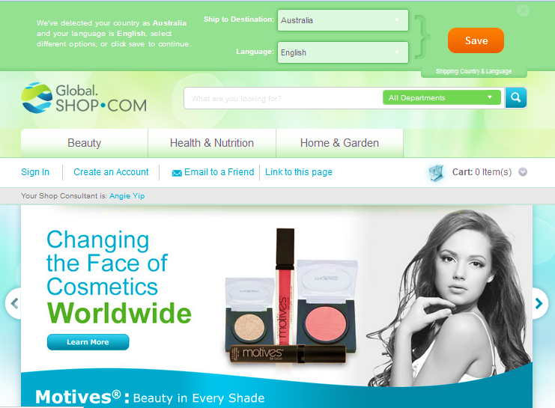
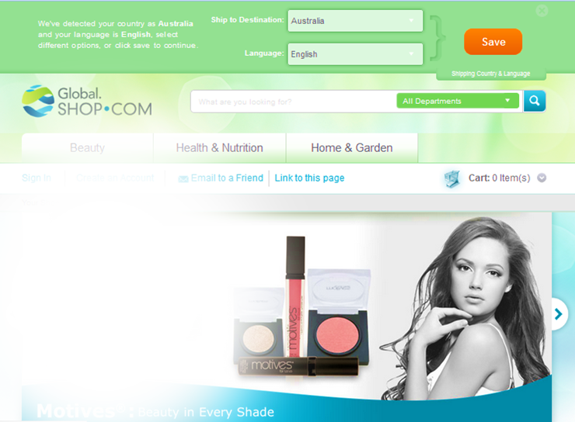
from AFGHANISTAN
OVER
200
COUNTRIES
to ZIMBABWE

