Slide 1
The ma Shopping Annuity
Turning Spending into Earning
The Logic and Reality

Slide 2
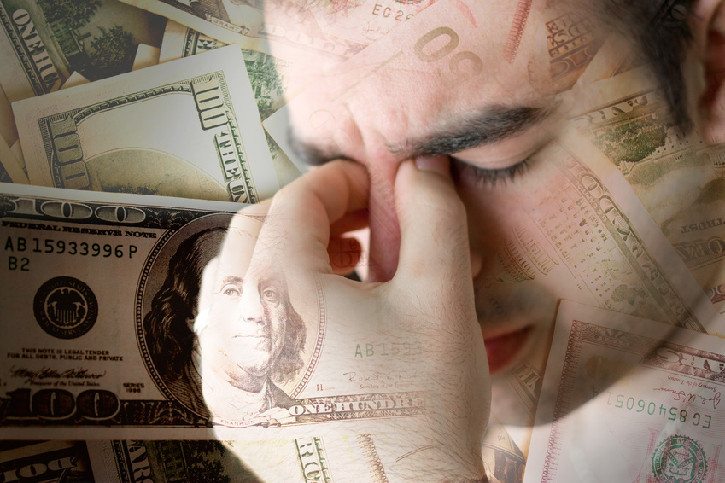
The economy of a nation begins with their production versus their consumption.
And, so is for a state, province, community and you.

Slide 3
The power of you, “the consumer”... how does it fit, and how should it be? What is and what isn’t?

Slide 4
The consumer is the last link in the distribution chain.

Slide 5
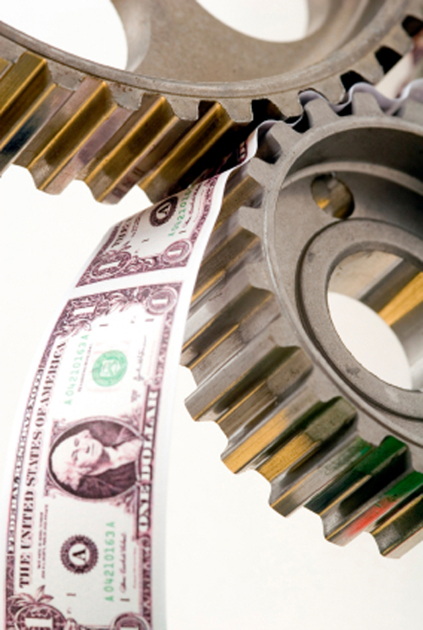
Consumers are the clients... the people who come in the door, buy a product or service, and keep the proverbial money machine cranking.
We are all consumers, and we can’t help it. You name it, we buy it!

Slide 6
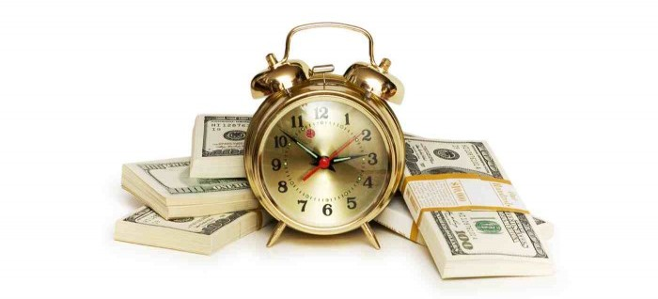
Time is money...
RIGHT?

Slide 7
After all, look at your life. Your working life.
Time in to make ends meet and a little left over.
You want more money. It takes more time. Where does that time come from?

Slide 8
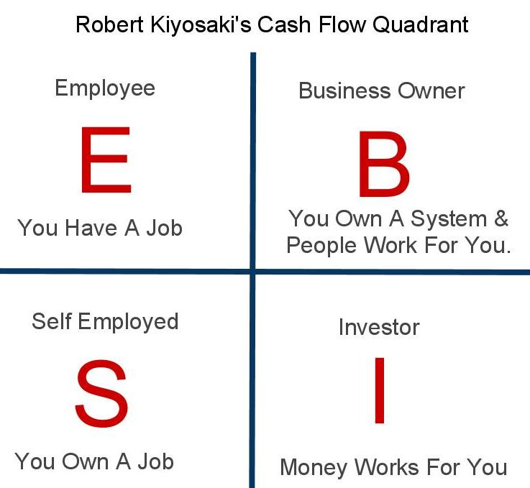
People Offer Solutions

Slide 9
The Future Solution...
Consumers purchasing to create residual income!

Slide 10
The Future Solution...
The evolution... customers will be paid for their purchases.

Slide 11
The Future Solution...
Customers who influence other customers. There will be more pay for that!

Slide 12
Consumer Power
We have always had it...we just did not know we did.
We certainly did not know how to organise it for profit. Then…..
Note: We did know how
to organise it for savings
with the buying clubs.

Slide 13
Consumer Power “The Next Level”
Internet and personal computers,
mobile devices...tablets and phones.
What if it were possible to create an income by generating profits from goods and services you are already paying for...
And, if you could create an income from what other people would earn from the purchases of goods and services they already were paying for?

Slide 14
What if...no way, totally too good to be true!

Slide 15
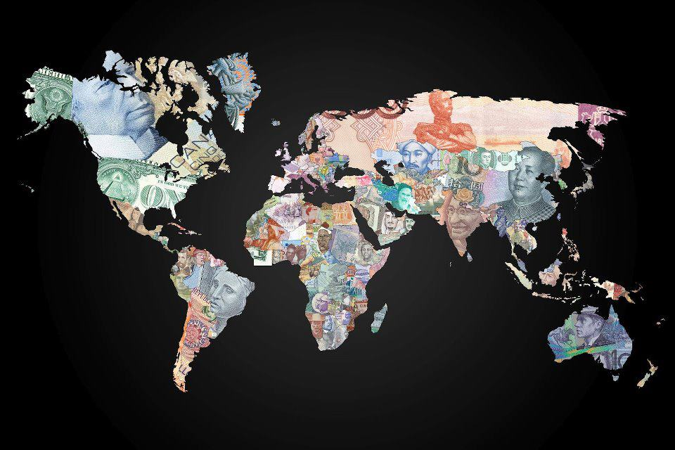
Think about it..
It’s not love, but money that keeps the world’s machinery running.
Money is the medium of exchange for goods and services.
When money is not moving, neither are you!

Slide 16
Money extends your
personal power!

Slide 17
It is not just
“time is money.”
It is also
“more money creates free time.”

Slide 18
CONSUMERS
If money makes the world go around, who makes the money go around?
create the demand
and buy and pay the bills!

Slide 19
Consumers
drive the entire economy
at every level!
No consumers, no profits.

Slide 20
THINK ABOUT IT!
There are manufacturers, middle men, wholesalers, and retailers. But, without the consumers buying and paying...?

Slide 21
YOU, the consumer!
So, who is important?

Slide 22
YOU, the consumer!
BUT...
of all the people in the profit chain, who is the only one who gets excluded?

Slide 23
Wait a minute...
You get the product or service. So, why should you get a profit?
Because, you drive the market. No you, no market, no economy.

Slide 24
So, why have we not recognised this before?
Because, you are conditioned from generations before you not to have it.

Slide 25
Times Are Changing
The Internet, online shopping, social networks, social shopping...
“consumers hold the proverbial power”...
online and through word of mouth!

Slide 26
Where will the money come from?
The billions of dollars spent on advertising?
Have you looked at the landscape lately for advertising?
Have you gone online lately?

Slide 27
The Hard Reality
You can’t do it by yourself. Alone you are not very powerful. But, in a group of 10 to 20, this can become hundreds, then thousands. Things begin to happen!

Slide 28
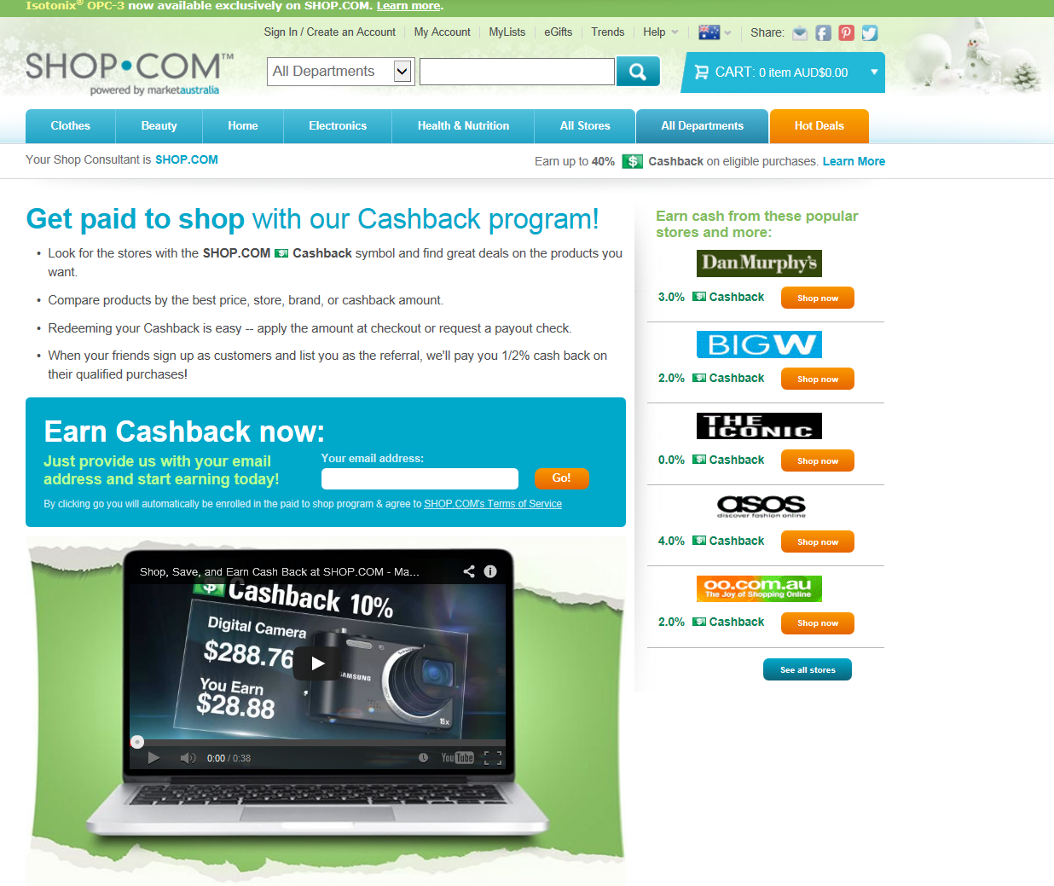
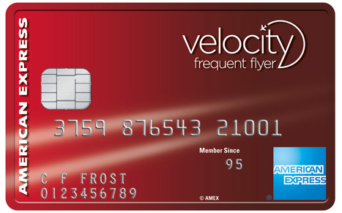
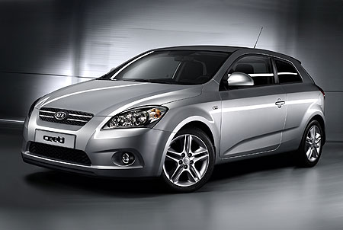
Today and The Future
People are earning cash back shopping online, using credit cards, buying a car...

Slide 29
Today and The Future
Communities of people are becoming entrepreneurs in online internet businesses.
They are not limited by geographic locations.
They are earning cash back and a compensation from the cumulative sales of products and services being sold to consumers, both as customers and independent business owners.

Slide 30
Today and The Future
People are building teams...digital communities that organise and incent consumers to leverage their consumer buying power.

Slide 31
Welcome to the FUTURE!
Welcome to Market Australia...a product brokerage and internet marketing company specialising in one-to-one marketing and social shopping.

Slide 32
Welcome to MARKET AUSTRALIA!
A company that provides a way for entrepreneurs to create wealth through ongoing income by changing the way people shop through the power of technology and people creating the economy of the future!
We are an internet based distribution business and initiators of the Shopping Annuity where you can turn your spending into earning.

Slide 33
CHANGING THE WAY PEOPLE SHOP
SHOPPING ANNUITY

Slide 34
How do we put that all together?
People have less $,
NO $ to Save or Invest
Tracking System to track all orders
People must SHOP/Spend to Live
(Tighten Belt)
Automation Program to find what you are buying
We provide Shopping & Savings for everyone
MA Products to Brick and Mortar, Value, Savings are Better
Brick and Mortar to Click and Order

Slide 35
Is this feasible? How could that be possible with the UnFranchise Business? Consider what we have.
UFO’s tied in vertical distribution
Customer tracking + accrual: Ever see a “good” movie
UFOs are economically linked in the MPCP
Mall without Walls –Better solutions at a better price or value
Product Brokerage System
Shopping site with everything
/

Slide 36
Social
Shopping

Slide 37
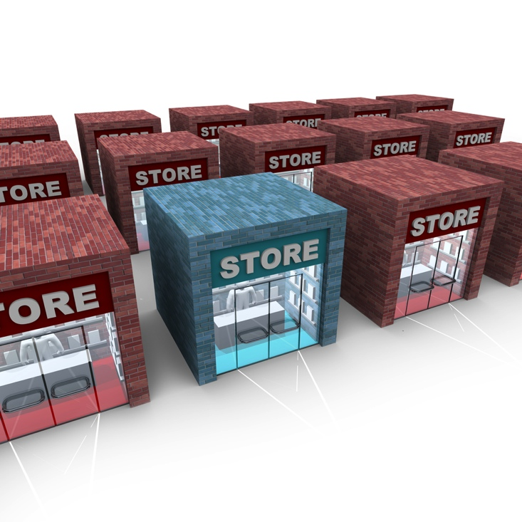
BRICK AND MORTAR
Brick and Mortar

Slide 38
Click and Order

Slide 39
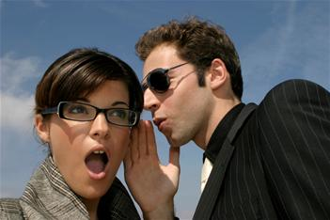
WORD OF MOUTH

Slide 40
WORD OF MOUSE

Slide 41
Why Will It Work...
People Power: monetised network of UFOs.
Economic glue exists between UFOs.
Customer tracking system tied to UFOs and the MPCP.
An automated way to find everything you buy and compare prices and make a list + ORDER!
Home Advisor.
Automation and transparency to do the assessment, translate it into a MyList, customisation of list, functionality of list and back office, user experience driven.

Slide 42
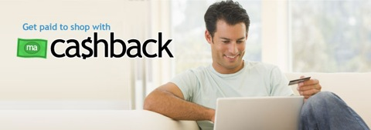
Popular Partner Stores
2% Cashback
4% Cashback
3% Cashback
2% Cashback
2% Cashback

Slide 43
Top NEW Stores Added in 2013 Australia
Big W
Sony Australia
Dyson Australia
HP Australia
Hotwire Australia
ASOS
Bonds Outlet
Menulog
TOMS
Princess Polly
WOW Sight & Sound
Peter Alexander
Missguided
ePharmacy
Gray’s Online
Dollar Shave Club
Wayfair Australia
Sportscraft
FAB
Bookworld

Slide 44
Partner Stores Growth Australia
252 NEW Partner Stores added in 2013
Added over 1.4 million products to search in 2013
2013 Partner Store sales increased nearly 100% over 2012

Slide 45
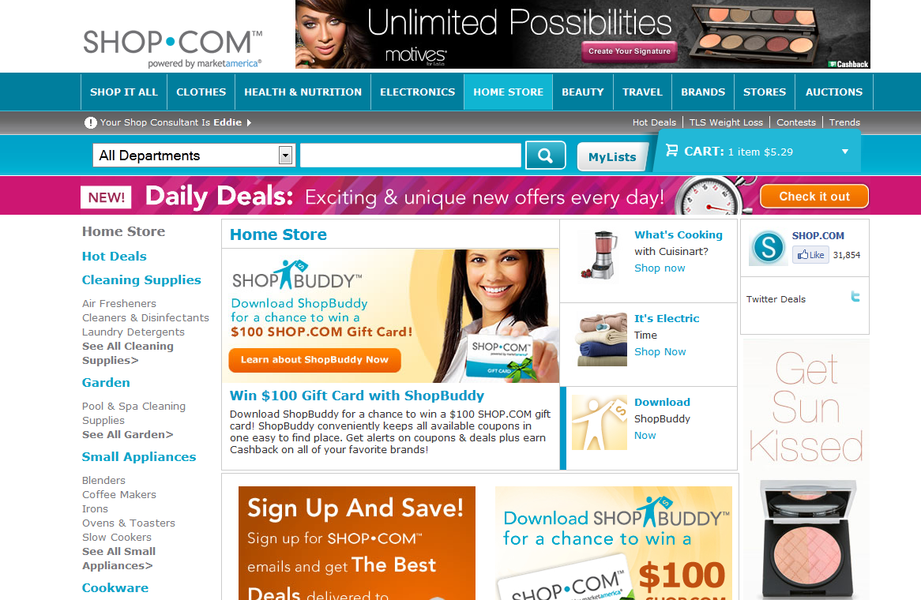
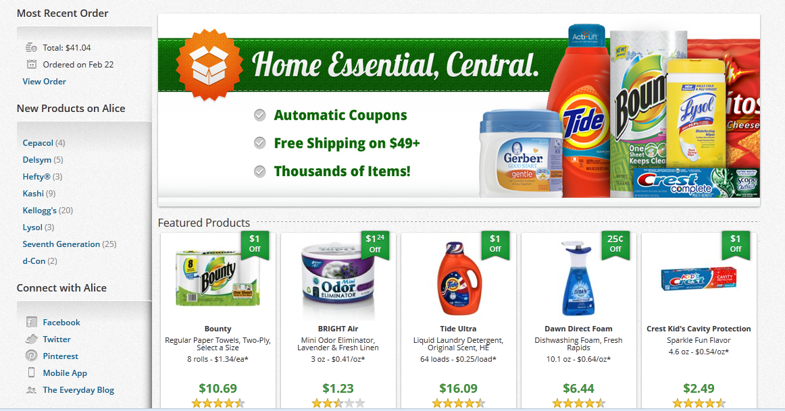
es
SHOP.COM - Tomorrow
Immediate wins make it even easier for consumers to turn spending into earning – creating an annuity out of home essentials.
CPG –Specific Categories & Filters
Personalized product recommendations
Manufacturer funded coupons
Coupon targeted to repeat customer

Slide 46
We have partnered with
Customised transparent product recommendations for each customer!

Slide 47
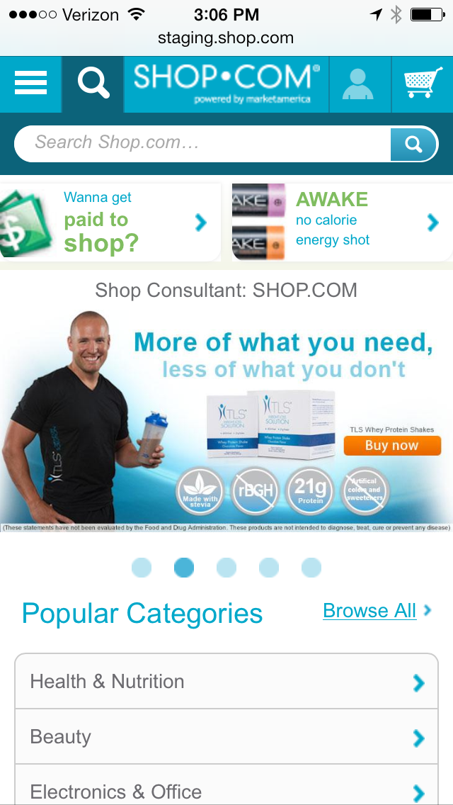
SHOP.COM Mobile (Personal URLS)
SHOP.COM Application
Launch
in Australia
October 2014

Slide 48
What are people looking for with online shopping?
Convenience. User-friendly. Simple. Fast.
Eliminate having to go to the store.
Save extra dollars in gas, wear and tear on car, parking, and time.
Get everything you order and consume each month delivered to your doorstep with a single click of a mouse.
Free shipping with AutoShip.

Slide 49
We can demonstrate the savings!
Comparison Shopping
Hot Deals + Coupons
ma Products – through you...
(Explaining savings or value and your personal experience from using the product yourself.)

Slide 50
Paid To Shop
Paid To Share

Slide 51
What’s your time worth?

Slide 52
18 minutes - per day - on the avg. driving to stores
109 hours - per year
$63,685 - annual household income
$30.54 - per hour
$3,328 - per year
YOU’RE WORTH MORE!!!
Wasting valuable time.
Spend time with family, hobbies, etc.
Doing things that are important to you.

Slide 53
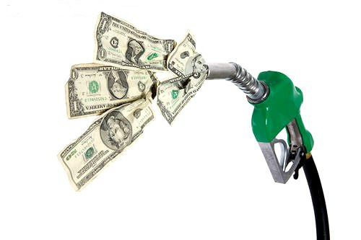
Avg. spent on gas per year - $4,659.20
40% gas used to go shopping
$1,863.68 wasted on gas.
When you can buy the same things
online and save money!

Slide 54
Doesn’t account for...
Store is out of stock.
They don’t have your size or colour.
You want and you have to drive somewhere else.
No one to help you in the store.
Finding a parking space.
Carry the bags yourself.
Time to find and cut the coupons from the newspaper.
Wear and tear on your vehicle = $1,627.00.

Slide 55
STARTING THE CLIMB
Shopping Annuity Plan
10
Duplicate in Groups
9
Shop Points – (IBV)
8
7
Cashback
6
PC’s – Recommendation
5
Auto Ship
4
Generate Fast Order to Cart
3
My List
2
Home Shopping List
1
Home Advisor
Assessment

Slide 56
Shopping Annuity Plan & Projection document or agreement provided in printout and digitally.
Deliver a Shopping Annuity Plan - (Document + Agreement) providing:
SHOP.COM Portal and Shopping Rewards Program with Shop Points – (IBV)
Spending and Shopping Profile by Category
My List - (personal shopping data base)
Projected Savings per Month
Total committed shopping dollars to Transfer Buying to fund Shopping Annuity
Savings in time, gas, convenience = calculated estimated total dollars or pounds
Projected total residual income from Shop Points for referring customers or clients
Shopping Annuity projected residual income to a UFO

Slide 57
SHOPPING ANNUITY FUNDING PLAN
P
P
P
P
P
P
P
P
P
P
P
P
P
P
P
P
P
P
P
P
P
P
P
P
P
P
P
P
P
P
P
P
$600
P
P
P
P
P
P
P
P
P
P
$600
$600
P
P
P
P
P
P
P
P
P
P
$600
400 BV
400 BV
400 BV
400 BV
P
P
P
P
P
P
P
P
P
P
P
P
P
P
P
P
P
P
P
P
P
P
P
P
P
P
P
P
P
P
P
P
P
P
P
P
P
P
P
P
P
P
P
P
P
P
P
P
P
P
P
P
P
P
P
P
P
P
P
P
P
P
P
P
P
P
P
P
P
P
P
P
P
P
P
P
P
P
P
P
P
P
P
P
P
P
P
P
P
P
P
P
P
P
P
P
P
P
P
P
P
P
P
P
P
P
P
P
P
P
P
P
P
P
P
P
P
P
P
P
P
P
P
P
P
P
P
P
P
P
P
P
P
P
P
P
P
P
P
P
P
P
P
P
P
P
P
P
P
P
P
P
P
P
P
P
P
P
P
P
P
P
P
P
P
P
P
P
P
P
P
P
P
P
P
P
P
P
P
P
400
400
400
400
400
400
400
400
400
400
400
400
400
400
400
400
165
165
165
165
165
165
165
165
165
165
165
165
165
165
165
P
P
P
P
P
P
P
P
P
P
P
P
P
P
P
P
P
P
P
P
P
P
P
P
P
P
P
P
P
P
P
P
P
P
P
P
P
P
P
P
P
P
P
P
P
P
P
P
P
P
P
P
P
P
P
P
P
P
P
P
P
P
P
P
P
P
P
P
P
P
P
P
P
P
P
P
P
P
P
P
Earn > $2,100, from BV, per week after twenty-four months
Notes:
9
11

Slide 58
CHANGING THE WAY PEOPLE SHOP
SHOPPING ANNUITY

