Slide 1
NEW PRODUCTS
AUSTRALIAN ANNUAL CONVENTION
2014
auWebCentres

Slide 2
Home & Garden

Slide 3
Snap™ Products – The Beginning
Snap originated in 1995
Safe, concentrated, plant-based ingredients
Environmentally-friendly before its time
Many Snap products are…
Biodegradable
Phosphate-free
Non-toxic
Use recyclable bottles
Notes:
From the beginning snap was formulated with the environment in mind. When it originated in 1995, Snap was using plant-based ingredients and was biodegradable, phosphate free and nontoxic and using recyclable bottles. But what does that mean to you?
Non toxic
Not poisonous, harmful, or otherwise destructive upon exposure.
Biodegradable
Capable of being decomposed by natural processes
Readily and inherently biodegradable as tested by OECDG 302 Testing Guidelines
Phosphate free
Phosphates, salts of phosphoric acid, are sometimes used in detergents.
Leach into rivers & waterways
Serve as food source for algae resulting in excessive algae growth reducing oxygen levels in water which kills native fish and other aquatic creatures.
In the pursuit of keeping Snap Ecofriendly we are always looking to reduce our environmental impact and to use ingredients in our formulas that meet that criteria.
We consult with CleanGredients to ensure quality formulations during development and in our latest reformulations of Snap. Cleangredients is designed to:
help formulators identify ingredients that have potential environmental and human health and safety benefits. CleanGredients is an online database of cleaning product ingredient chemicals, providing verified information about the environmental and human health attributes of listed ingredients. CleanGredients is a project of GreenBlue®, a nonprofit that equips business with the science and resources to make products more sustainable. For more information on Cleangredients check out their website.
In keeping Snap green our vendor minimizes the carbon footprint through creative recycling and conservation projects. Currently they recycle nearly 1 mill pounds of plastic and corrugated recycled annually
In addition we always seek to keep Snap formulas kid, pet and septic system safe

Slide 4
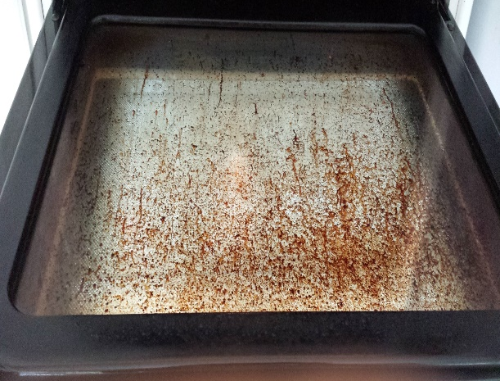
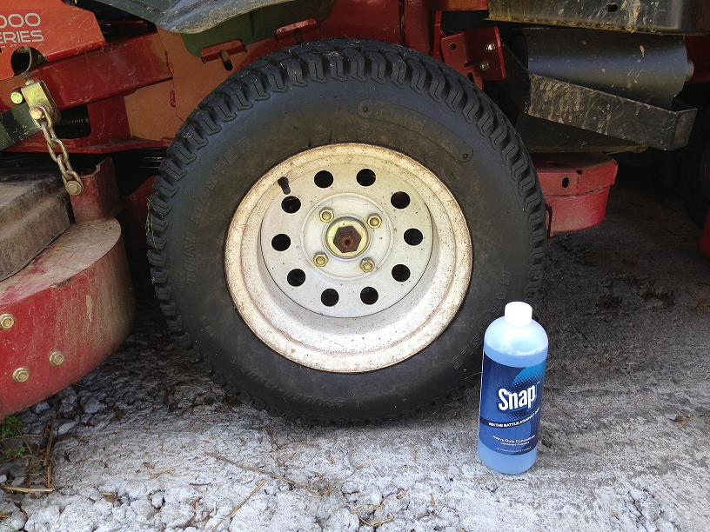
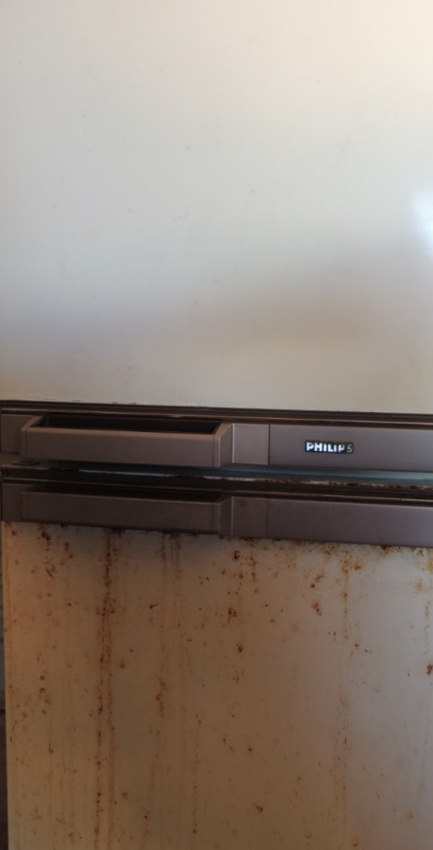
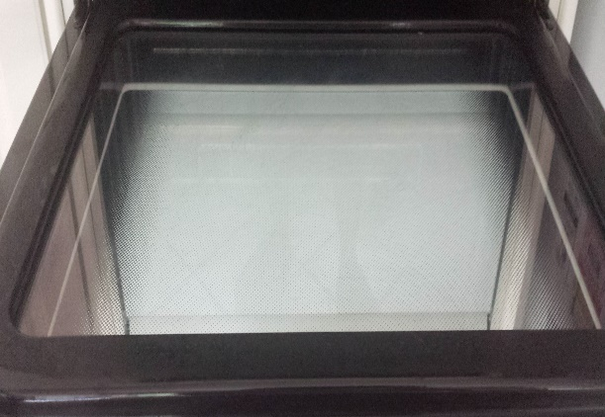
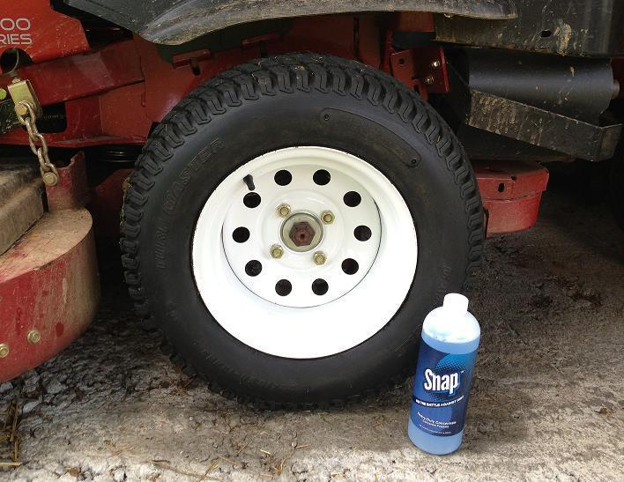
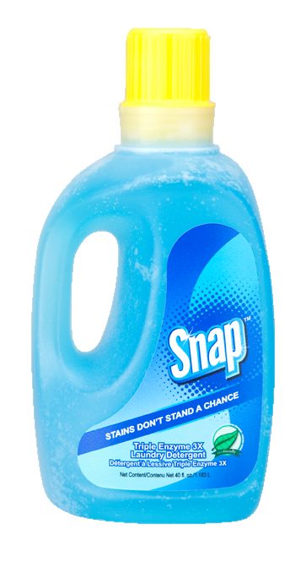
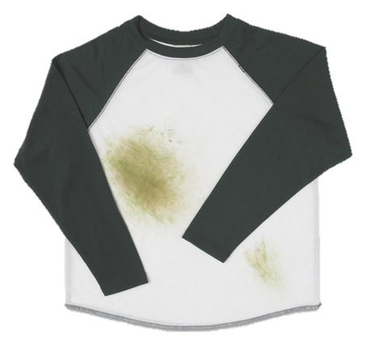
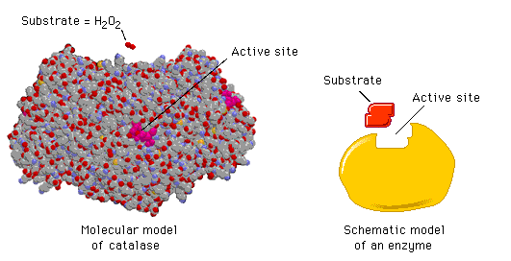
Current Snap™ Range
gentle
All-Purpose Natural Concentrate
Heavy-Duty Concentrate
Scouring Deep Cleanser
Dishwashing Liquid
Triple Enzyme 3X Laundry Detergent

Slide 5
Coming to your Store
Home & Garden

Slide 6
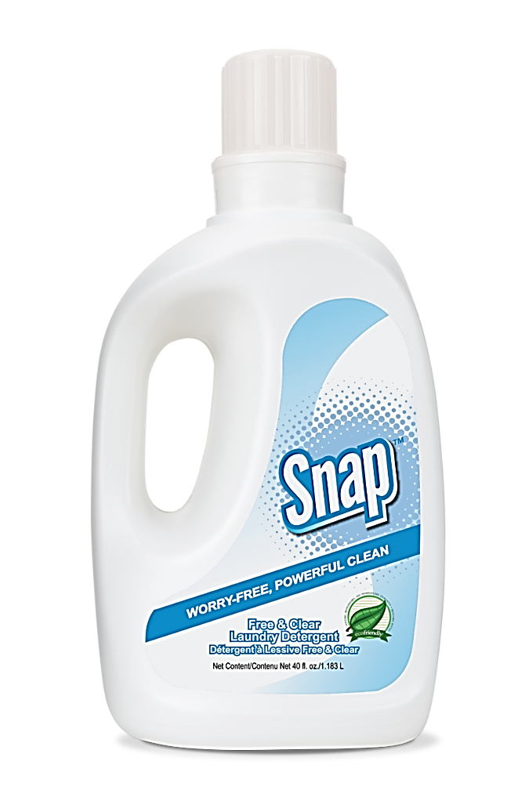
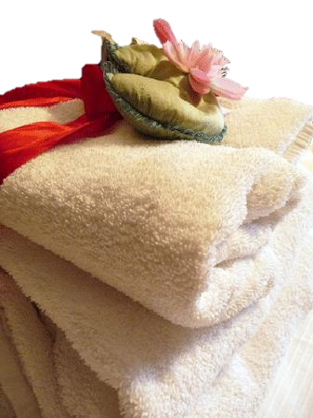
Snap™ Free & Clear Laundry Detergent
Primary Benefits:
For use in front and top-loading washers
Cleans in all water temperatures
Safe for delicates and baby clothes
One bottle does up to 80 loads of laundry
Hypoallergenic
Dye free
Fragrance free
Economical
Highly concentrated
High Efficiency (HE) Friendly
Environmentally-friendly

Slide 7
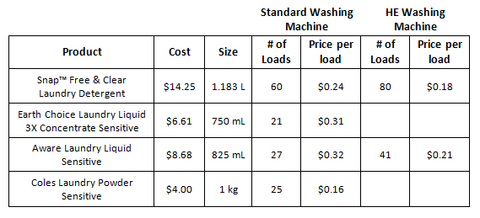
Snap™ Free & Clear Laundry Detergent
Product Comparison

Slide 8
Snap™ Free & Clear Laundry Detergent
Code: 76228
DC: $10.25
SR: $14.25
BV: 5.25

Slide 9
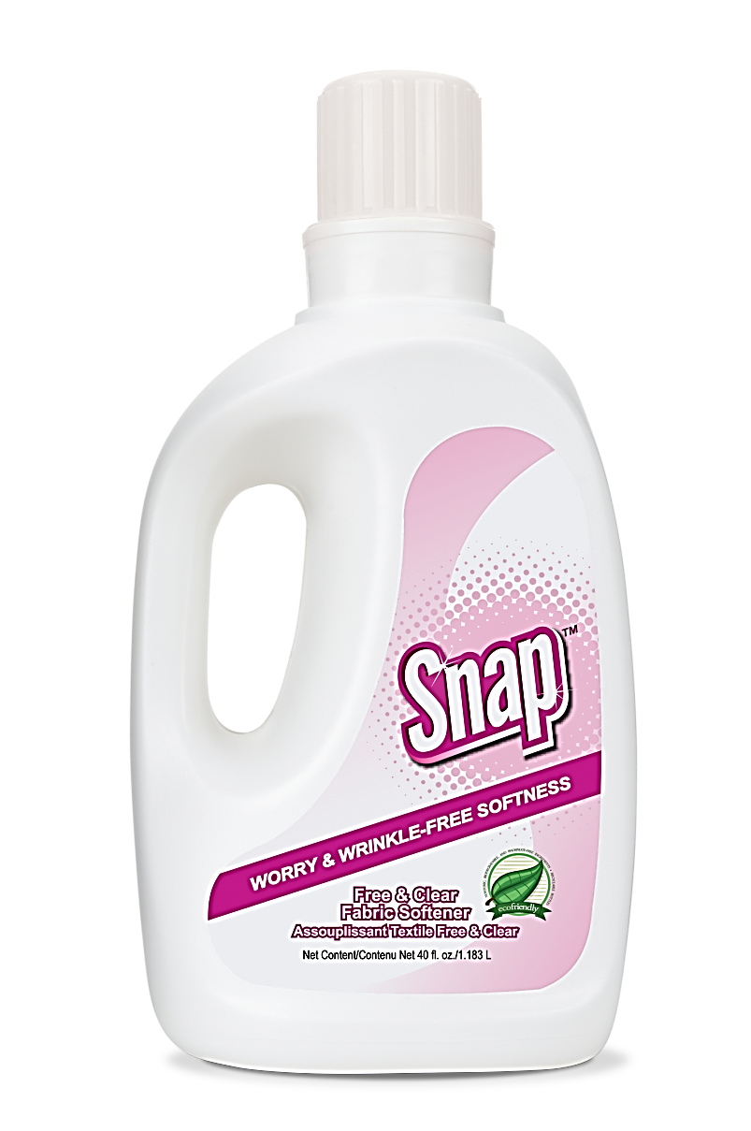
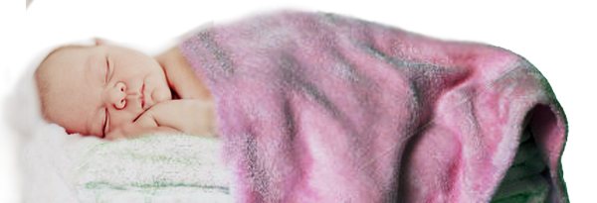
Snap™ Free & Clear Fabric Softener
Primary Benefits:
For use in front- and top-loading washers
Leaves clothes fresh and soft
Safe for delicates and baby clothes
One bottle softens up to 80 loads of laundry
Eliminates static cling
Hypoallergenic
Dye free
Fragrance free
Economical
Highly concentrated
High Efficiency (HE) Friendly
Environmentally-friendly

Slide 10
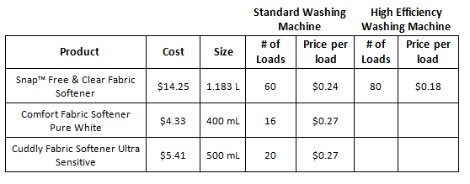
Snap™ Free & Clear Fabric Softener
Product Comparison

Slide 11
Snap™ Free & Clear Fabric Softener
Code: 76229
DC: $10.25
SR: $14.25
BV: 5.25

Slide 12
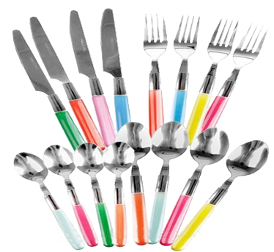
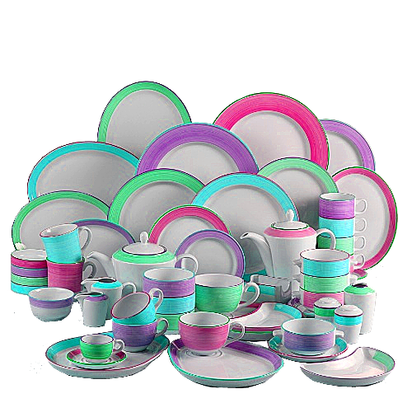
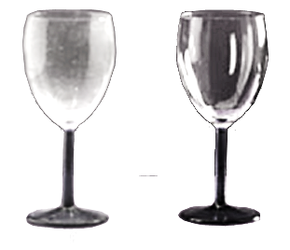
Snap™ Crystal Clean Automatic Dishwashing Crystals
Primary Benefits:
Blasts off dried foods and baked-on solids without the need to pre-wash
One container does up to 120 loads of dishes
Increased rinsing action eliminates water spots and residue
Safe for dishwasher-safe porcelain and fine china
Will not tarnish pots and pans
Biodegradable, phosphate free and safe for septic systems
Contains no dyes, perfumes, EDTA or NTA

Slide 13
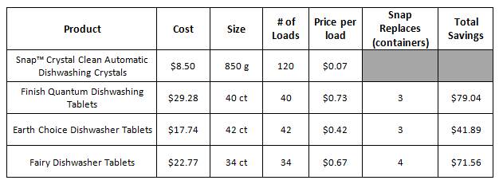
Snap™ Crystal Clean Automatic Dishwashing Crystals
Product Comparison

Slide 14
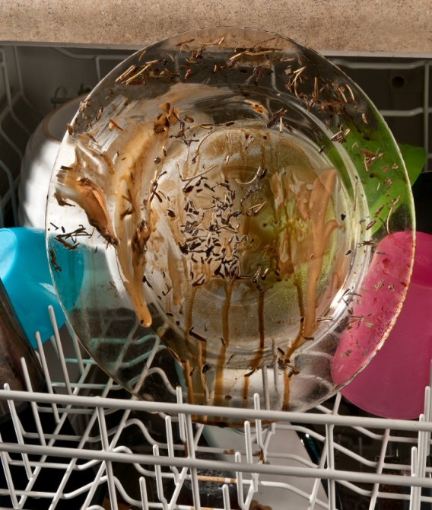
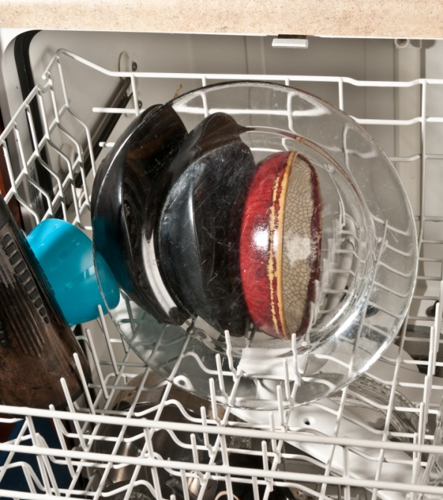
Before After
Snap™ Crystal Clean Automatic Dishwashing Crystals
Notes:
Here you can see the before and after of a clear glass dish. Stuck on food residue was washed easily away with the new reformulated dishwashing crystals. Keep in mind these three main contributing factors to the effective use of Snap Crystal Clean Automatic Dishwashing Crystals. If you have hard water you will want to add slightly more than ½ tablespoon of the dish crystals into your dishwasher to improve cleaning ability. Water temperature is key to proper dissolving of the crystals to effectively remove stains and residue. Use hot water at approximately 150° F. Check the setting on your water heater to ensure proper temperature. Finally, unless you have hard water, use no more than the ½ tablespoon recommended. A little goes along way with Snap Crystal Clean Automatic Dishwashing Crystals

Slide 15
Snap™ Crystal Clean Automatic Dishwashing Crystals
Code: 76217
DC: $6.00
SR: $8.50
BV: 2.00

Slide 16
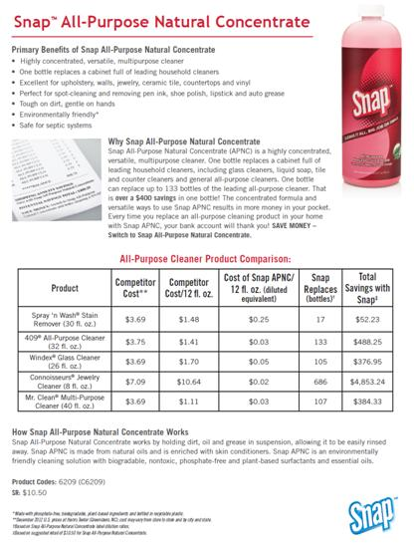
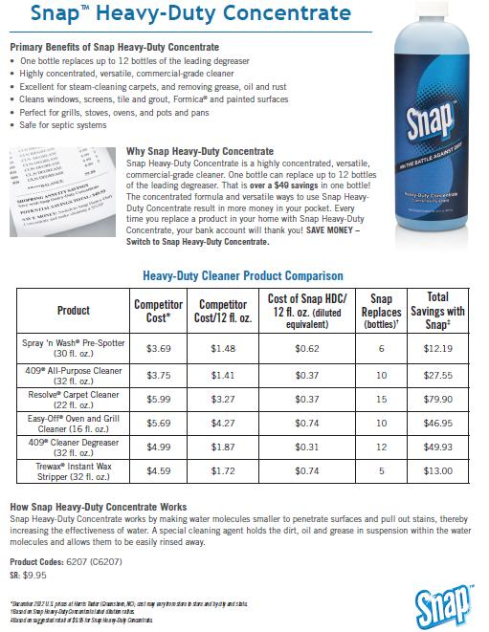
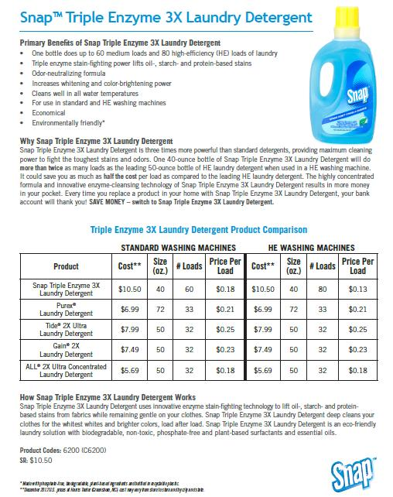
Snap™ Product Information Sheets
Available as a Download on unFranchise.com.au

Slide 17
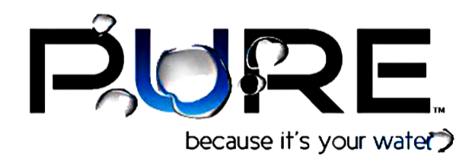

Slide 18
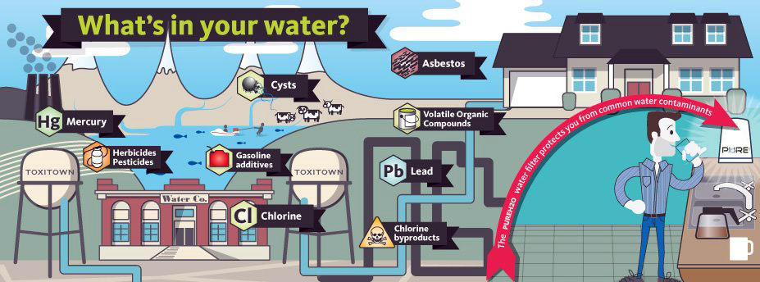
Most of these contaminants are categorized as a
VOC, SOC or heavy metal.
Lead • Mercury • Chlorine • THM’s • HAA’s • Herbicides • Pesticides • Gasoline Additives
Heavy Metal
Heavy Metal
VOC
VOC
VOC
SOC
SOC
VOC

Slide 19
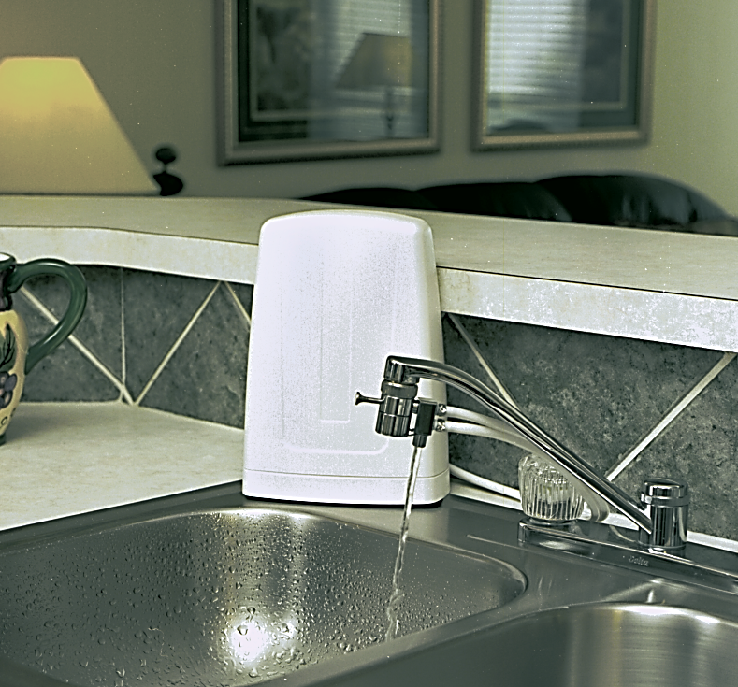
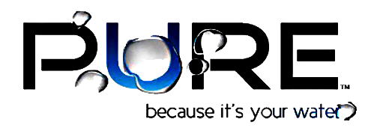
POINT OF USE
WATER
TREATMENT
It’s not just the
best way to be
sure about the
quality of your water
IT’S THE ONLY WAY!
Code: 714031
DC: $88.00
SR: $120.00
BV: 25.00
VERY LOW COST OF OWNERSHIP

Slide 20
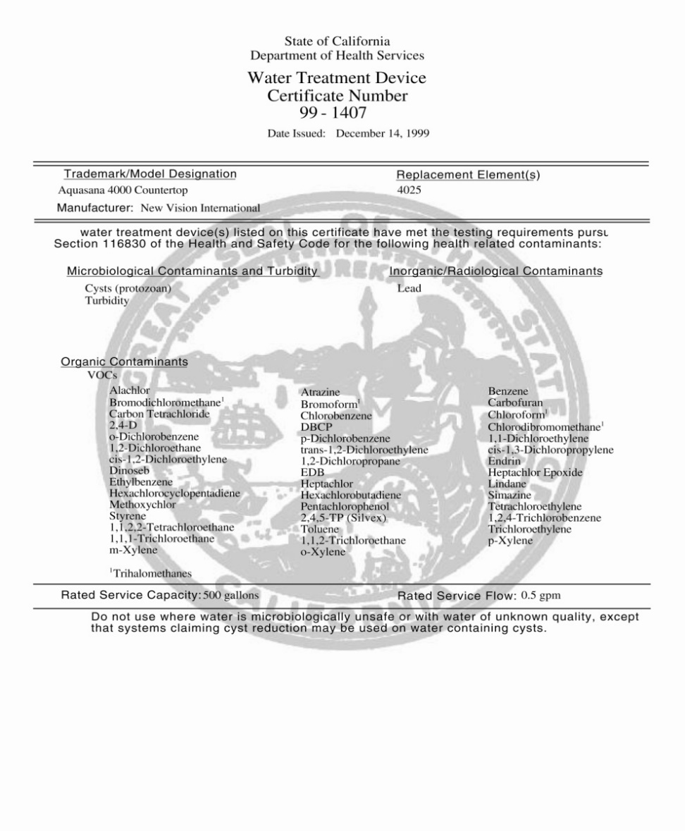
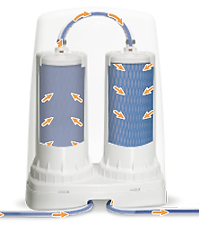
With a Dual Filter system
Stage 1 – A cartridge
Reduces sediment, tiny microscopic particles and chlorine taste and odor
Stage 2 – b cartridge
Features a complex ion exchange process that enhances the mineral balance of water while reducing the lead
Activated carbon removes volatile organic compounds (VOC) and synthetic organic compounds (SOC)
Notes:
Removes over 99 % of impurities from our water system, certified by Underwriters Laboratories

Slide 21
Take your Daily Shower
Tap water contains at least as much, if not more, chlorine than is recommended for use in swimming pools
Negative effects of chlorine in showering water
Creates elevated levels of chloroform
In household air
Enters the body through dermal
absorption and inhalation
Harsh, drying effects on skin and hair
Can cause rashes and other skin
irritations when absorbed by the skin

Slide 22
References
http://www.manageyourlifenow.com/importance-of-drinking-water-for-a-healthy-body/
http://www.mangosteen-natural-remedies.com/benefits-of-drinking-water.html
http://www.epa.gov/oppt/existingchemicals/pubs/tscainventory/basic.html
http://water.epa.gov/drink/contaminants/basicinformation/index.cfm
http://greenliving.nationalgeographic.com/water-bottle-pollution-2947.html
http://www.back2tap.com/resources/get-the-facts/your-tap-water/
http://www.allaboutwater.org/
http://water.epa.gov/drink/info/lead/
http://australianmuseum.net.au/BlogPost/Science/Interesting-plastic-facts
http://coolaustralia.org/bottled-water-secondary/
http://www.gotap.com.au/en/Did%20you%20know/Facts.aspx
http://australianmuseum.net.au/BlogPost/Science/Say-no-to-plastic-water-bottles
"A long, hot shower can be dangerous. The toxic chemicals are inhaled in high concentrations." Bottom Line Health, Aug. 1997, J Andelman, Ph. D.
"Taking showers is a health risk, according to research presented last week in a meeting of the American Chemical Society. Showers, and to a lesser extent baths, lead to a greater exposure to toxic chemicals contained in water supplies than does drinking water. The chemicals evaporate out of the water and are inhaled. They can also spread through the house and be inhaled by others." - New Scientist -18 September 1986, Ian Anderson
"Showering is suspected as the primary cause of elevated of chloroform in nearly every home because of the chlorine in shower water. Chloroform [a known carcinogen] blood levels increase up to 100 times during a ten-minute shower in residential tap water" - Environmental Protection Agency - Dr. Lance Wallace

Slide 23
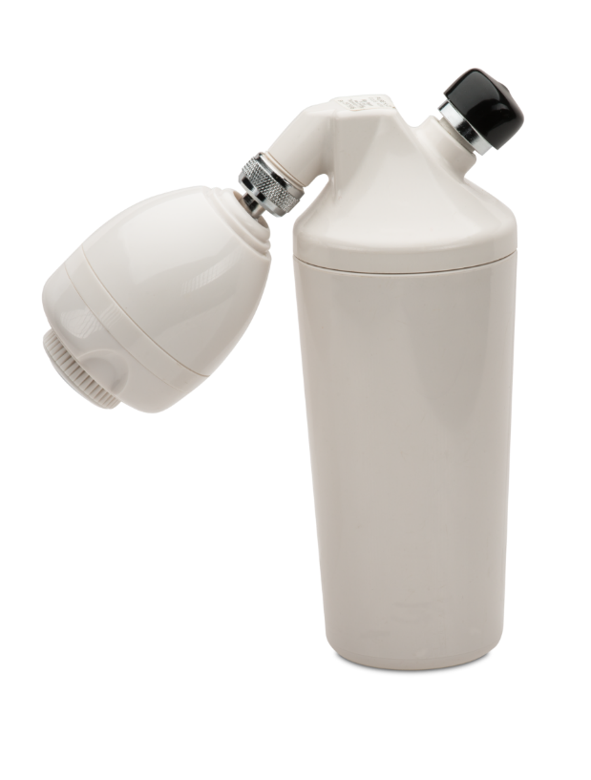
Install a Shower Filter
Reduce harmful exposure to chlorine and other chemicals
Greater respiratory health by reducing inhalation of chlorine and other chemicals
Better air quality throughout the house
Softer, healthier skin and hair

Slide 24
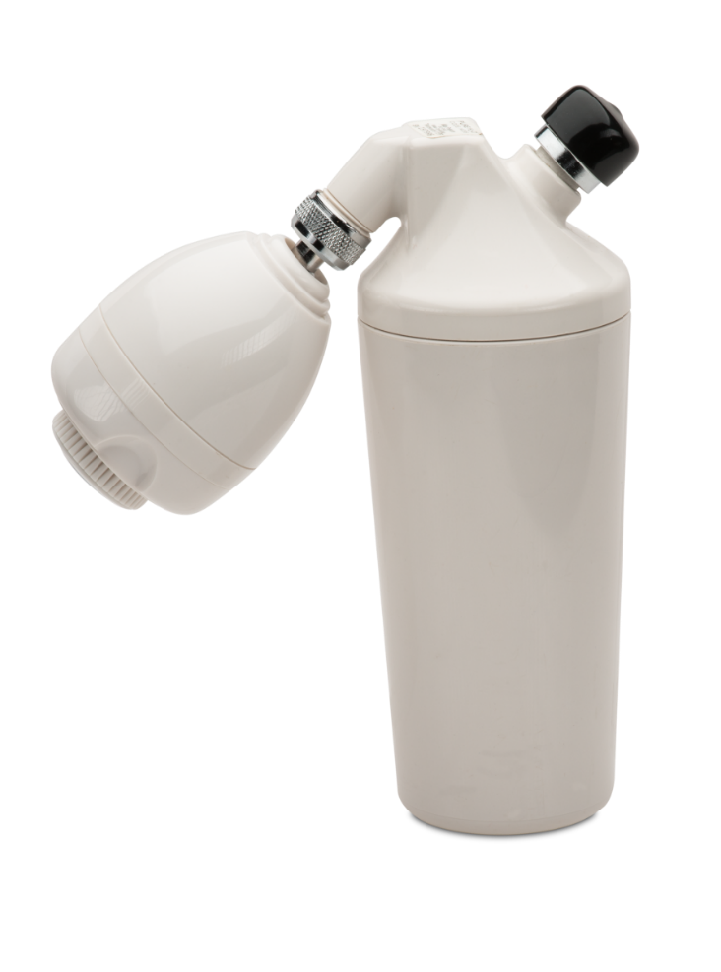
Why PureH2O™ Shower Filter?
Reduces chlorine and balances the water pH level
Filters out the harmful volatile organic compounds (vocs)
Provides clean, refreshing shower water before it reaches your body
Promotes healthy hair and skin
Easy installation and has a 37,854 litre capacity

Slide 25
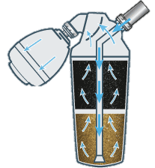
How it Works?
Stage 1: uses a KDF-55 medium for the reduction/removal of Chlorine, certain Heavy Metals and slight pH enhancement.
Stage 2: uses a carbonized coconut shell medium for the reduction of synthetic Chemicals and voc’s.
Stage 2
Filters Synthetic Chemicals
Stage 1
Filters Chlorine
Enhances pH

Slide 26
PureH2O™ Shower Filter
Shower Filter
Code: 714035
DC: $86.25
SR: $121.00
BV: 35.00
Replacement Filter
Code: 714036
DC: $34.50
SR: $48.00
BV: 10.00

Slide 27
NEED = OPPORTUNITY
Less than 1% have Shower Filters.
Hardest part is getting the customer,
Easiest and most valuable... Is keeping them!
99%

Slide 28
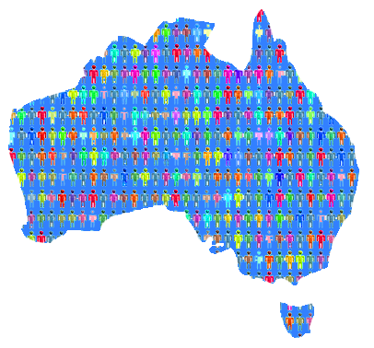
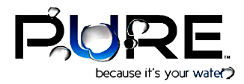
TECHNOLOGY
SCIENCE BASED
99%
auWebCentres

Slide 29
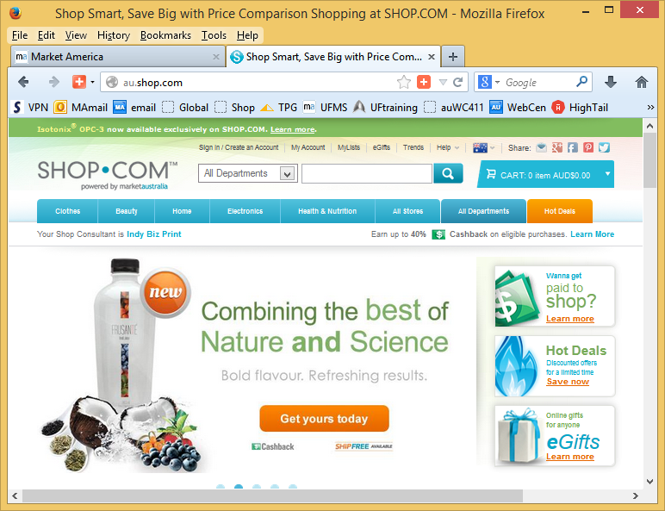
99%
auWebCentres

Slide 30
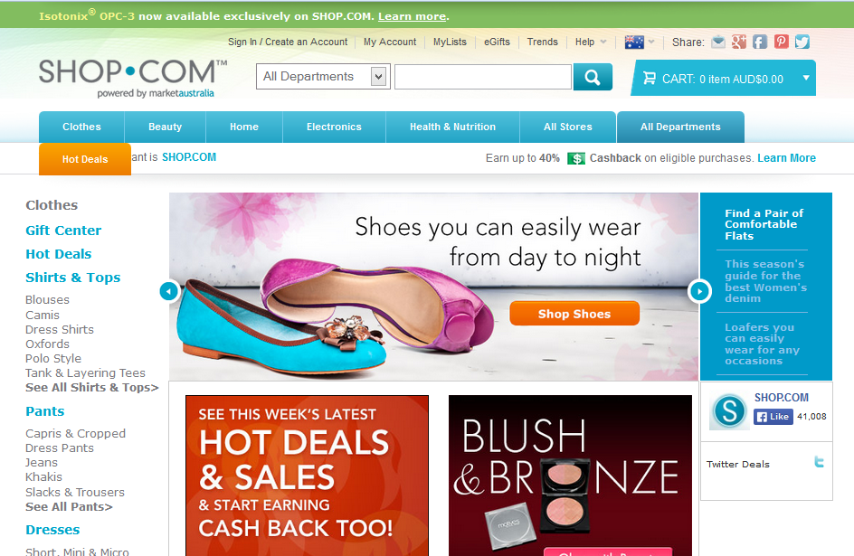
TECHNOLOGY
CUTTING EDGE
99%

Slide 31
Let’s go shopping with DOREEN LING
auWebCentres

Slide 32
ONLINE SHOPPING
auWebCentres

