Slide 1
AUSTRALIA
Supporting Health Professionals
With Wellness for Your Patients and Practice

Slide 2
Serving The Health Care Community
Market Australia is growing quickly and we are quickly taking steps to help health professionals in Australia leverage the exceptional results of these wellness products to support the health of their patients.
By implementing wellness solutions for the patients, we also add ancillary income for the health professionals.
As you know, every business must run profitably to succeed. We can improve revenue in any business by providing the answers to the questions that your patients or customers are asking.

Slide 3
Let’s start by listening to the questions that patients are asking.
“What do you recommend to help me lose weight?”
“What multivitamin, calcium or omega -3 do you recommend?”
“What healthy alternatives do I have?”

Slide 4
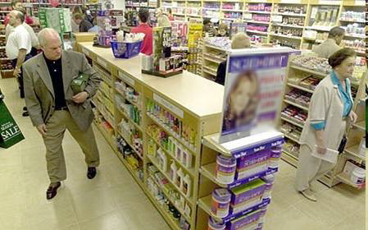
Patients Are Already Purchasing Wellness Products…
Patients have already been sold on supplementation.
WHAT are your patients buying?
Who is giving them advice?

Slide 5
Is the average consumer educated in science-based, nutritional support?
Many of the most popular brands have attractive labels full of ingredients, but often contain unhealthy ingredients:
Artificial chemical dyes
Artificial, chemically synthesised flavouring agents
Preservatives
Disintegrating agents
Bulk fillers such as talc or starch, hydrogenated oil, chemical coatings

Slide 6
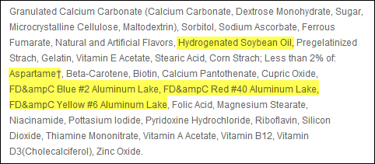
Two Popular Store Supplement Labels
Centrum® Women Under 50 is a product of Pfizer Consumer Healthcare. For more information, visit http://www.centrum.com/centrum-women-under-50#tablets
Flinstones™ Complete Chewables is a product of Bayer Healthcare. For more information, visit http://www.flintstonesvitamins.com/en/products/Flintstones_Complete.php/
Notes:
Many popular brands have ingredients that are not healthy. We can see by looking at the labels. Most patients are not educated in these topics.

Slide 7
Market Australia Commitment to Quality
Market Australia products lead the industry thanks to cutting-edge ingredients, sound science and exceptional quality control.
The Product Brokerage Advantage:
Identifies the latest market-driven products from the best manufacturers.
Provides comprehensive and synergistic formulations based on current research.
Offers a wide variety of products formulated by experts in the industry.

Slide 8
Market Australia Commitment to Quality
Every product is manufactured with strict quality control guidelines and continuous quality control monitoring.
Specifications are set for raw materials and finished products.
Raw materials are sourced with Certificates of Analysis.
Products are manufactured using Standard Operating Procedures in manufacturing facilities that are audited on a regular basis for GMP compliance.
Products are inspected at our warehouse for damage, label accuracy, appearance, taste and odour prior to release.
Products are assayed by independent labs for isotonic capability, micro contamination and potency.

Slide 9
The Market Australia Difference
Isotonic-capable nutrition
High-quality tablets and gel caps that have exceptional absorption rates
Comprehensive solutions
Measurable patient results
Science-based solutions
Setting you apart from other practices of the same specialty.
Notes:
One of main things that sets our products apart from the competition is our isotonic capable formulas. With no binders and fillers, the isotonic solutions deliver maximum absorption for patient results. With the right ingredients and right absorption into the body, patients get results, and our doctors do also. We also have very high quality pills and gel caps that are also designed for successful patient results. Not every product can be delivered in isotonic form, but with the best product design and technology, our pill formulations also deliver results the patients can experience.

Slide 10
Isotonic-Capable Nutrition
Superior nutrient delivery
Exceptional quality control measures
Quality sourcing of ingredients
Comprehensive and synergistic formulations
Health Professional Value:
Better delivery
Better compliance
Better results
Patient Value:
Easy to take
Great taste
Results they can feel
Notes:
There are many benefits to our formulas but what matters most is that the patients get results. With that, our health professionals also get results. Quality matters and that is the first thing to look for when patients say they are already taking a supplement.

Slide 11
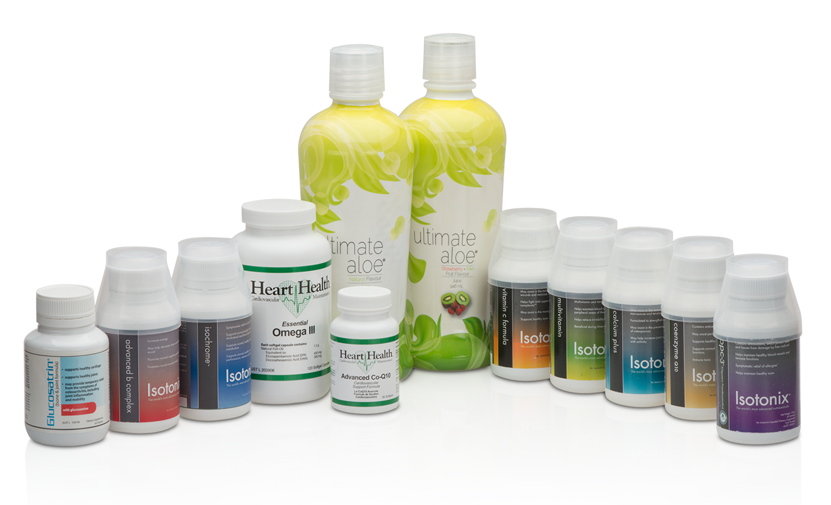
Products To Support Your Patients

Slide 12
au.Shop.com
Bone & Joint Kit
Weight Loss
Cognitive Health
Age Management
Vision
Children’s Supplements
Blood Sugar Maintenance
Sports Performance

Slide 13
THEME : Wellness Planning
-5 -4 -3 -2 -1 0 +1 +2 +3 +4 +5
Focus On Critical Care
Wellness Care
Health professional addresses primary concern or “Critical Care”.
Wellness Planning:
Step 1: How do you feel about your health today?
Step 2: Where do you want your health to be?
Step 3: If you can improve one thing about your health, what would it be?
Step 4: Assist the patient with a solution that they can maintain to help them toward their health goal.
Future Patient Visits
Support critical care as you would normally.
Measure progress and adjust the wellness solution and teach the patient to maintain changes.
Step 1: How are you feeling today?
Step 3: If you could improve one thing about your health, what would it be?
Step 4: Assist your patient.
Notes:
We

Slide 14
THEME : Wellness Planning
-5 -4 -3 -2 -1 0 +1 +2 +3 +4 +5
Focus On Critical Care
Wellness Care
EXAMPLES
0 – Healthy Dietary Lifestyle
May include education support or adjustments for dietary lifestyle
1 – Essential Nutrition Support
May include a multivitamin or other essential nutrients
2 – Optimal Health Support
May include a product kit to help make sure they have a solid foundation for good nutrition.
3 – Customised / Targeted Health Support
This many include a customised regimen to help with what they uniquely need.
4 – Healthy Metabolism and Fitness
This patient may be motivated for fitness and good health. You can support them with more advanced options.
5 – Proactive Health Support
This patient is serious about their wellness and will be interested in advanced solutions.
Notes:
We

Slide 15
Two Forms of Income: Profit & Commission
Why does our compensation plan produce powerful results in healthcare?
It promotes teamwork among multiple Health Professionals or disciplines.
It provides a solution for staff incentives at no expense to the Health Professional.
It operates as a business to provide a true, ongoing income stream that can be leveraged for retirement.
It helps to build a solid referral network in support of new patient generation.
Market Australia offers you two forms of income:
Retail Profit
Ongoing Commissions

Slide 16
Two Forms Of Income
The first form of income is retail profit. You can receive profit from products moved through your practice or online through your web site.
The second form of income is Business Volume Commissions (BV).
For Success: Help patients maintain an ongoing wellness program and calculate your profits based on the number of patients “maintaining a monthly reorder of a product.”
Notes:
By using product kits, we make it easier to help patients maintain on a successful wellness maintenance program. Multiply the kit profit times the number of patients who are maintaining on the monthly reorder of a wellness program.

Slide 17
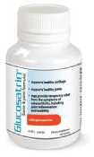
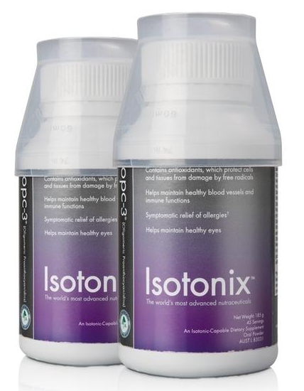
Two Forms Of Income
Joint Health Recommendation
Suggested Retail
Glucosatrin - 30-day $42.95
Omega III - 60-day $63.95
OPC-3 - 45-day $48.95
Retail Profit Sample
Commission Sample
Suggested Retail: $155.85
Commissions
BV: 60 x 500 = 30,000 BV Monthly Approx: $5,000 Monthly
Approx: $60,000 Annually
Distributor Cost: $114.65
Net Profit: $41.20 x 500 = $20,600 Monthly Gross Annual Profit - $247,200
Notes:
This is the globla hp program, there are no nmx labels, use each country label

Slide 18
Worksheet
EXAMPLE: JOINT HEALTH
SR DC BV
$42.95 Glucosatrin $30.75 18
$19.00 Calcium $12.50 4.5
$63.95 Omega III $46.95 29
$48.95 OPC-3 $36.95 20
$93.00 (2 Pack of OPC-3) $66.50 33.5
$42.95 12.20 $30.75 18
$63.95 17 $46.95 20
$48.95 12 $36.95 29
$155.85 41.20 $114.65 67
SAVE 10%
Notes:
This is the globla hp program, there are no nmx labels, use each country label

Slide 19
Two Account Options For Health Professionals
FIRST...
International HP1: Health Professional Introductory Account
Simple introductory account designed for a Health Professional or small group practice that is focused on the success of their own practice.
Simple, easy, profitable and automated.
Earn profit and commissions on your own product sales.
Can upgrade from an HP1 to HP account anytime.
Can earn unlimited retail profit.
Can earn up to $1500 USD per week in BV commissions on their own retail.
Notes:
Determine official name / global vs international – let’s confirm with everyone

Slide 20
Two Account Options For Health Professionals
SECOND...
International HP : Health Professional UFO
Advanced account option designed for larger practices or Health Professionals who refer patients with other Health Professionals and want to leverage our solution to maximise their ongoing income.
Able to receive commissions on Business Volume from other professionals you support & leverage your referral market.
Can earn unlimited retail profit and leverage unlimited potential in BV commissions.
This account has the same requirements as a regular UnFranchise Owner (UFO).

Slide 21
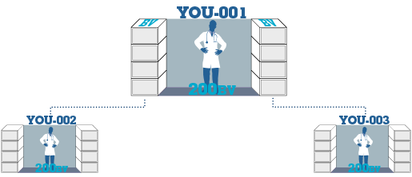
Understanding How HP1 Works…
5,000
5,000
= $600
3,600
3,600
= $300
2,400
2,400
= $300
1,200
1,200
________________
$1,500 USD
= $300
Weekly Potential
A simplified account type that allows Health Professionals to get paid BOTH retail AND commissions on their own sales and Business Volume (BV). This allows them to focus on their own practice and patients in a simple manner, without the requirements of a regular distributorship.
Health professionals will earn unlimited retail profit and up to $1500 per week in BV Commissions, without activation requirements, Form 1000 or Transfer Buy.
They may only earn BV Commissions on their own sales.

Slide 22
Option 2: International HP (Full UnFranchise Owner - UFO) Helps Leverage Your Existing Referral Network For Additional Income
Five Steps To Successfully Implement Market (Country)® Into Your Practice
Refer professionals who need
wellness for their patients or
revenue for their practice to your Market Australia® UnFranchise Owner.
Notes:
Creative – please change the text items for HP specialty to text objects so they can be changed on the fly instead of embedded in the graphic. NOTE: Distributor: If you know the specialties of the professionals you are working with you can edit the specialty names to target the prospects you are working with.

Slide 23
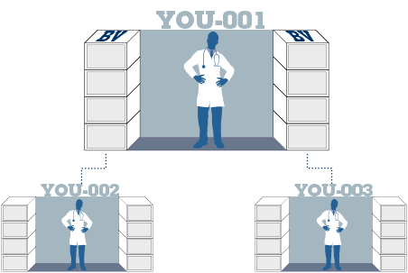
Option 2: International HP Distributor Account
}
HP Distributor Account provides unlimited income potential to leverage additional business development.
5,000
5,000
= $600
3,600
3,600
= $300
USD
2,400
2,400
= $300
1,200
1,200
= $300
Additional requirements include training and basic monthly requirements. Same as other UnFranchise Owners.
= $1,500
+ $600 Mgnt Bonus
$2,100 USD
Management bonus earned according to compensation plan.
Add additional Market Australia® professionals to support development of additional locations or referrals.
Repeats To Achieve Weekly Potential
Market Australia® professionals partner to provide business development support.
Annual earning potential of $109,000 USD
Business Volume (BV) compensation is shared 100% according to compensation plan.
The income levels mentioned in this presentation are for illustration purposes only. They are not intended to represent the income of a typical Market Australia Independent Distributor, nor are they intended to represent that any given Independent Distributor will earn income in that amount. The success of any Independent Distributor depends on the amount of hard work, talent, and dedication which he or she devotes to building his or her Market Australia business

Slide 24
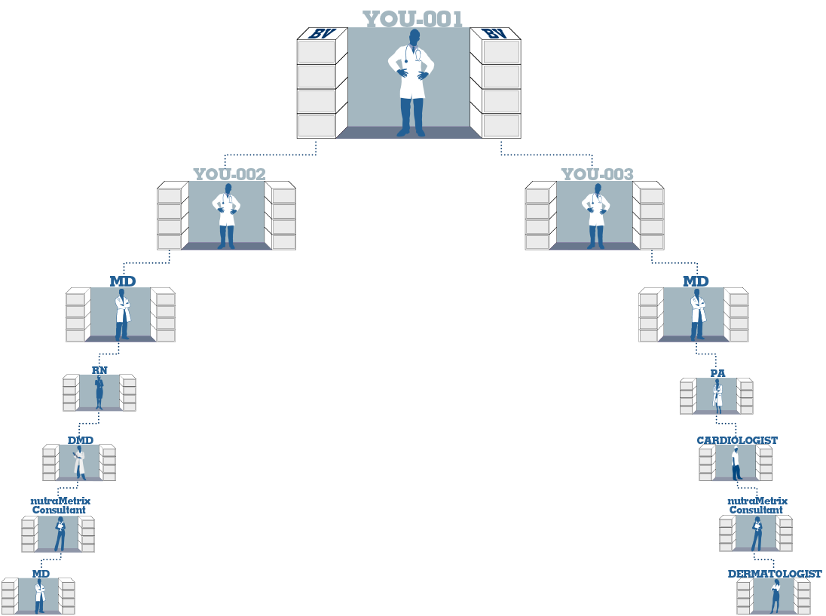
Option 2: HP Distributor Account — Leverage Additional Business Centres
You have the option to increase income by activating additional Business Development Centres.
By leveraging additional Market Australia ® UnFranchise Owners, you can develop new business.
Additional Business Development Centres are available through Re-Entry. See full compensation plan for further details.
Note: You are now able to place your Business Volume in accounts that you set up.
Potential Annual earning of $327,000 USD
Business Volume (BV) compensation is shared 100% according to compensation plan.

Slide 25
So what will happen next?
Get your questions answered and set the next appointment.
Determine your vision statement and practice goals.
Review a recommended plan of action and implementation.
Register your account.
Set the implementation date.
At this time, all existing health professionals in Australia can be classified as health professionals in system and can be changed to an HP1 Status.
We are committed to your success and we are looking forward to the rapid growth of your businesses.

Slide 26
If you are currently a HP and Market Australia UFO...
Complete the HP Notification Form on UFMS Administration
Determine if the HP1 status is a preferred option.

Slide 27
AUSTRALIA
Supporting Health Professionals
With Wellness for Your Patients and Practice

