Slide 1
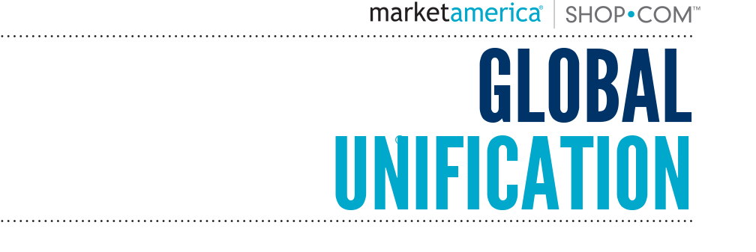

Slide 2
Global Unification
Notes:
This slide has been modified.

Slide 3
Global.shop.com Asia-Pacific Unification EMP IRC UGC
Notes:
This slide has been modified.

Slide 4
ASIA-PACIFIC
REGION (AP)
Unified BV/IBV Banks
AMERICAS
REGION (AM)
Unified BV/IBV Banks
EUROPE
REGION (EU)
Unified BV/IBV Banks
Market Countries
Australia
Taiwan
Hong Kong
United States
Canada
Mexico
United Kingdom
EMP Countries
Singapore
New Zealand
Colombia
Panama
Dominican Republic Ecuador
Spain
Global SHOP.COM
Customers can buy Market America (USA) branded BV products
Customers can buy Market America (USA) branded BV products
Customers buy Market UK branded BV products

Slide 5
Change the dynamics!
Asia-Pacific BV/IBV is unified within the region and will be added to the Global Unification Program in the next deployment phase.
BV and IBV are unified within a region. This unified BV/IBV encompasses volume generated by Regional Market Countries UFOs, EMP Countries and applicable Global Shop.com purchases.
For the purpose of this presentation the two regions being used are: Americas and Europe.
Americas = AM
USA
CANADA
MEXICO
Europe = EU
UNITED KINGDOM
SPAIN
Home Region
New Region
Global SHOP.COM – All countries
(North America, Central America and South America)
Global SHOP.COM – All of Europe

Slide 6
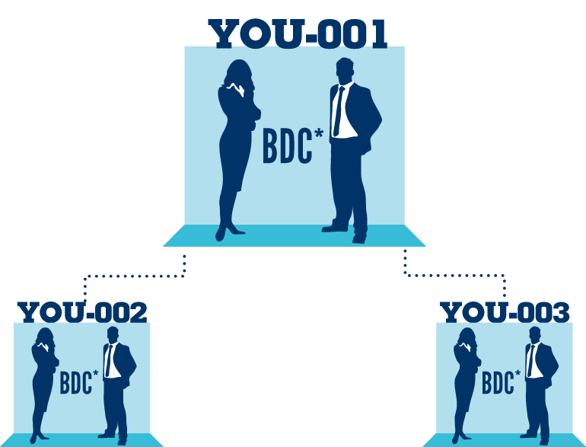
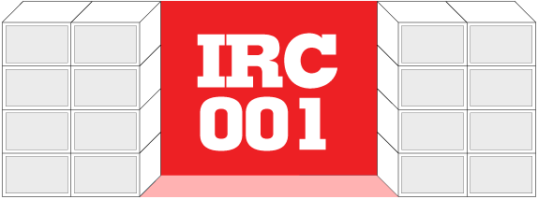
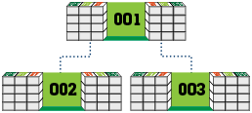
All UFOs are awarded an IRC (International Re-entry Center) for future placement
IRCs allow for earning additional commissions from regional global expansion
IRCs convert “New Region” BV/IBV to earn in “Home Region” MPCP
All UFOs are awarded 3 UGCs (Unified Global Center) when the IRC is placed
UGCs earn commissions from “New Region” BV/IBV in excess of 5,000 “Home Region” GBV
*BDC - Business Development Center

Slide 8
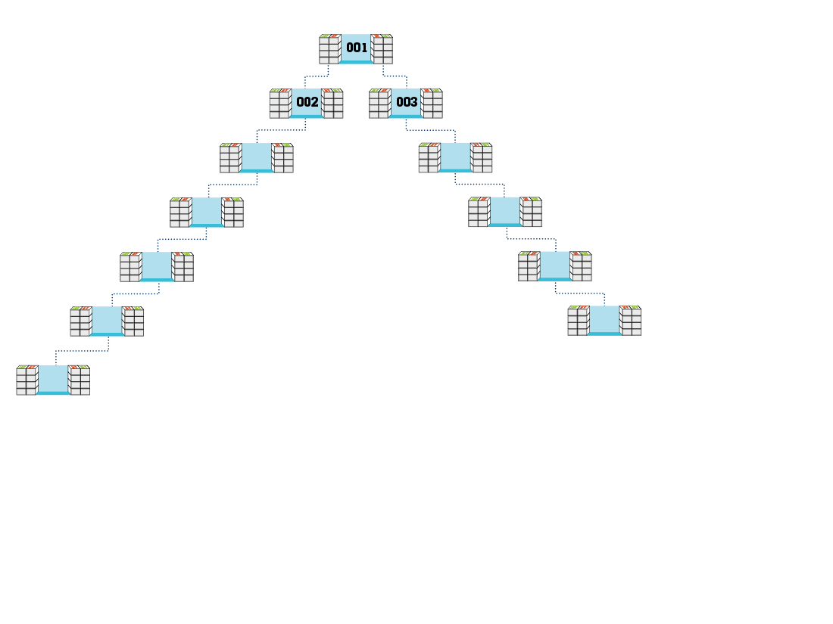
200BV
In order for an IRC to accrue “New Region” BV/IBV from the “New Region”, UFOs have to place and qualify the IRC with a 200 BV product order

Slide 9
200
200
200
200
200
200
200BV
“New Region” GBV is converted to “Home Region” GBV and is accrued by all qualified BDCs in “Home Region” above IRC

Slide 10
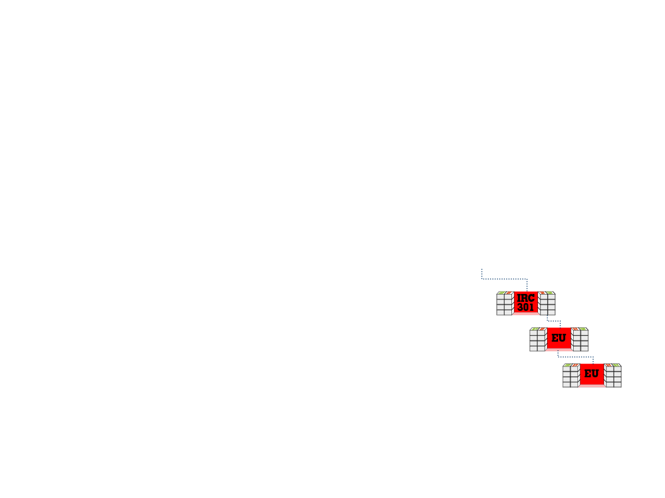
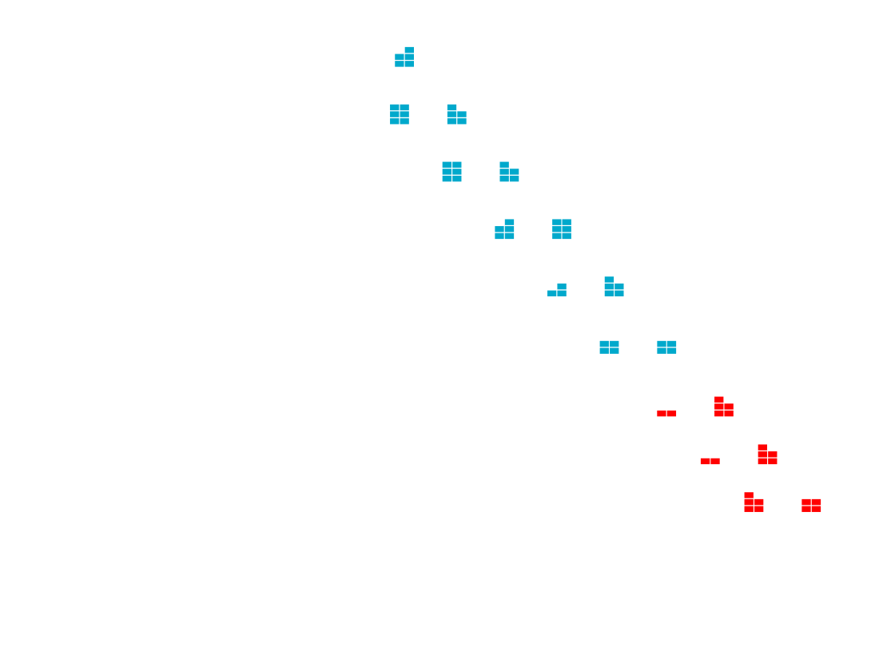
300
300
300
300
300
300
300
300
300
“New Region” GBV is accrued in IRC and is converted to “Home Region” GBV for all qualified BDCs in the “Home Region” above the IRC

Slide 11
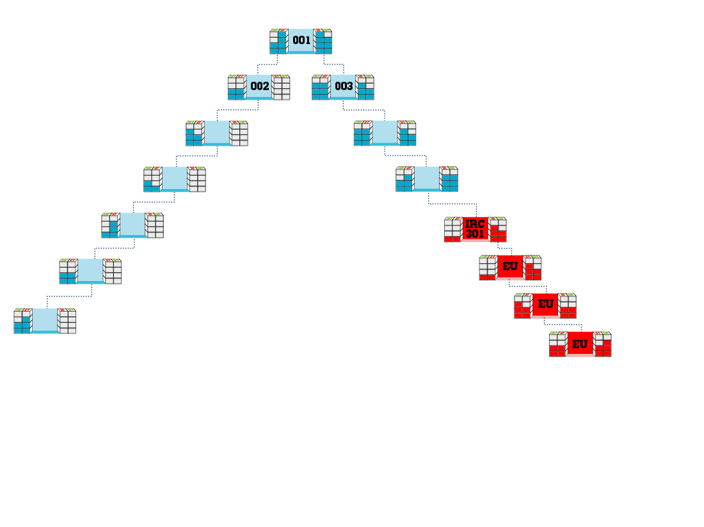
5,400
(Balance)
3,300
(Balance)
+ 300 = 3,600
($300)
3,000
(Balance)
+ 300
2,600
(Balance)
+ 300
1,000
(Balance)
+ 300
300
300
300
300
Converted “Home Region” GBV generated from “New Region” GBV will accrue to meet payout criteria in respective “Home Region” MPCP

Slide 12
An IRC must be Activated with UFOs from the “New Region” to earn commissions

Slide 13
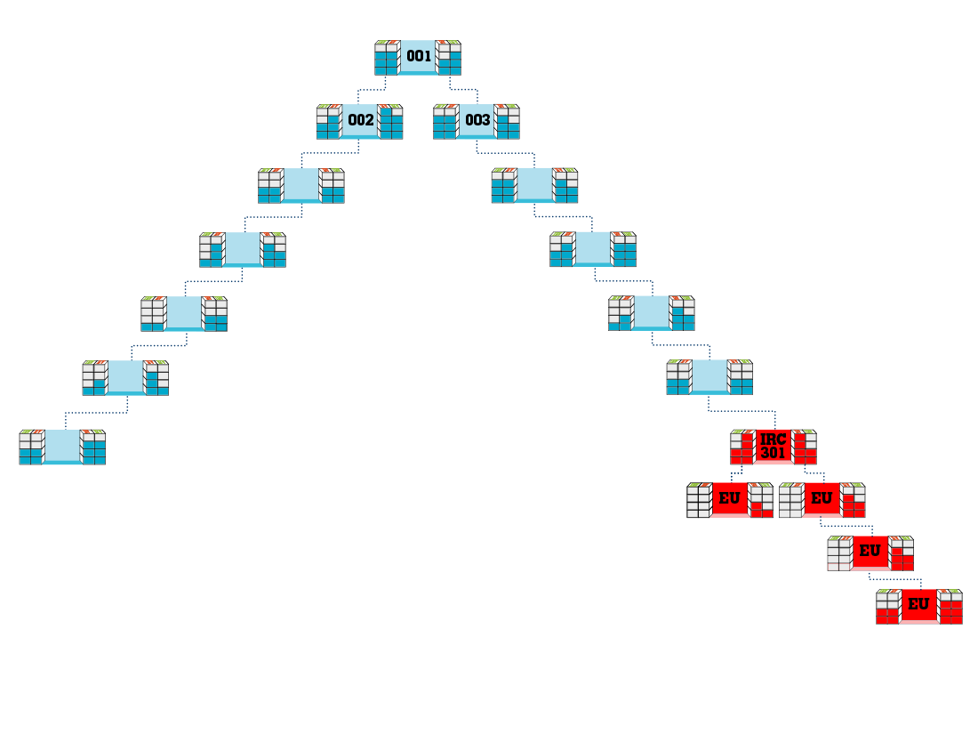
The first time an IRC accrues 5,000 GBV / 5,000 GBV,
one IRC is awarded for reentry

Slide 14
UGC “Banks” for 3 BDCs (001, 002, 003) are opened upon placement of your IRC

Slide 15
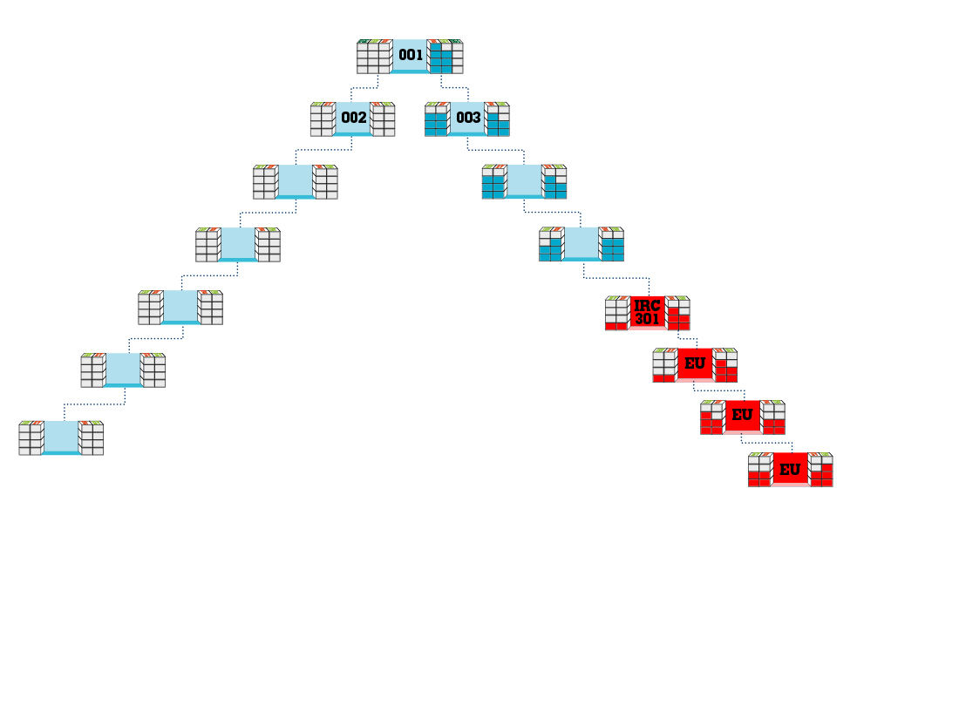
100 BV
+ 300 = 5,100
4,800
(Previous Balance)
+ 300 = 3,600
3,300
(Previous Balance)
+ 300 = 3,200
2,900
(Previous Balance)
+ 300 = 1,600
1,300
(Previous Balance)
300
300
300
300
When your BDC 001 exceeds 5,000 GBV in combined “Home Region” and converted “New Region” GBV, all additional “New Region” GBV will overflow to the respective UGC bank

Slide 16
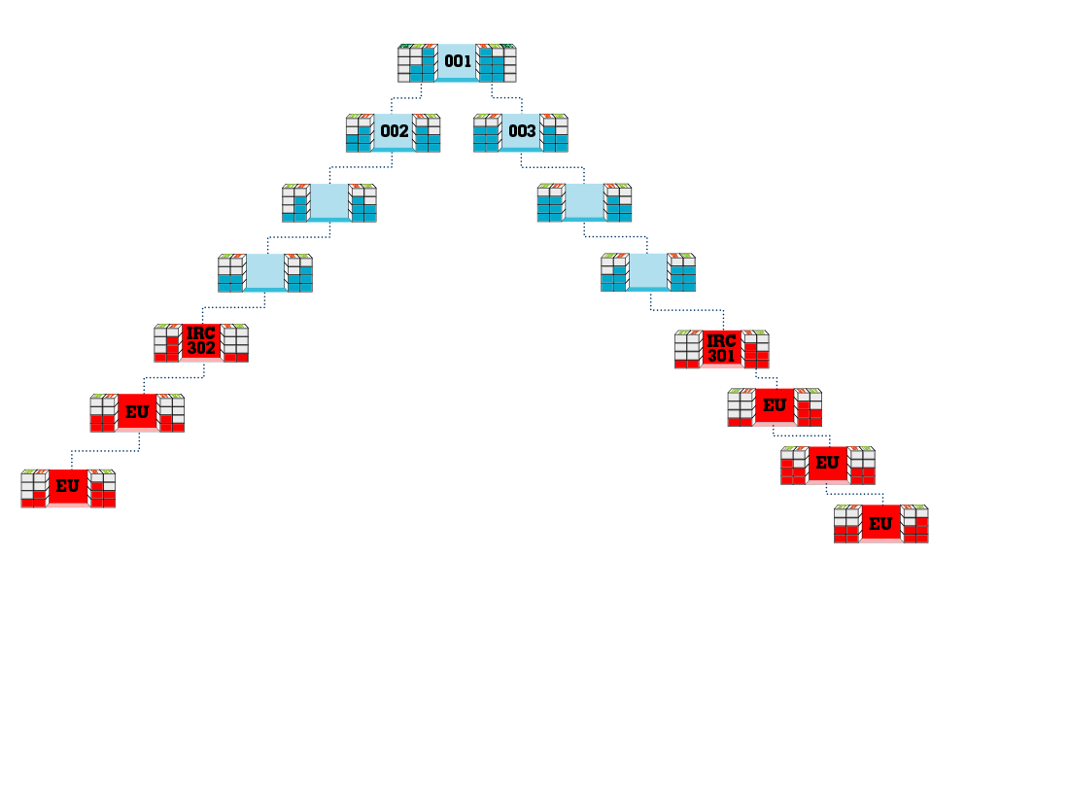
1200 BV
1200 BV
$300
5,000
5,000
1,200
1,200
Each UGC is eligible to earn commissions from excess converted “New Region” GBV when the respective BDC has accrued 1,200 GBV / 1,200 GBV in “Home Region” volume
(Converted “New Region” GBV Does Not Count)

Slide 17
IRC
In order for an IRC to accrue “New Region” BV/IBV from the “New Region”, UFOs have to place and qualify the IRC with a 200 BV product order
“New Region” GBV is converted to “Home Region” GBV and is accrued by all qualified BDCs in “Home Region” above IRC
“New Region” GBV is accrued in IRC and is converted to “Home Region” GBV for all qualified BDCs in the “Home Region” above the IRC
Converted “Home Region” GBV generated from “New Region” GBV will accrue to meet payout criteria in respective “Home Region” MPCP
An IRC must be Activated with UFOs from the “New Region” to earn commissions
The first time an IRC accrues 5,000 GBV / 5,000 GBV, one IRC is awarded for reentry

Slide 18
UGC
UGC “Banks” for 3 BDCs (001, 002, 003) are opened upon placement of your IRC
When your BDC 001 exceeds 5,000 GBV in combined “Home Region” and converted “New Region” GBV, all additional “New Region” GBV will overflow to the respective UGC bank
Each UGC is eligible to earn commissions from excess converted “New Region” GBV when the respective BDC has accrued 1,200 GBV / 1,200 GBV in “Home Region” volume (Converted “New Region” GBV Does Not Count)
There are no earned reentries for UGCs

Slide 20
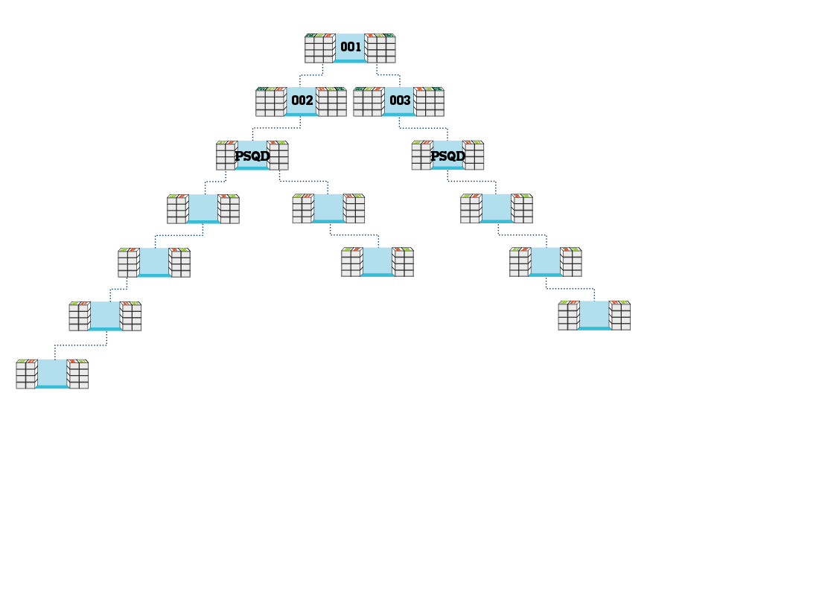
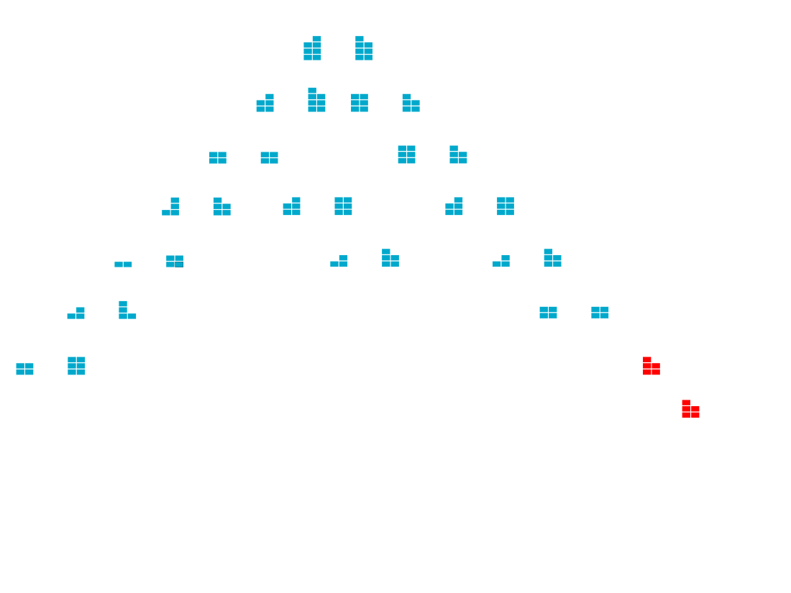
STRONG
WEAK
GET THE “ONE DONE” AND PREPARE TO EARN ON UGCs
Place Your IRC in the weak leg and use the “New Region” growth to maximize weekly “Home Region” commissions
Strengthen a leg for all “Home Region” UFOs above Your IRC
Assist “New Region” UFOs with expansion into Your “Home Region”
Placement of Your IRC opens banks in your UGCs to accrue converted “New Region” BV in UGC 001(R) and 003(R) in future

Slide 21
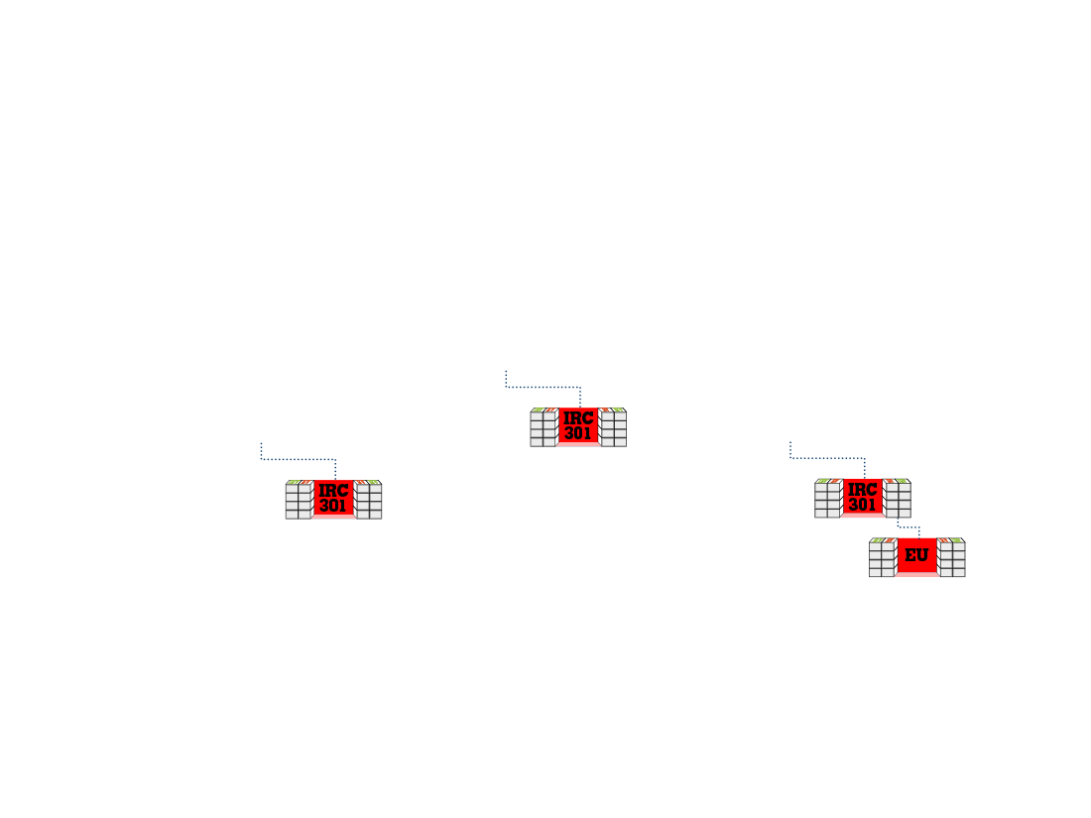
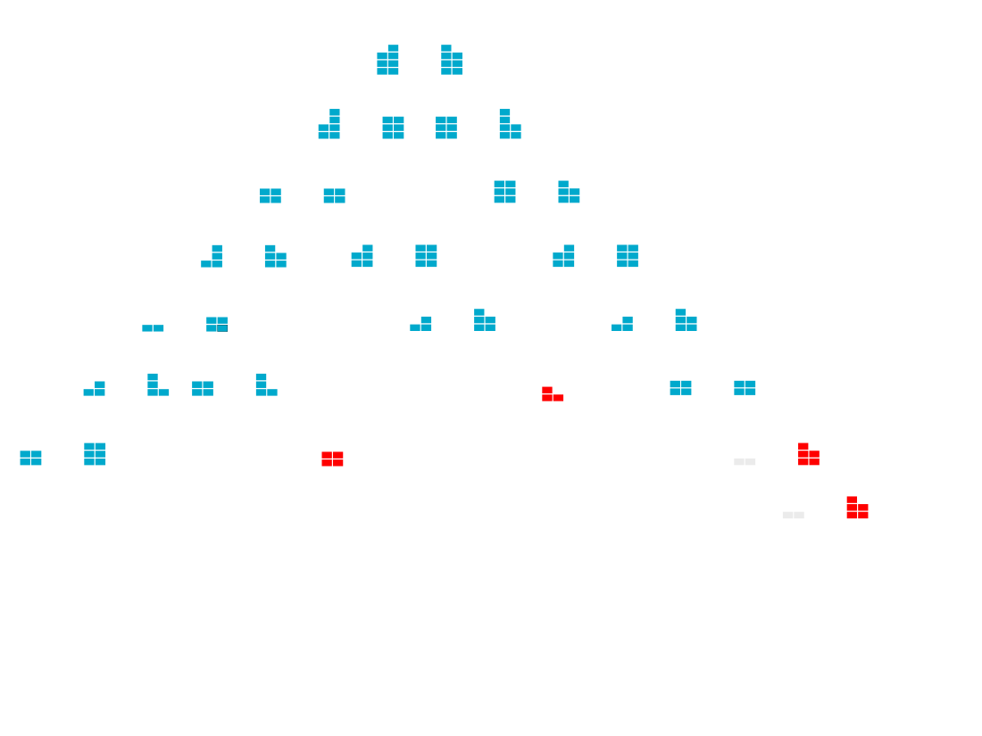
STRONG
WEAK
STRONG
WEAK
STRONG
WEAK
WORKING COMBINATIONS
1 on 1
HBP
UBP
Trainings
EARN ON UGCs
Get UFOs in Both Strong and Weak Legs to prospect for “New Region” growth and place Their IRCs on their Weak Leg to “GET THE ONE DONE”
Work Combinations to increase an “New Region” growth under your UGCs (001,002,003)
When your BDC-001 is at 5,000/wk and 5,000/wk GBV, all the converted “New Region” GBV will accrue in the UGCs 001(L & R), 002(L) and 003(R)

Slide 22
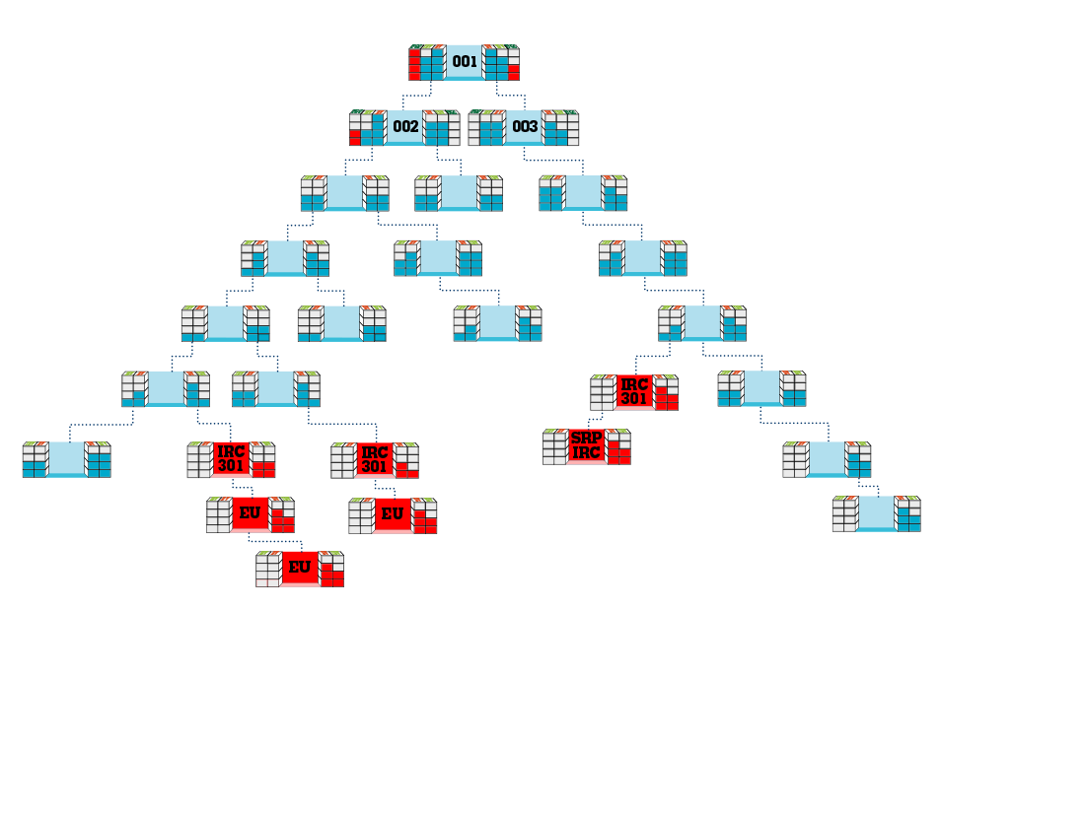
Senior Partner
STRONG
STRONG
YOU
STRONG
WEAK
STRONG
WORKING COMBINATIONS
1 on 1
HBP
UBP
Trainings
SENIOR PARTNER Strengthening Leg(1)
All converted “New Region” GBV flows up to a Senior Partner that has over 5,000 “Home Region” GBV weekly and overflows into UGC bank(s), if they have placed Their IRC
Senior Partner places Their IRC under Your IRC to increase “New Region” GBV generation
Results in You getting paid in “Home Region” and Senior Partner getting Paid in UGC

Slide 23
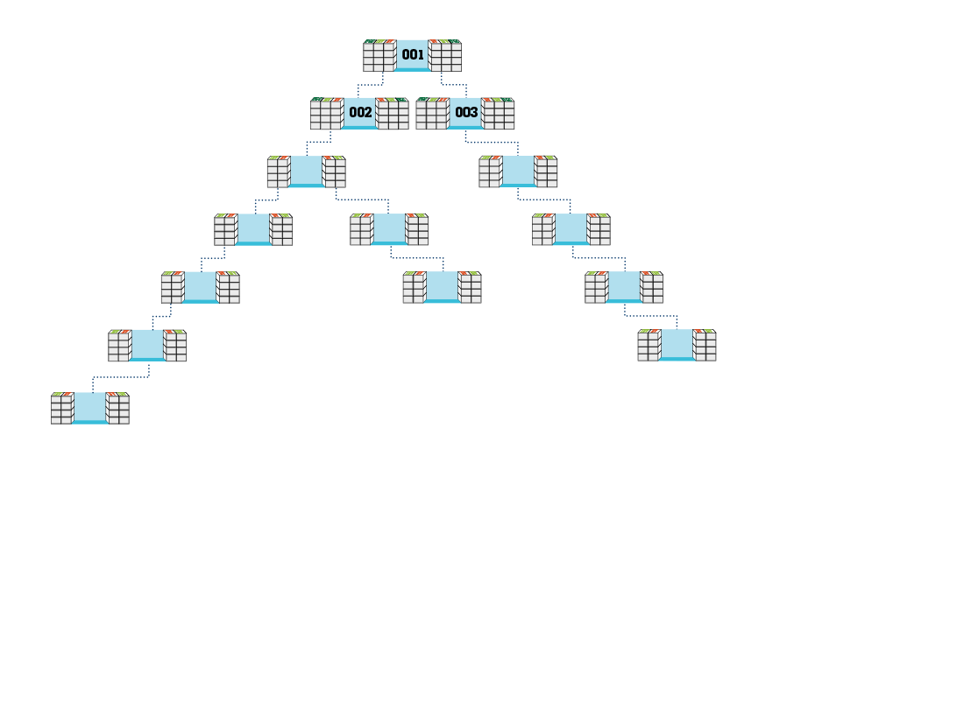
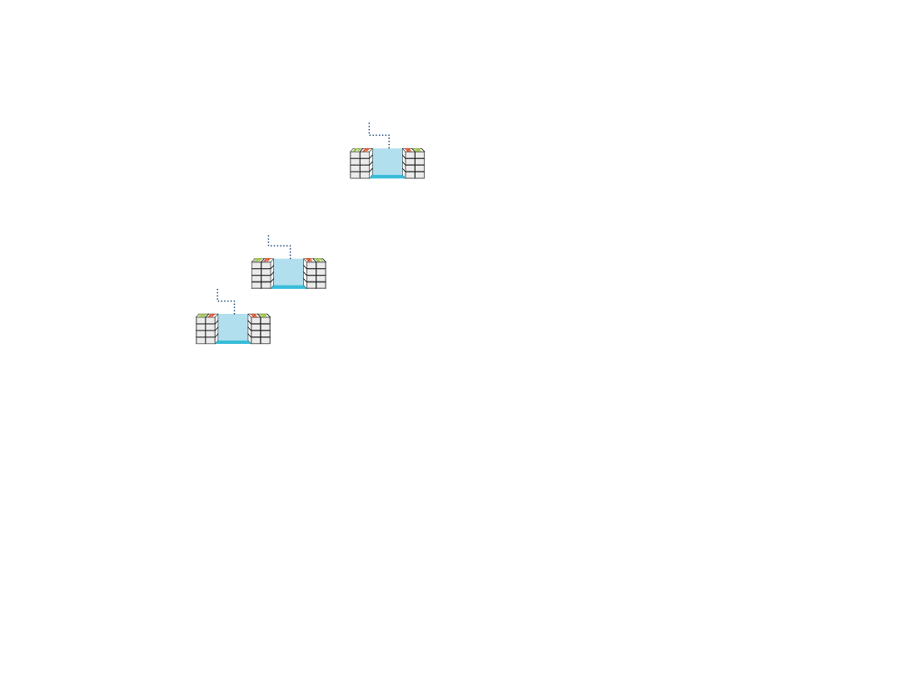
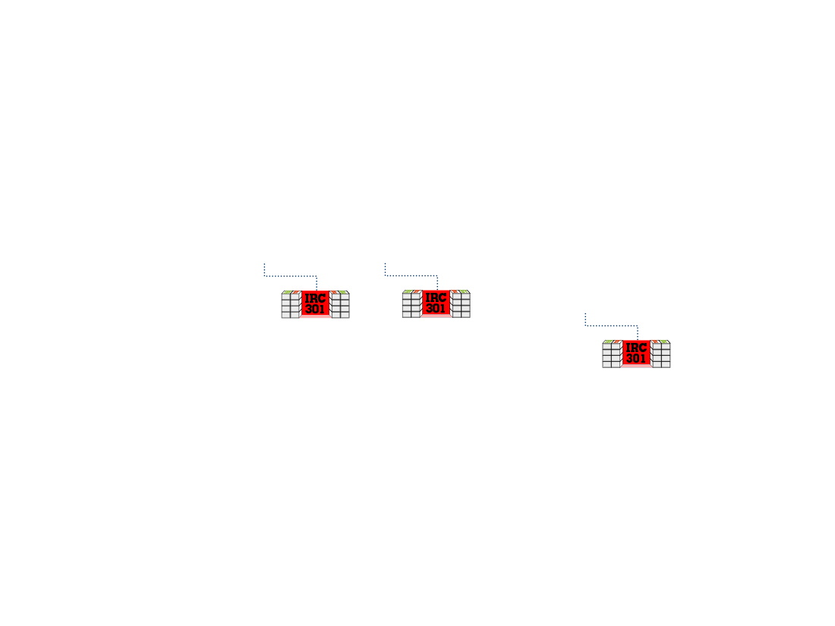
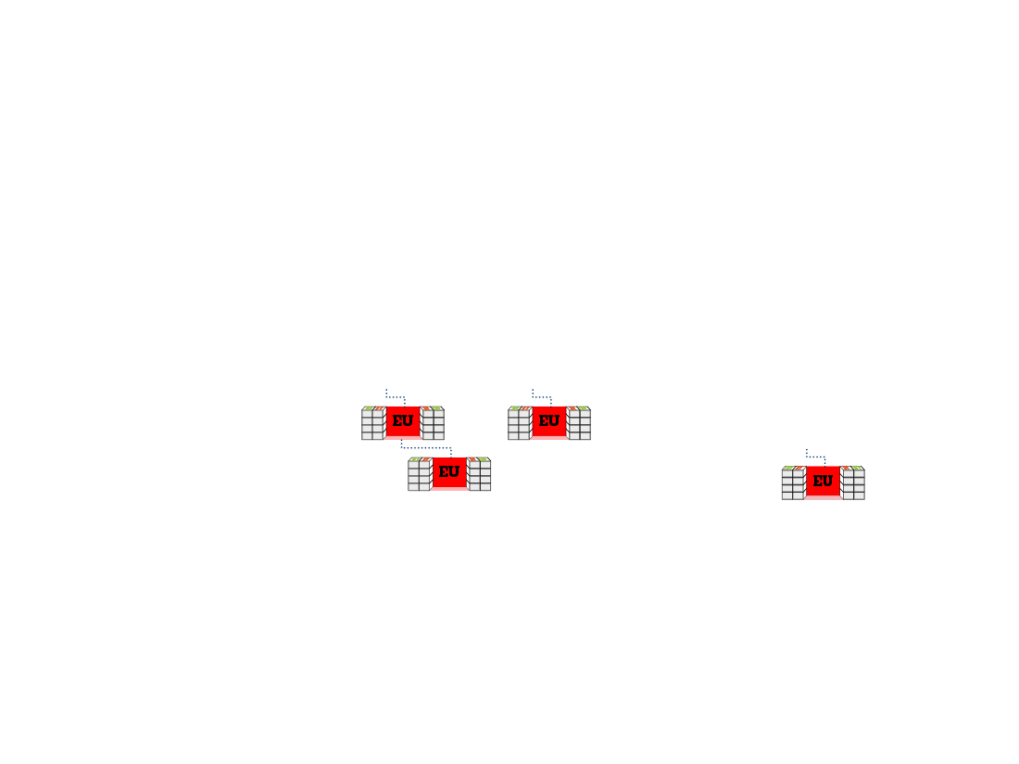
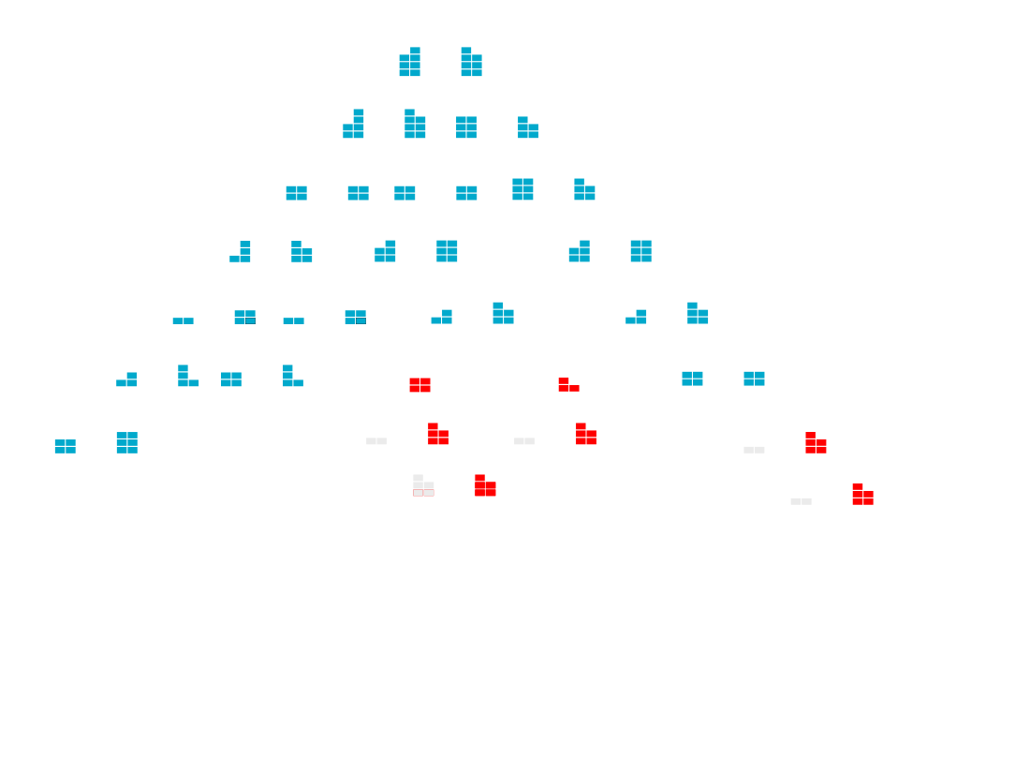
Senior Partner
STRONG
STRONG
YOU
STRONG
WORKING COMBINATIONS
1 on 1
HBP
UBP
Trainings
LEVERAGE YOUR SENIOR PARTNER(2)
All converted “New Region” BV flows up to a Senior Partner that has over 5,000 “Home Region” BV weekly and overflows into UGC bank(s), if they have placed Their IRC
The greater the “New Region” volume from your organization, the greater the economic reason for Senior Partner to build in “New Region” with you
Integrate Senior Partner into working combinations

Slide 24
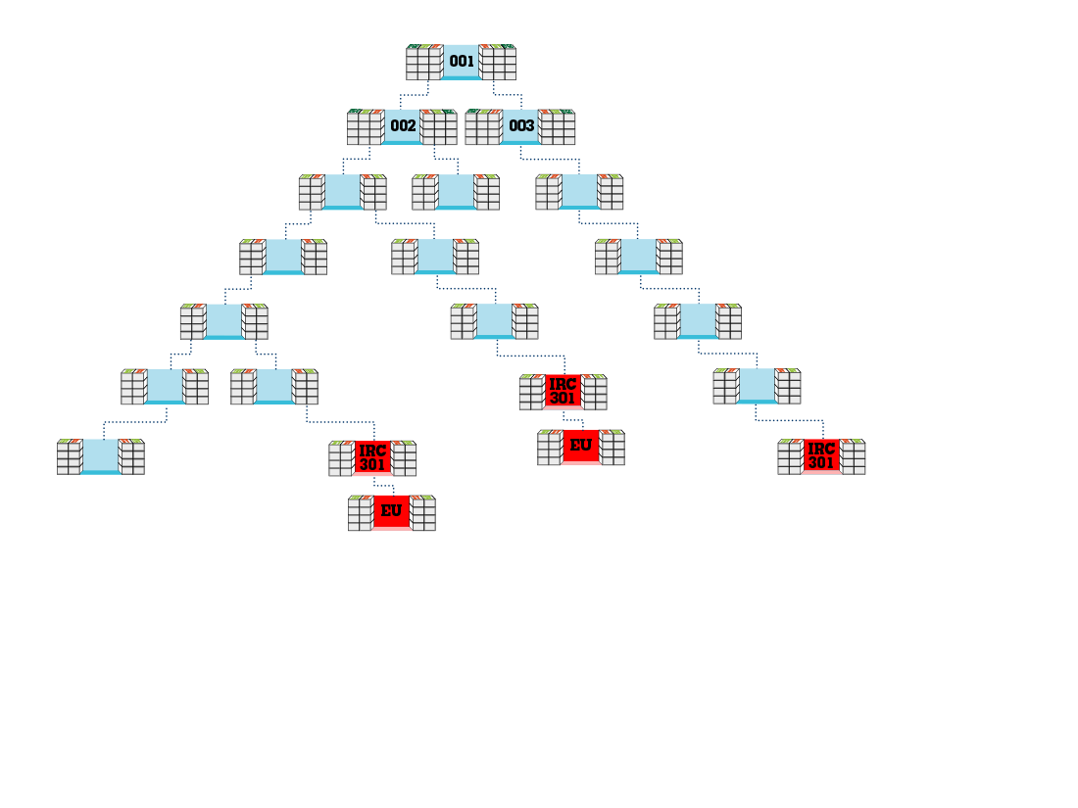
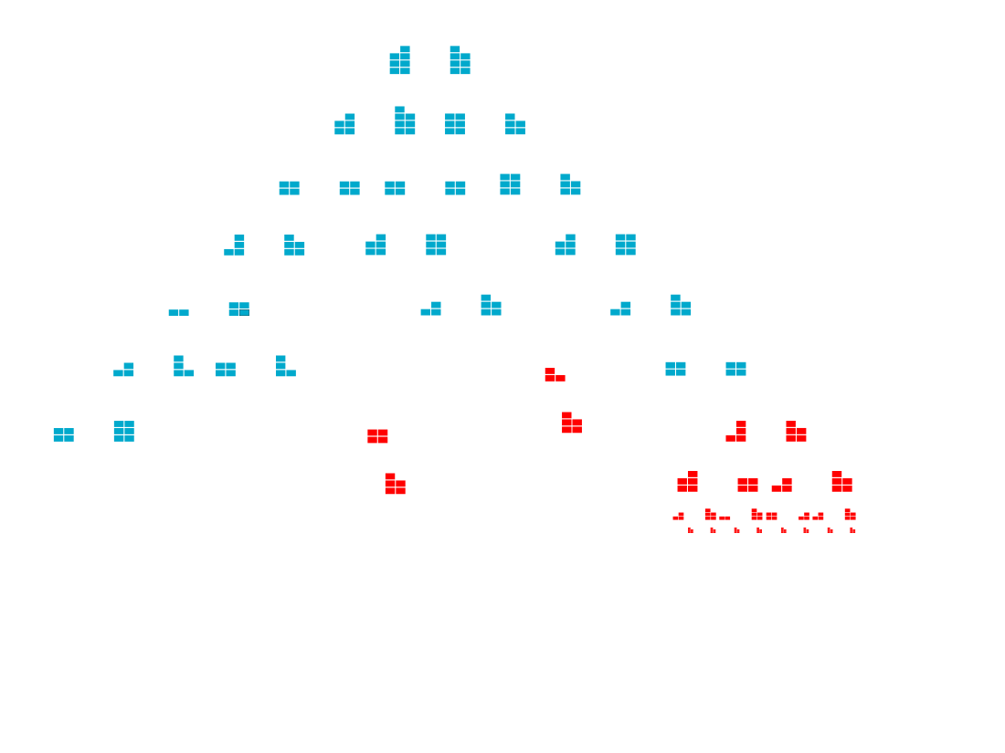
EARN COMMISSIONS ON YOUR IRC
Activate Your IRC with 2 Personally Sponsored and Qualified UFOs from “New Region”
Build two “New Region” organizations and earn commissions in “New Region” MPCP
Continue to maximize weekly “Home Region” commissions in 001 OR accrue “New Region” BV in excess of 5,000 “Home Region” BV in UGC Bank
Continue to strengthen a leg for all “Home Region” UFOs above Your IRC

Slide 25
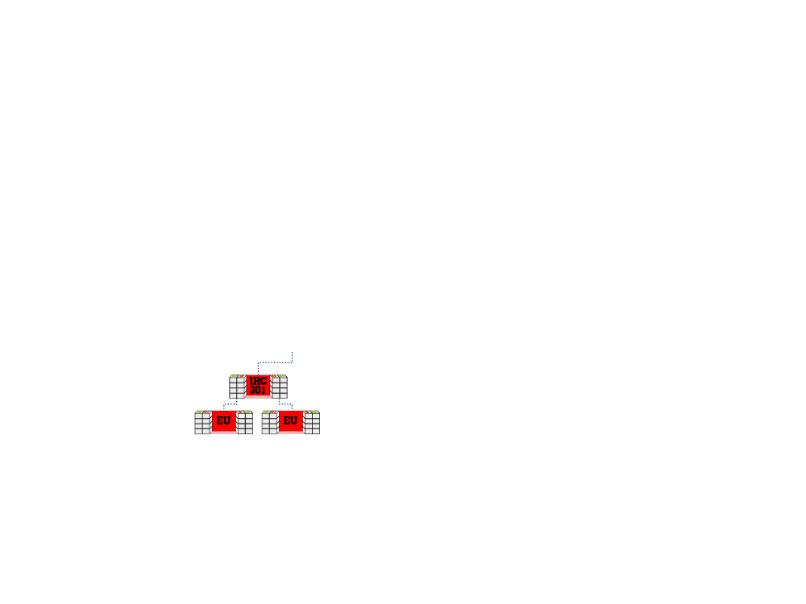
STRONG
Business Builder
WEAK
USE “NEW REGION” TO EARN ON ABANDONED REENTRY
Place Your IRC on weak leg of RE ENTRY and build in “New Region” to earn in 004 in “Home Region” MPCP
Business Builder earns and You accrue overflow “New Region” BV toward earning on your UGC
Strengthen all “Home Region” UFOs above Your IRC from converted “New Region” BV while you earn on the IRC

Slide 26
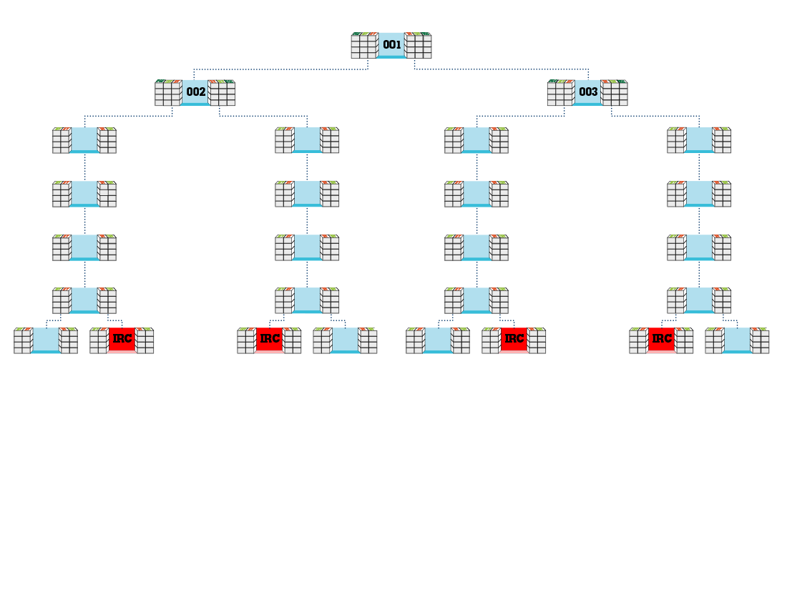
UFOs that need converted “Home Region” volume accrue it
UFOs that need “New Region” volume accrue it
UFOs that qualify for UGC overflow volume accrue it
UFOs that need converted “Home Region” volume accrue it
UFOs that need “New Region” volume accrue it
UFOs that qualify for UGC overflow volume accrue it
STRONG
WEAK
WEAK
STRONG
STRONG
WEAK
WEAK
STRONG
BUSINESS BUILDER
BUSINESS BUILDER
BUSINESS BUILDER
BUSINESS BUILDER
DIRECTORS AND HIGHER
Locate Business Builder in basement and place Your IRC in their weak leg
Get at Least one Leader in each leg to locate Business Builder in weak leg and place their IRC in basement
Get UFOs in all four legs to prospect for “New Region” growth and place Their IRCs on Weak Leg to get their "Business Builders” one done
You work COMBINATIONS in all four legs to build “New Region” to earn additional $4,500 weekly commissions from UGCs and maximize Team members getting paid weekly in Their “Home Region”, Their “New Region” and Their UGCs

Slide 27
Basic Knowledge
“New Region” BV/IBV created by international growth and expansion has both short-term and long-term benefits:
Short-Term
You do not have to physically go to “New Region” if you are working with Senior Partner(s) to expand.
BV/IBV credited and accrues as “Home Region” GBV towards YOU earning in “Home Region” MPCP
BV/IBV credited and accrues as “Home Region” GBV towards TEAM earning in “Home Region” MPCP
BV/IBV credited and accrues as “New Region” GBV towards YOU earning in “New Region” MPCP (from IRC)
BV/IBV from “New Region” credited to “Home Region” bank that accrued 5,000 GBV in “Home Region” will overflow into the UGC bank towards YOU earning on converted “New Region” volume

Slide 28
Long-Term
BV/IBV that was converted and credited from “New Region” will accrue as UGC volume toward YOU earning; if its use as “Home Region” volume has maxed out (i.e. ≥ 5,000 BV/IBV)
BV/IBV that was converted and credited from “New Region” will accrue as UGC volume toward SENIOR PARTNER earning; if its use as “Home Region” volume has maxed out (i.e. ≥ 5,000 BV/IBV)
“New Region” prospects provided by you and your team helps your TEAM, YOU and YOUR SENIOR PARTNERS to earn on IRCs and UGCs
Senior Partner(s) has vested economic interest in actively working in an organization that generates over 5,000 GBV/Week in the “Home Region” MPCP because the growth potential represents 3 or more new income streams

Slide 29
Creating “New Region” Possibility List
Who do you know in a “New Region”?
Who do you know that may be able to refer possibilities to you?
Travel for business, work, vacations, etc.
Family, friends, associates or customers etc.
Who do each of your Team Members know in a “New Region”?
Who do each of your Team Members know that may be able to refer possibilities to you?
Travel for business, work, vacations, etc.
Family, friends, associates or customers etc.
Hold corings with Global Expansion Team to ensure each Team Member performs steps 1-4 above with their organizations. REMEMBER, WE ONLY NEED TO IDENTIFY ONE BUILDER PER LEG!

Slide 30
Actively search in “Home Region” for individuals that know people in the “New Region”
_______________ , maybe you can help me out. My business partners and I are expanding SHOP.COM and Market America in “EUROPE” and need someone who knows the area, has a good business mind, and is well connected to help spear head the growth. I realize you are commited to what you are doing and are satisfied. But I thought you might know someone who may be interested or at least know the right people. I would love an introduction to see if they can connect me to the right people in which case there could be some financial benefit in it for them and you. (Be prepared to answer what Market America or SHOP.COM is).

Slide 31
Evaluate each team member (use UFMS Mgmt. Reports)
Identify location/position of each team members BDCs
Calculate average weekly GBV (use past 3 months) for each BDC
Recruit “Leaders” in your organization to participate
Make them aware of those in their organizations that are on team
They are going to be positioned for additional income streams
Present Global Expansion Team to Senior Partner(s)
Show them number of team members and their location of organization
Identify any Re Entries “Leaders” may have in the organization
Discuss their global expansion strategies/options
Integrate Senior Partners into your Building Strategies

Slide 32
Placement of IRCs by team members
Set up IRC placement corings with “Team Leaders”
Draw each team out so everyone agrees on maximizing placement of “New Region” growth
“New Region” NMTSS and Coverage
All Team Members should have NMTSS schedule for next 3 months
Schedule Team Member(s) to ensure maximum coverage

Slide 33
Schedule accountability system
New prospects and bio information to team
Follow Up Status (Next Step...)
Set scheduling combination events for next “Team Member” coming in
Measure, Monitor, Adjust and Control
Each month compare GBV average vs. baseline
Each month monitor new growth (New Team Members)
Assess product sales
Assess numbers being exposed to business plan

